Slide 1
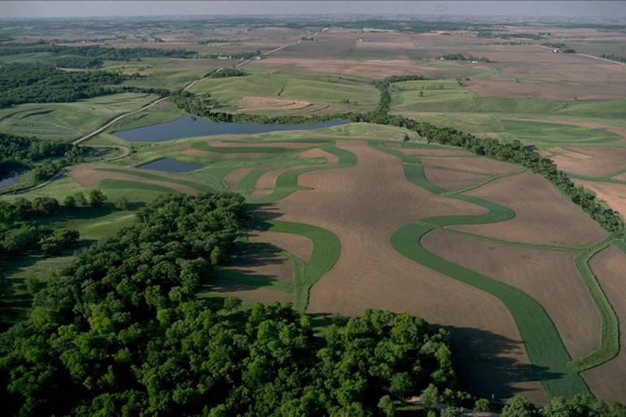
Conservation Planning and Technical Soil Services for Sustainable Farming Systems
Linda Scheffe, USDA- NRCS, NSSC
Conservation planners and soil scientists work with producers to inventory soil, water, air, plant, and animal resources on the land and develop conservation plans and resource management systems
Objectives include:
Reduce overall on-farm energy use, inputs, production costs, pest incidences, water loss, soil loss; improve production, air, water, and soil quality
More economical, sustainable farming enterprise
Healthier watershed and community

Slide 2
Conservation Planning and Use of Soil Surveys
Soil survey information is key to inventory of natural resources, site selection and design of conservation practices, establishment/installation/construction
and operation/maintenance phase of conservation practices and resource management systems
Evaluate site-specific conditions, including chemical, biological and physical
Build soil quality and improve integrated farming system

Slide 3
NRCS Conservation Planning and Use of Soil Survey
NRCS has offices in each county and provides technical and financial assistance to landowners with planning, design, and installation of conservation practices which improve natural resources
NRCS can provide advisory assistance to other countries in setting up a conservation planning and soil survey infrastructure

Slide 4
NRCS Conservation Planning and Tech Soil Services
NRCS uses simple resource inventory tools and observation skills to assess if there is a resource concern (soil, water , air, plant, animal, energy and human)
NRCS planner and producer develop conservation management alternative systems to address identified resource concerns; one is selected by producer

Slide 5
NRCS Conservation Planning/Use of Soil Survey
Conservation planning considers resource opportunities on farm and also resources available in community or watershed which could be utilized; use problem-posing/solving approach
Goal is to reduce use of external inputs if these are available internally
Philosophy is to provide technology exchange with a producer, not technology transfer and develop an economically feasible and environmentally responsible conservation management system

Slide 6
NRCS Conservation Planning and Tech Soil Services
Conservation Planning considers on site and off site effects of each conservation practice installed; considers impacts to watershed and downstream landowners; considers run-on to fields/farm from hydrologically upstream
System must contribute to improvement of all resources and not negatively impact any one resource (e.g. can’t improve water quality while depleting water quantity)
Since dynamic system, need to plan creatively and flexibly as conditions change
Soil scientists provide onsite technical investigations and services for specific land uses

Slide 7
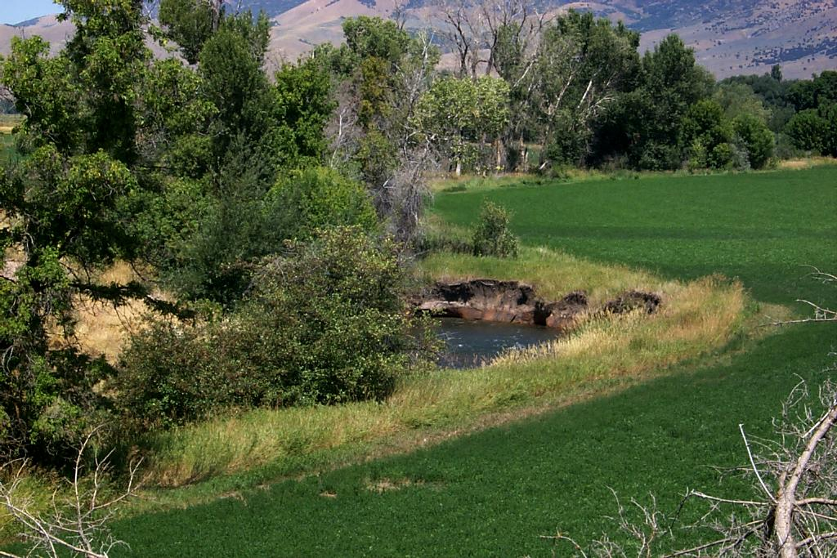
Sustainable Farming Systems must integrate:
  Soil Quality
  Water Quality
  Nutrient and Salinity Management
  Cropping Systems, incl. Cover Crops
  Irrigation Water Management and Systems
  Integrated Pest Management
  Livestock and Wildlife
  Energy and Air Quality
  Economics
  Whole Farm Planning
  Watershed, Marketing Opportunities

Slide 8
Planning Software
  Planners have integrated software which assists in developing conservation plans
  Brings in soil survey information and other inventory data for field, farm, watershed or other planning area
  Facilitates resource assessment, development of conservation plan and recordkeeping

Slide 9
Web Soil Survey
http://websoilsurvey.nrcs.usda.gov
Create Soils Map, Field Maps,
Base information for many agronomic and management decisions (all at your leisure)
View capabilities and interpretations, for example:
  Dryland/Irrigated Capability Unit
  Available Water Capacity, Wilting Pt, Field Capacity
  Limitations for irrigation such as slope, permeability
  Soil Physical and Chemical Properties (baseline info for CEC, SAR, pH, Calcium content, OM, clay content…)
  Print reports and maps to go with them

Slide 10
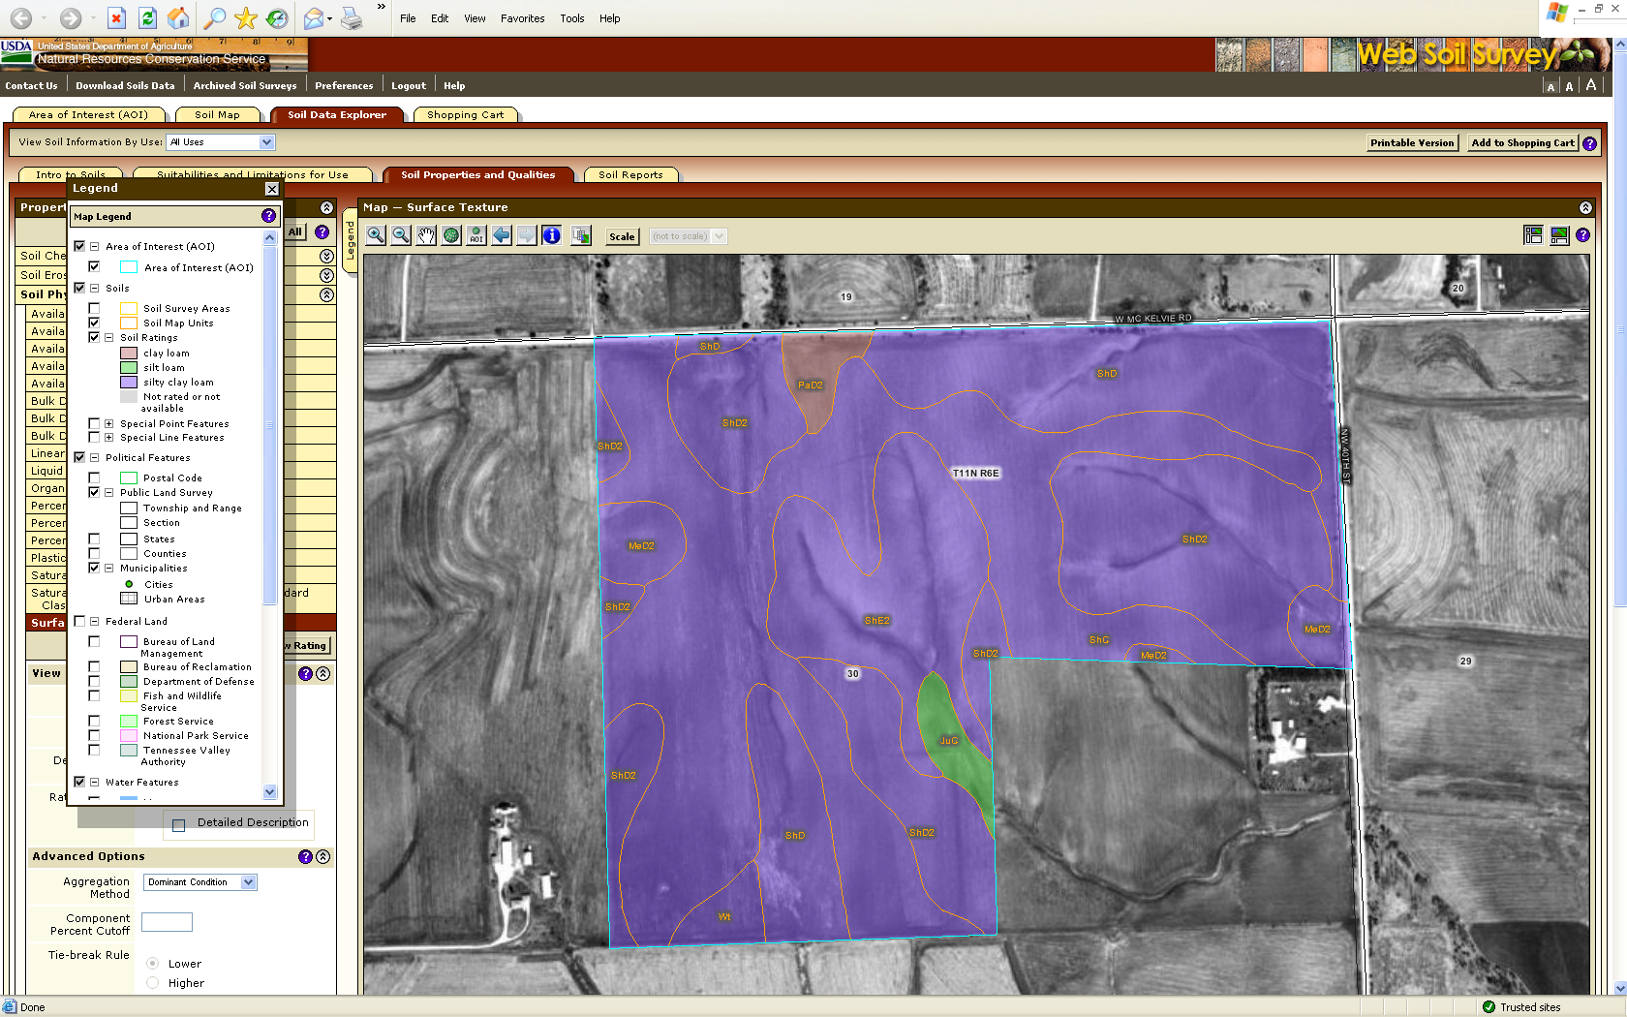
Surface Texture

Slide 11
Achieving Sustainable Farming
. Keep energy flow through the integrated system.
Integrate chemical, biological, and physical.
Improving soil quality is basis for improving soil, water, air, plant, and animal resources.

Slide 12
Sustainable Farming – Build Soil Quality
Minimize or eliminate tillage
Apply nutrients according to soil, plant, tissue tests and nutrient budget
Increase on-farm nutrient cycling, plant species diversity
Maintain ground cover year round by using cover crops and mulches and by leaving crop residues in field
Manage/protect soil organisms to preserve biodiversity
Rotational grazing, prescribed grazing

Slide 13
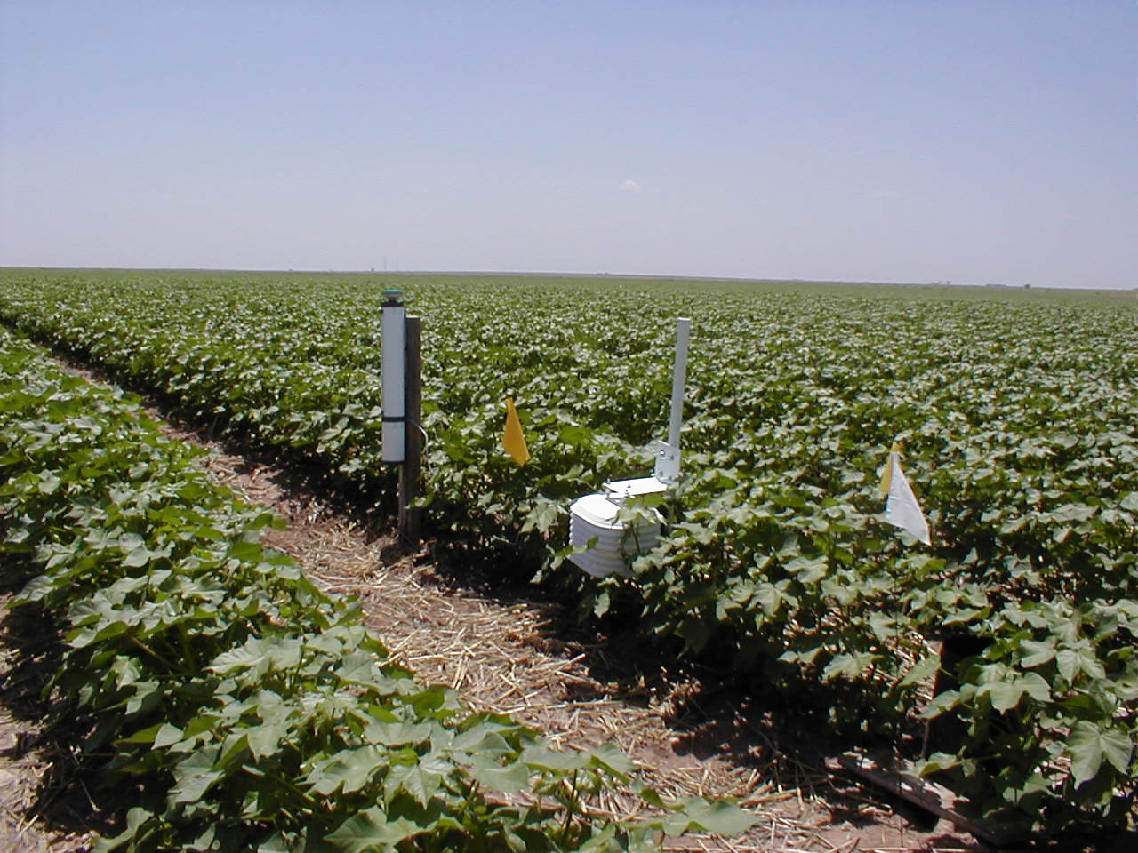
Potential Benefits of Sustainable Systems: Water Resource
Conserved surface and ground water quantity and quality
Increased efficiency, higher yields
Reduced pumping costs
Water losses minimized (evaporation, runoff and deep percolation)

Slide 14
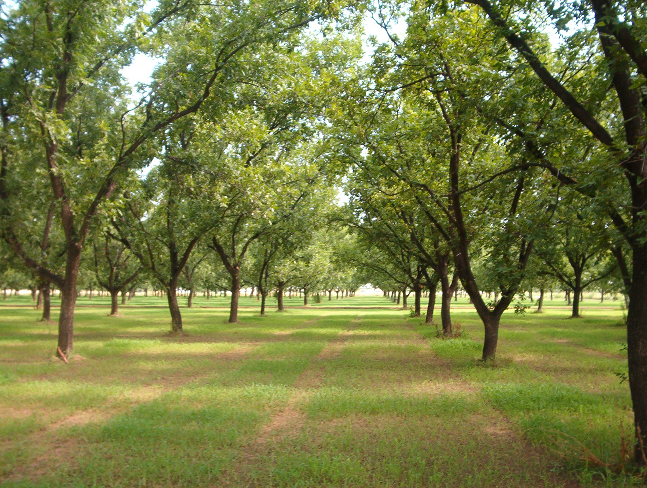
Potential Benefits: Plant Resource
Crop production costs reduced
Increased crop yield and quality
Reduced pest incidences (e.g. weeds, insects, disease)
Available water quantity and quality meet specific
requirements of crop (consumptive use, leaching)

Slide 15
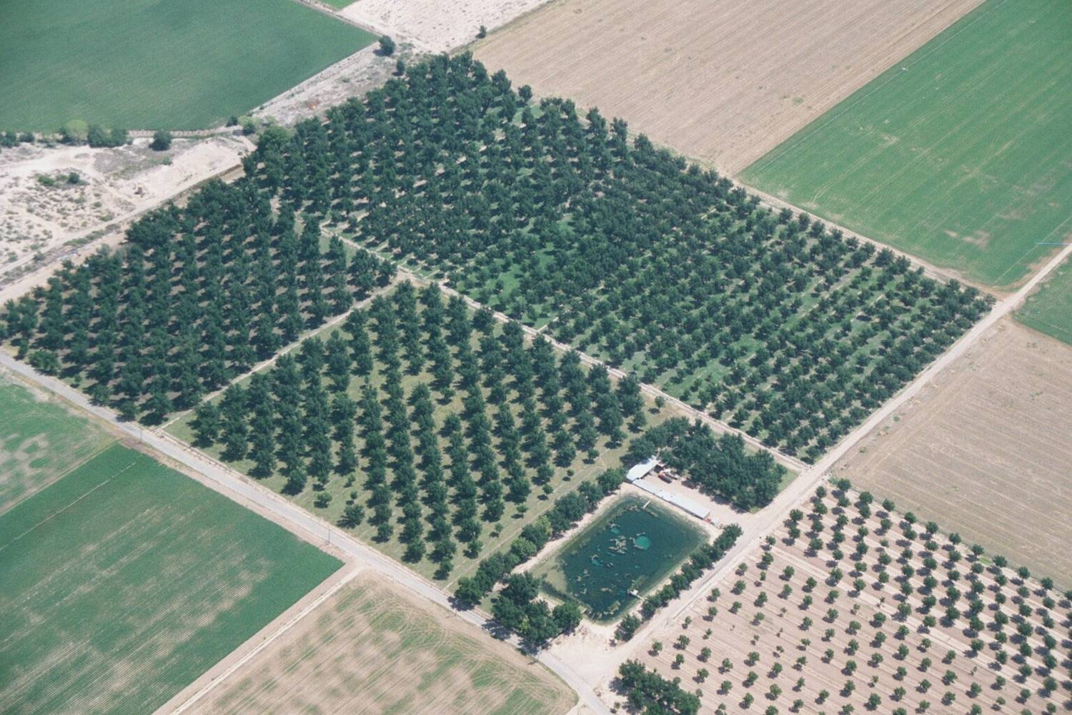
Other Potential Benefits
  Reduced overall on-farm energy use
  Increased beneficial use and recycling of nutrients
  Protection of resources by planned judicious use of water and all inputs
  Record keeping is used as a tool in decision-making and management of current and future resources

Slide 16
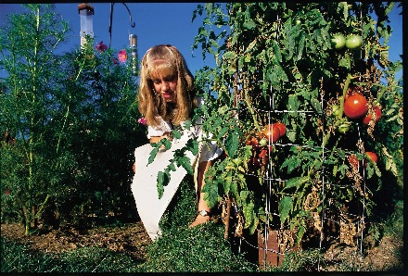
Sustainable Farming – Develop Conservation Plan
Use integrated approach to inventory resources and develop conservation plan for whole farm
Choose and apply conservation practices, technologies, approaches to address identified resource concerns and take advantage of opportunities
Not only think outside the box but step outside the box

Slide 17
Achieving Sustainable Farming
Whole System (Ecosystem, Field, Farm,
Watershed)
Resource Opportunities
Think Critically
Use Problem-Posing/Solving Approach

Slide 18
Achieving Sustainable Farming
Producers need to demand quality service. NRCS, in addition to universities, and other partners, must help develop sustainable farming systems.
Form interdisciplinary, interagency team, producer networks to identify/resolve resource problems/ opportunities
Producers are the drivers of sustainable farming as we develop/exchange technologies, case studies, field trials, on-farm demonstrations, farmer-to-farmer networks.

Slide 19
Achieving Sustainable Farming: Perspective and Attitude is Everything
Interconnected system comprised of soil, water, air, plant, animal, and human components/ resources, constantly changing, interacting, through which energy is flowing
Team members must come to the table/field in active listening/learning mode and with open mind, keen observational skills, and be ready to adapt to change
Proactively become involved in every step; only hands-on experience changes paradigms

Slide 20
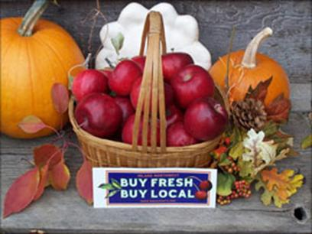
Sustainable Farming – Diversify Enterprise
Market outside commodity supply
Emphasize direct marketing and specialty markets
Form cooperative
Add value through on-farm processing

Slide 21
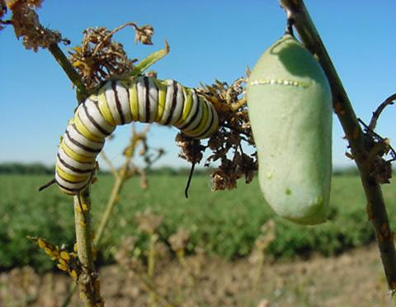
Sustainable Farming – Manage Pests Ecologically
Prevent pest problems by building healthy, biologically active soil, creating habitat for beneficial organisms, and choosing appropriate plant cultivars/rotations
Tolerate, don't eradicate
There is no silver bullet
Treat the causes of pest outbreaks, not the symptoms
If you kill the natural enemies, you inherit their job
Pesticides are not a substitute for good farming
Notes:
Tolerate, don't eradicate
Most crops tolerate low pest infestation levels
IPM seeks to reduce pest populations below levels that are economically damaging rather than to totally eliminate infestations
There is no silver bullet
Over-reliance on any single control measure can have undesirable effects including resistance, resurgence and replacement
Treat the causes of pest outbreaks, not the symptoms
IPM requires a detailed understanding of pest biology and ecology so that the cropping system can be selectively manipulated to the pest's disadvantage
If you kill the natural enemies, you inherit their job
Naturally occurring predators, parasites, pathogens, antagonists and competitors help keep many pest populations in check
IPM strives to enhance the impact of beneficials and other natural controls by conserving or augmenting those agents
Pesticides are not a substitute for good farming
A vigorously growing plant can better defend itself against pests than a stressed plant
IPM takes maximum advantage of farming practices that improve soil quality, promote plant health and allow crops to escape or tolerate pest injury

Slide 22
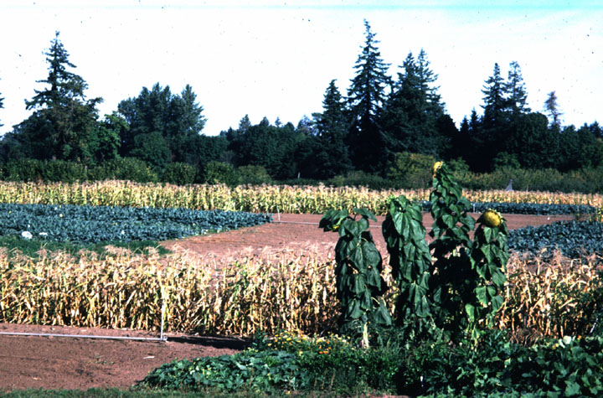
Sustainable Farming – Maximize Biodiversity
Integrate crop and livestock production
Use hedgerows, insectary plants, cover crops, etc. to attract beneficial insects, bats, and birds
Plant trees and perennial crops
Abandon monocropping in favor of crop rotations, intercropping and polycultures
Manage pastures to support diverse selection of forage plants
Plant cover crops

Slide 23
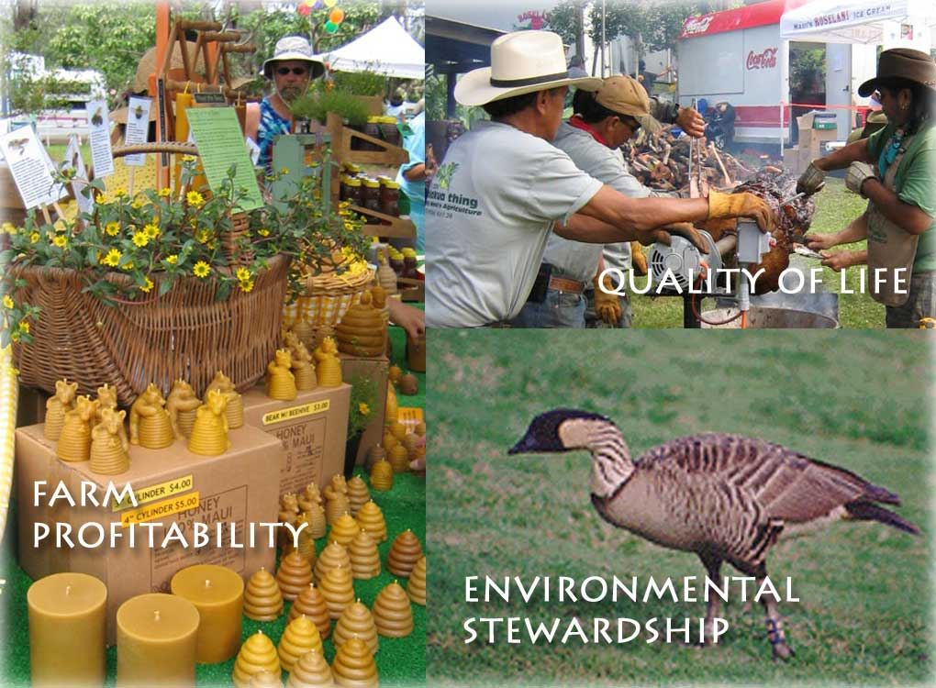
Sustainable Farming – Other Considerations
Take an inventory; think about every field, pasture, stream, well, etc.
What are the natural resources on my farm? How can these be used more efficiently?
What resource opportunities exist throughout the watershed?
What crops can I grow? Marketing niche/
opportunities, climatic considerations,
agroecological needs, etc.

Slide 24
Sustainable Farming – Other Considerations
How is water quality on farm for all purposes? Have I minimized runoff and leaching?
How can I protect air quality, including reducing dust, odor?
Am I using crop rotations for nutrient cycling and to reduce disease/pest problems?
What type of livestock/wildlife exists or could be raised?

Slide 25
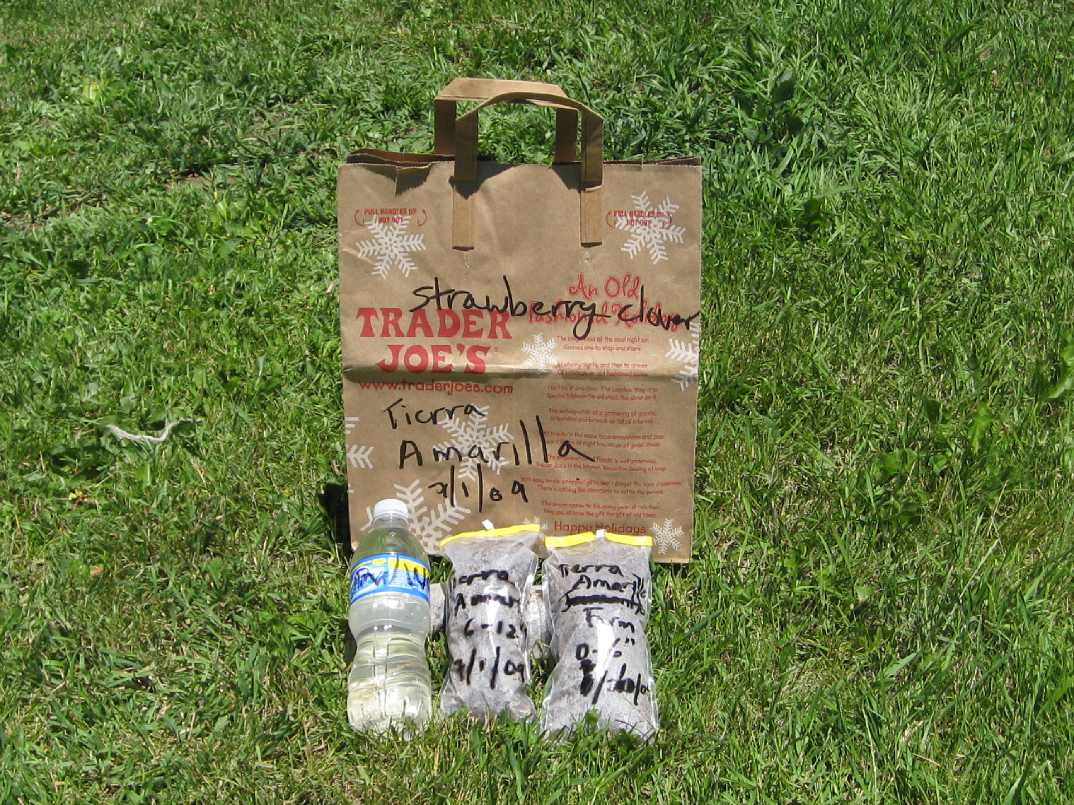
Sustainable Farming – Other Considerations
Have I taken a soil test?
Have I taken an irrigation water test?
Have I taken plant tissue tests?
How is my soil quality? Soil fertility, Aggregate stability, active organic matter; visual indicators, including erosion, weeds, blowing soil, sediment deposition, crop or plant quality and production, earthworms

Slide 26
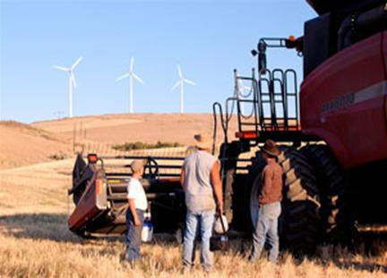
Sustainable Farming – Other Considerations
Besides using crop residues and cover crops,
what other practices can I apply to build soil
quality? To recycle nutrients? To use water
efficiently?
Which practices would contribute to an environmentally and economically sound farm?
Am I making the best use of compost, animal manure, legumes as nutrients for plants?
How can I conserve/produce energy or reduce energy use?

Slide 27
Sustainable Farming – Evaluations
Evaluation of need, design, implementation and
impact are all essential
Without proper evaluation at all phases, a
plan/project may not properly function and
address the needs/concerns/issues identified
Criteria, tools, and ongoing mechanisms should
be established for each type of evaluation
Recordkeeping is an excellent management and
evaluation tool so that changes can be made

Slide 28
Achieving Sustainable Farming: Evaluations
Evaluation of need – many methods, including producer surveys, observation, scoping meetings
Evaluation of design - ensure objectives are clearly defined and will be met and that the plan/project will have positive impacts.
Implementation evaluation - phase which is most clearly understood and most conducted. It ensures that a practice/system is constructed/
applied according to design, but does not address how effective or how well designed it is.

Slide 29
Achieving Sustainable Farming: Evaluations
Evaluation of impact or evaluation of the success and effectiveness of the sustainable system is based partially on achieving a loop effect or a balanced ecosystem.
Potential and actual negative and positive impacts should be evaluated. It is often the most forgotten of the evaluations, yet one of the most important, since this can lead to a multiplier effect of negative results.

Slide 30
Achieving Sustainable Farming: Outreach
Case studies, field trials, on-farm research/ demonstrations, field days, farmer-to-farmer networks, tours, exchanges are some of many important components of successful technology exchange and outreach. These can also serve in assisting in several of the evaluation types.
Case studies, including comparing a benchmark condition to a planned condition and showcasing integrated approaches/practices/systems/ technologies.
Criteria, target audience, method should be established prior to developing case studies to ensure achieving targeted objectives.

Slide 31
Achieving Sustainable Farming: Outreach
Field trials and on-farm research/demonstrations serve to ground-truth on-station research and provide an effective method for planners, soil scientists, consultants, universities to exchange/test technology with producers.
Workshops, field days, farmer-to-farmer networks, tours, international exchanges are also very effective outreach methods.

Slide 32
Keys to Achieving Sustainable Farming with Conservation Planning and Tech Soil Services
use integrated systems approach (ecosystem, whole farm, watershed)
problem-posing, problem-solving approach
actively seek resource, watershed, marketing opportunities
resource efficient and resource conserving
technology “exchange” vs. “transfer”
develop whole farm conservation plan; plan creatively and flexibly
consider on-site and off-site effects
focus on keeping energy flow through the integrated system
reemphasize biological factors, improve biodiversity
improving soil quality is key to improving soil, water, air, plant, animal resources
case studies, field trials, on-farm research/demonstrations, farmer-to-farmer networks
interdisciplinary teams including producers and partners
recordkeeping is tool in decision-making and management of current and future resources
need user friendly fact sheets, brochures on integrated systems, integrated planning tools
NRCS can advise on developing soil survey and planning infrastructure

Slide 33
Keys to Achieving Sustainable Farming with Conservation Planning and Tech Soil Services
Promote integrated systems approach (ecosystem, whole farm, watershed)
Living soil demos, share soil and conservation passion
Integrated systems tech notes, brochures, user friendly fact sheets
Integrated soils management training
Observational Conservation Planning tool
Soil Health Rapid Assessment Tool
Interdisciplinary teams; hold integrated planning workshops
Develop case studies, field trials, on-farm research/demonstrations, farmer-to-farmer networks
Work closely with commodity groups to exchange support
Advise other countries on developing soil survey and planning infrastructure; provide international exchanges

