Slide 1
RUSLE2 Advanced Data Management
Linda Scheffe, NSSC Agronomist (NRCS RUSLE2 database manager)
Giulio Ferruzzi, WNTSC Agronomist (NRCS RUSLE2 science lead)
Steve Boetger, ENTSC Agronomist
Steve Woodruff, ENTSC Agronomist/Forage Specialist

Slide 2
Field Office User
Selects –
Location (climate)
Soil map unit component
Slope length and steepness
Crop Management (Use Rotation Builder to develop rotation)
Supporting Practices

Slide 3
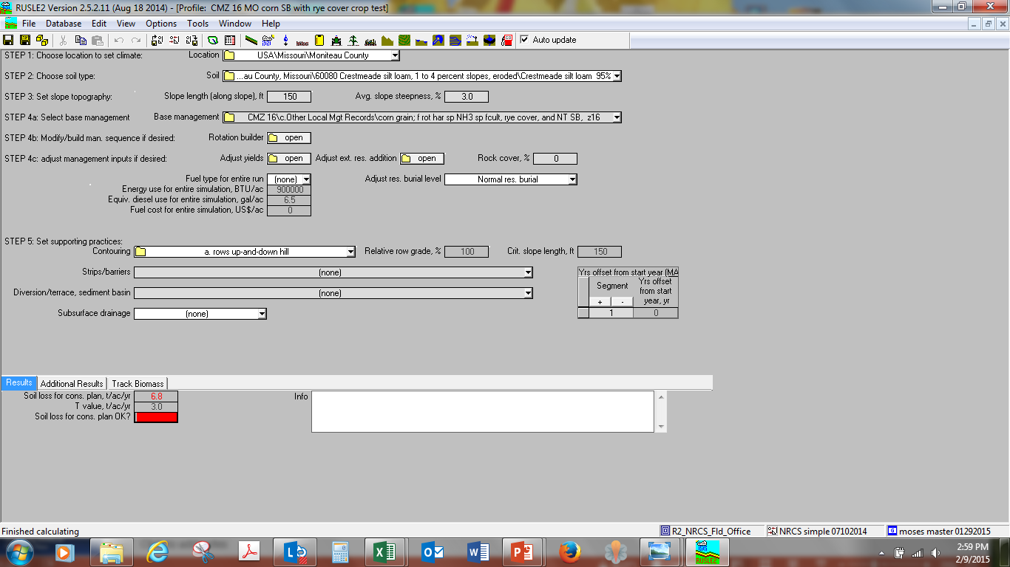

Slide 4
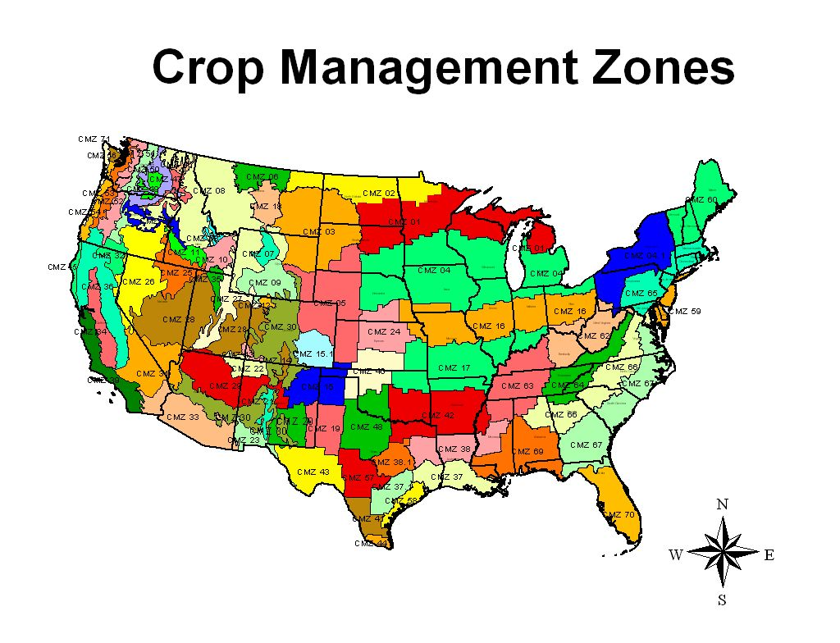

Slide 5
Crop Management Zones
Map represents common crop management zones or areas where the same crops are grown under similar climatic conditions.
Prepared in 2001 to 2004 by Dave Lightle, Agronomist at the NRCS National Soil Survey Center in Lincoln, Nebraska and was designed to be used to organize sets of crop management scenario templates for use in implementing the RUSLE2 and WEPS models.
The CMZ map provided the basis for the creation of standard sets of crop management scenarios for use in areas where the agriculture is similar.
Provides level of consistency between counties and field offices within the same crop management zone.

Slide 6
Crop Management Zones
Information sources included: USLE EI-distribution data and Figure 9 from Agriculture Handbook 537, the C-factor zone map previously used in implementing RUSLE1, National Agriculture Statistics Service (NASS) data on major crops grown and the Usual Planting and Harvest dates for these crops within the crop reporting regions.
In addition, Land Resource Regions, Major Land Resource Areas and the USDA Plant Hardiness Zones were also considered in establishing the CMZ zone boundaries.

Slide 7
Crop Management Zones
Input and concurrence was received from all NRCS State Agronomists and Regional RUSLE2 coordinators during the process in establishing the boundaries, and normalizing the boundaries to county boundaries and to major topographic features in order to aid in the implementation of RUSLE2 and WEPS in NRCS field offices.

Slide 8
Crop Management Zones
Over 30,000 crop management templates in 78 crop management zones in the Continental US, Caribbean, and Hawaii/Pacific Basin have been updated for representative cropping and management systems, including energy use

Slide 9
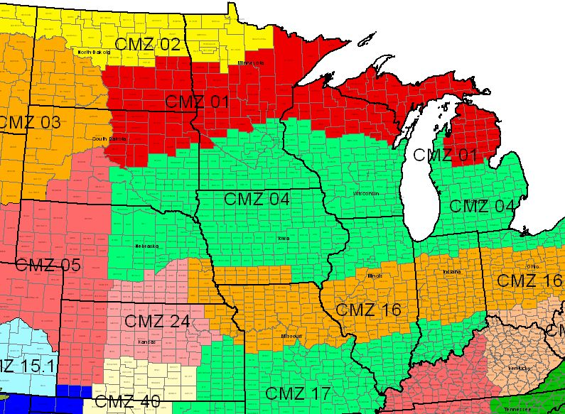
RUSLE2 CMZ Map

Slide 10
CMZ Lead Responsibilities
Maintenance of CMZ a: and b: management records
Work with state agronomists in Zone to achieve input and consensus for CMZ content
Request from state agronomists yearly to provide updated CMZ templates

Slide 11
CMZ Lead Responsibilities
CMZ lead provides updated a, b, c and d folders to regional agronomist and RUSLE2 database manager for review and processing (into Land Management Operations Database and official website)

Slide 12
CMZ Lead Responsibilities
CMZ lead provides updated a, b, c and d folders to regional agronomist and RUSLE2 database manager for review and processing (into Land Management Operations Database and official website)

Slide 13
State Agronomist Responsibilities
Maintenance of CMZ a and b folders with CMZ lead (includes new managements with new vegetations)
State agronomists request most representative and utilized c: management records from field offices and then make into a or b records and forward to CMZ lead
Maintain soils data for each soil survey area

Slide 14
State Agronomist Responsibilities
Request new vegetations/operations to be built through regional agronomist and db manager.
Provide area/field office databases and instructions on how to archive/update
Should build statewide moses database containing climate, soils, management templates of entire state (for state agronomist use)to enable troubleshooting and overall quality control

Slide 15
State Agronomist Responsibilities
Provide area/field office training
Provide ongoing input for changing needs for integrated erosion prediction technology, resources, tools, training
State agronomist RUSLE2 access allows higher access than field office access (should only be one person in state with state agronomist access unless requested in writing)
Access only works for version you were provided access for

Slide 16
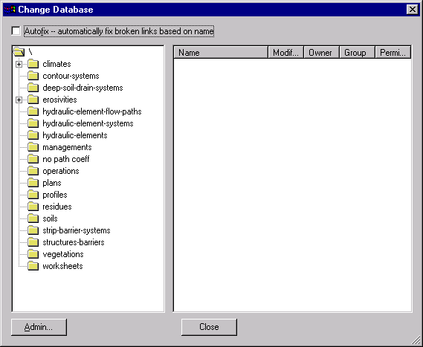
3084 Climate records in the 40 eastern states
7408 Climate records in the 11 western states plus Hawaii, PAC Basin and Caribbean area
594 Support Practice choices
29,310 Crop Management Scenario Templates in 78 CMZ’s (so far)
611 Tillage and Field operations records
140 Different plant residue records
1,048,659 Soil Component records in 649,032 map units in 3100 Soil Surveys
1360 Crop and vegetation records

Slide 17
Soils Data
State Action: *
NASIS SSURGO Downloads created for each county
State agronomist does RUSLE2 Import for each county from the SSURGO download files
State agronomist creates RUSLE2 Export file for each county and sends to database manager
Climate Data
Developed and Exported
Portland NWCC Action
Management Templates
State Action: *
CMZ leader coordinates and develops templates, then creates RUSLE2 export by CMZ and sends export file to database manager
Operations Data
Vegetation Data
Residue Data
Practices
Developed by:
Database Manager: Linda Scheffe
Science Lead: Giulio Ferruzzi
RUSLE2 Data Flow
Database Manager
Sets Access & Permissions
Field Office Computer or private RUSLE2 user
Install RUSLE2 Program
Customize the Base NRCS Database
  Copy the necessary files and import into base database
  - xyz County Soils *
  - State Climate *
  - CMZ Templates**
    a: Single Year **
    b: Multi-Year **
    c: FO created Management “Records” (RWCD permissions at FO level); possibly use State policy to manage development at the FO level
RUSLE2 Website
http://fargo.nserl.purdue.edu/rusle2_dataweb/RUSLE2_Index.htm
RUSLE2 Download (Install file)
Base NRCS Database (No soils, climate or management)
Soils by County - 2600 +/- files
Climate Data - 50 State files
Management Templates - 78 CMZ files
(Will eventually migrate to Data Warehouse)
* State Agronomist can read, copy, and delete (R-CD)
Read only at the FO Level (R---), RWCD for State Agronomist
** State Agron RWCD, Read only at the FO Level (R---)

Slide 18
How do the access and permissions work in RUSLE2?
Provides a mechanism to limit user access to certain critical parts of the databases.

Slide 19
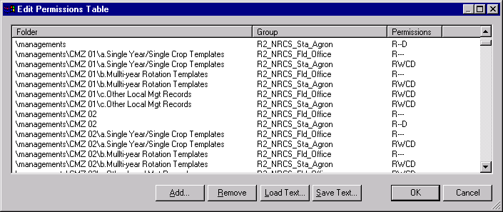
Permissions Table edited by Database Manager

Slide 20
RUSLE2 Screen View Hierarchy
Plan
  Worksheet field 1
    Profile
      Management
    Profile
      Management
  Worksheet field 2
    Profile
      Management
    Profile
      Management

Slide 21
RUSLE2 Hierarchy of Screen Views
Management
A crop and tillage system scenario. Contains crop and yield information, all tillage, planting, and harvest operations with dates, but is not a soil loss calculation.
All components housed within the
moses.gdb database file.
Profile*
Contains one erosion calculation for one slope. Combines climate, soil, slope, management and structural practice inputs.
*Contain actual soil loss calculations
Plan*
Climate is constant. Houses worksheets for each field or treatment unit. Each field worksheet has constant soil, and slope but contains multiple profiles with different management and support practice alternatives.
Worksheet*
Soil, slope and climate information
are constant. Compares multiple
profiles (alternatives) for one field.

Slide 23
RUSLE2 Features
Provides for
  Single soil loss runs in the Profile view.

Slide 24
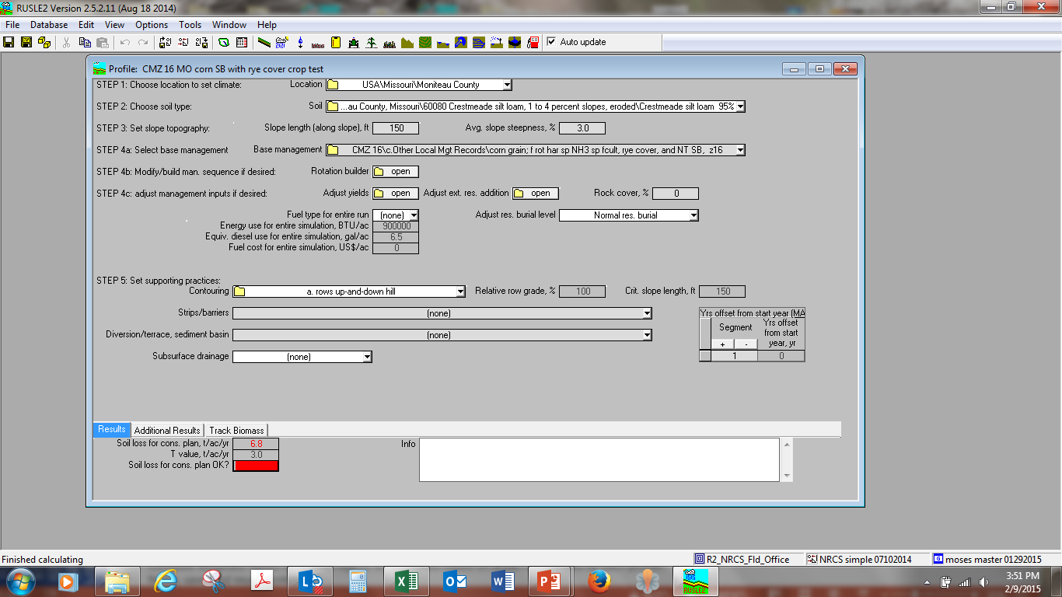
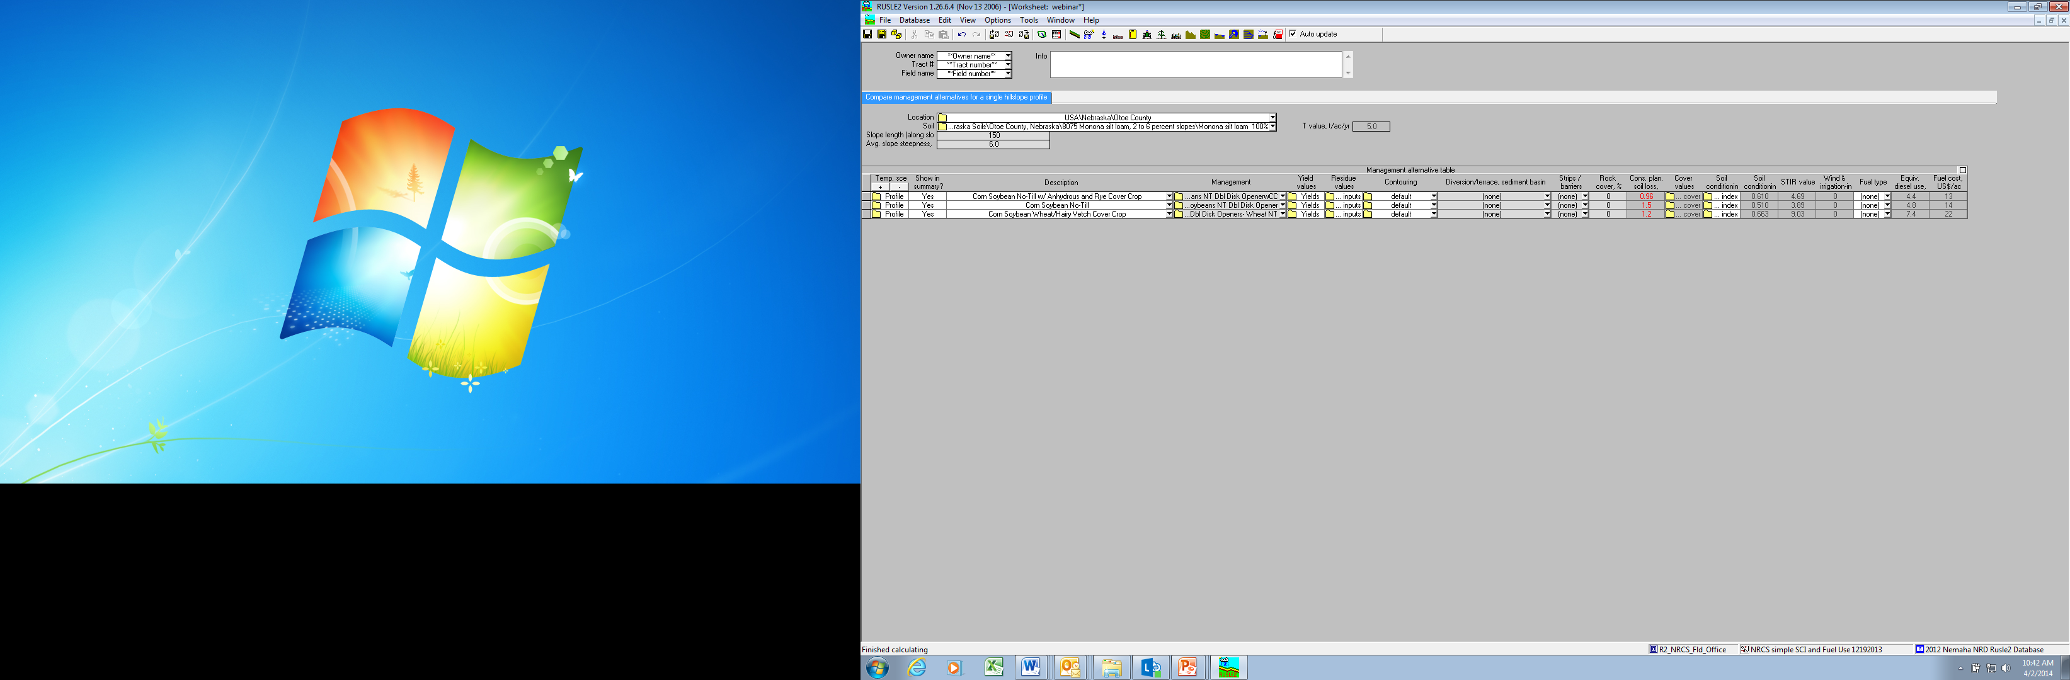
Comparing SHMSs in Worksheet View

Slide 25
RUSLE2 Features
Provides for
  Single soil loss runs in the Profile view.
  Comparison of alternative soil loss runs on the same slope in the Worksheet view.

Slide 26
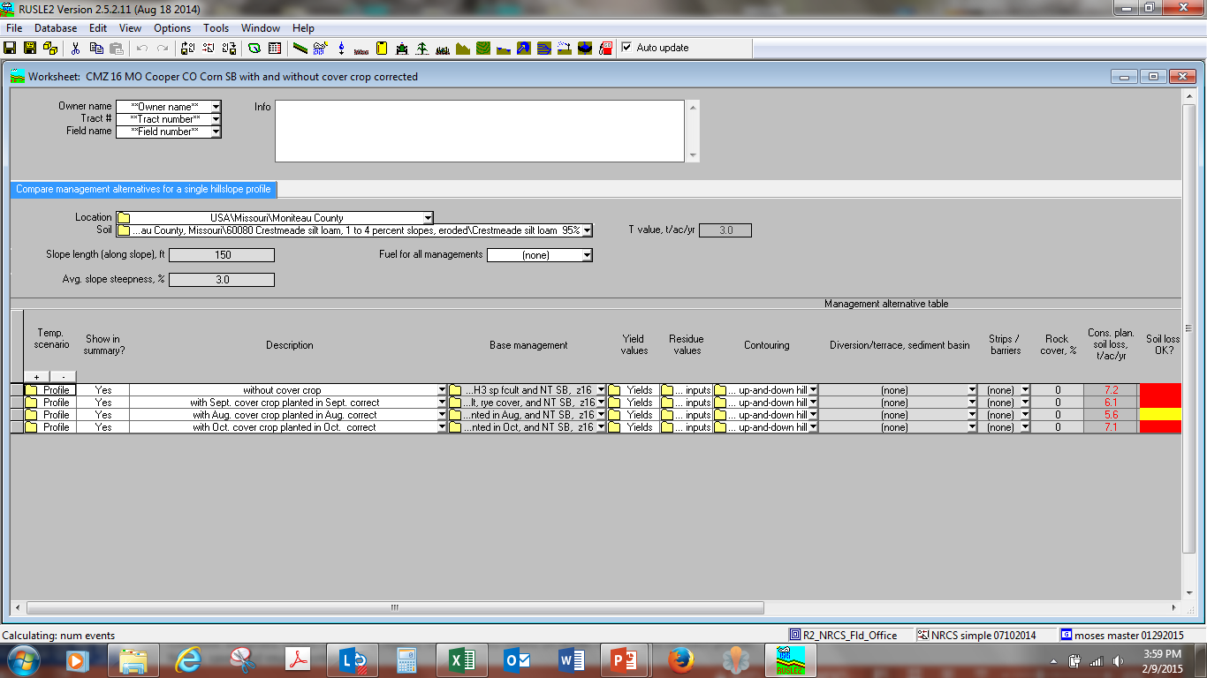
Comparing SHMSs or Alternatives in Worksheet View
Notes:
Major routine working tool with RUSLE2.
Compare alternatives for the same base profile
Compare profiles
Compute weighted values for a field, region, or watershed based on areas represented by each profile.
Name, save, and reuse worksheets

Slide 27
RUSLE2 Features
Provides for
  Single soil loss runs in the Profile view.
  Comparison of alternative soil loss runs on the same slope in the Worksheet view.
  A report of alternatives for each field for all fields on a farm in the Plan view.

Slide 28
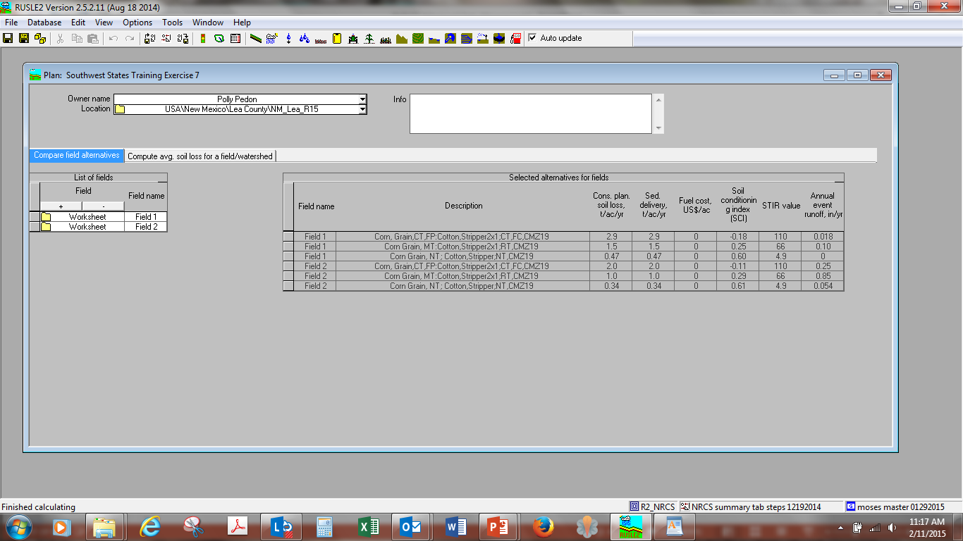

Slide 29
RUSLE2 Data
  When building managements, select appropriate operations and vegetations;
  Read information boxes
  View in profile, graph canopy cover, etc. to make sure site specific scenario is represented well
  Request new vegetation/operations to meet changing needs

Slide 30
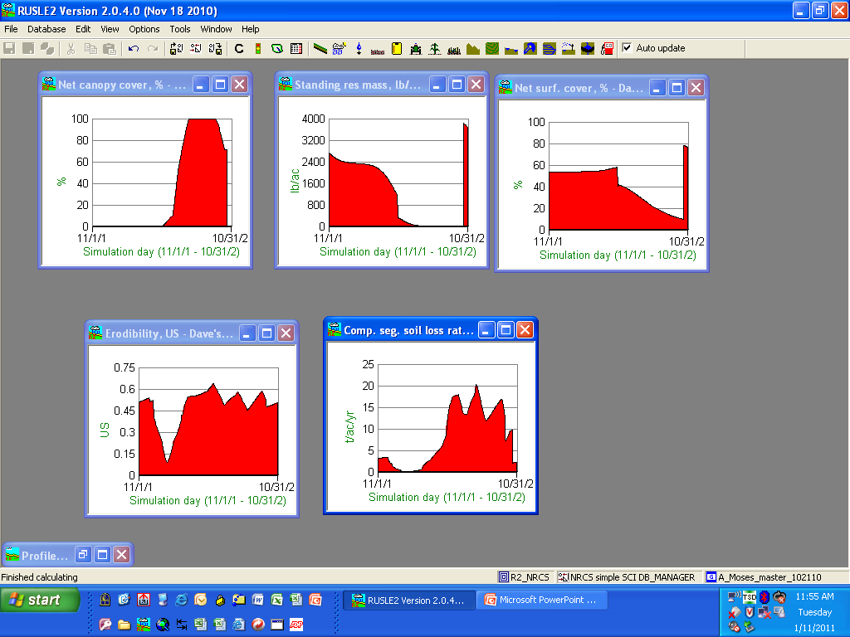

Slide 31
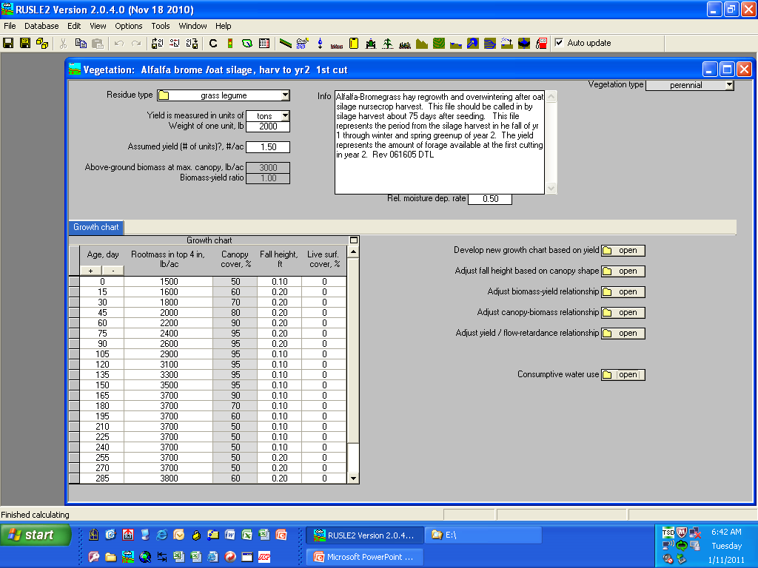

Slide 32
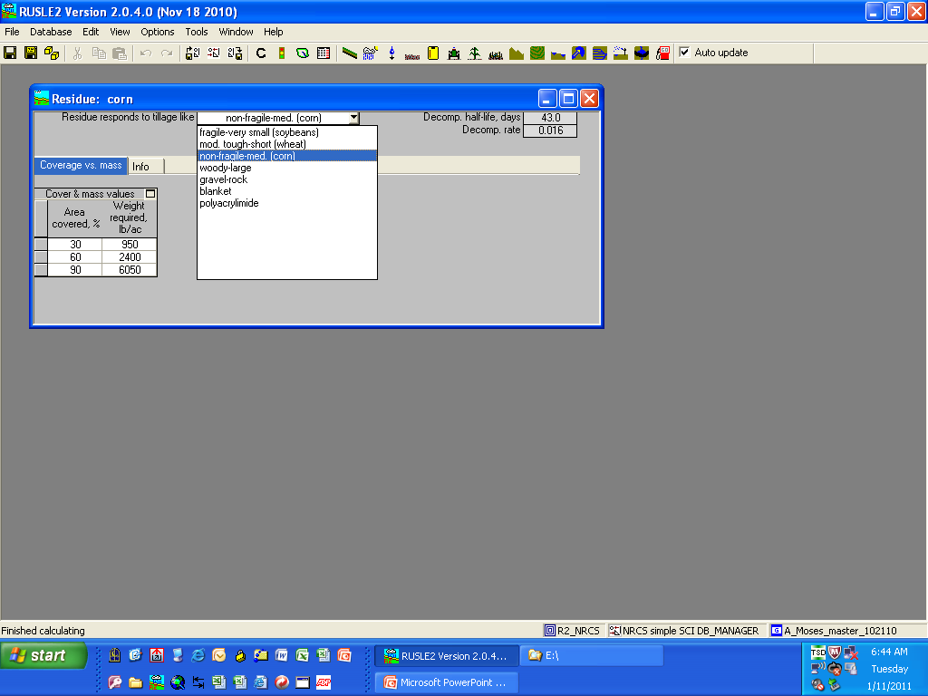

Slide 33
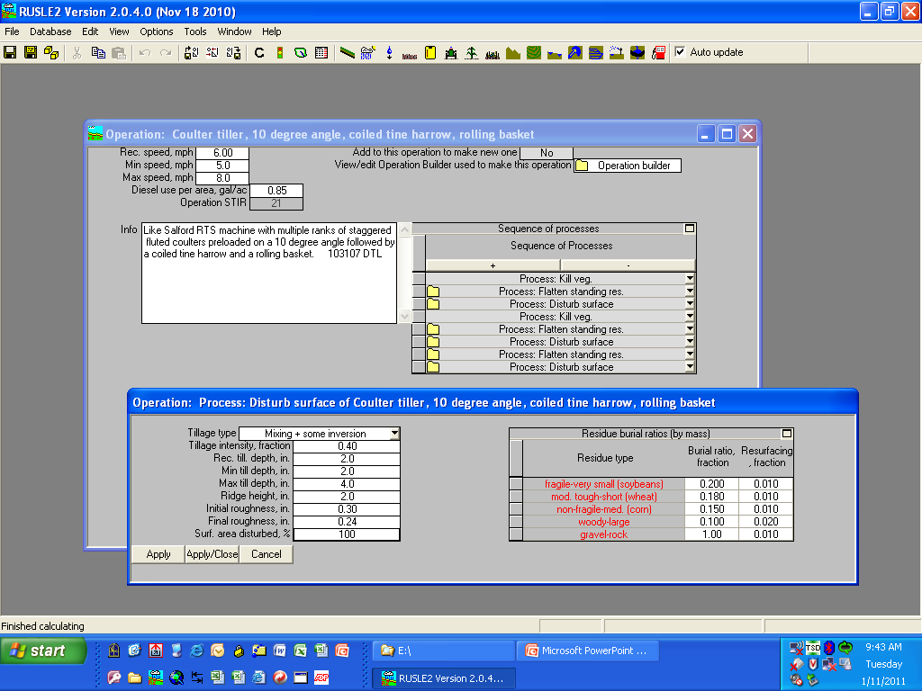

Slide 34
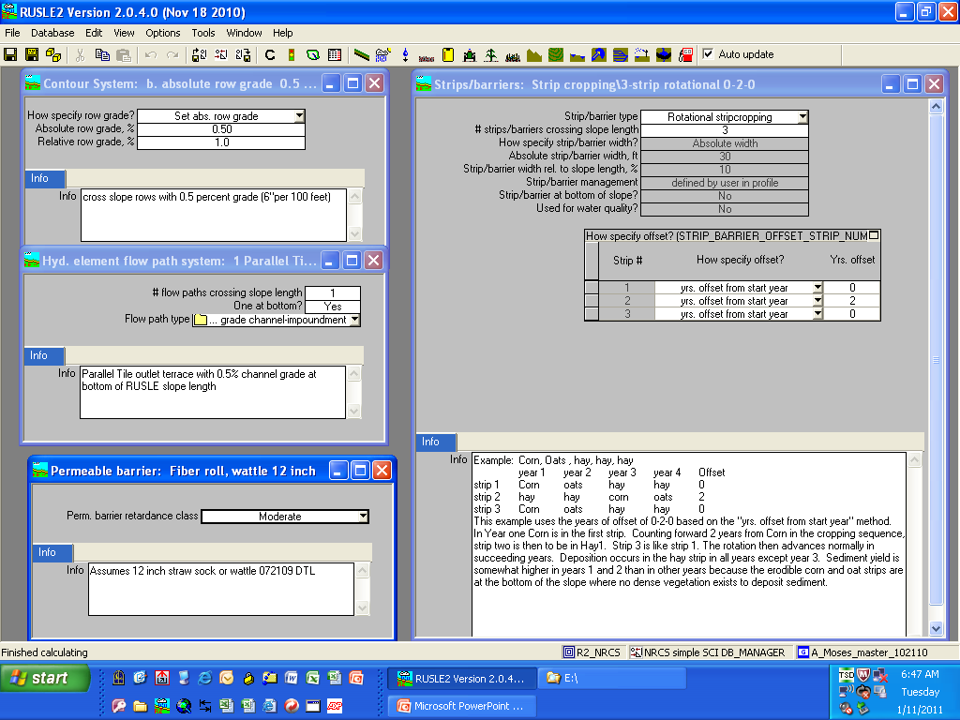

Slide 35
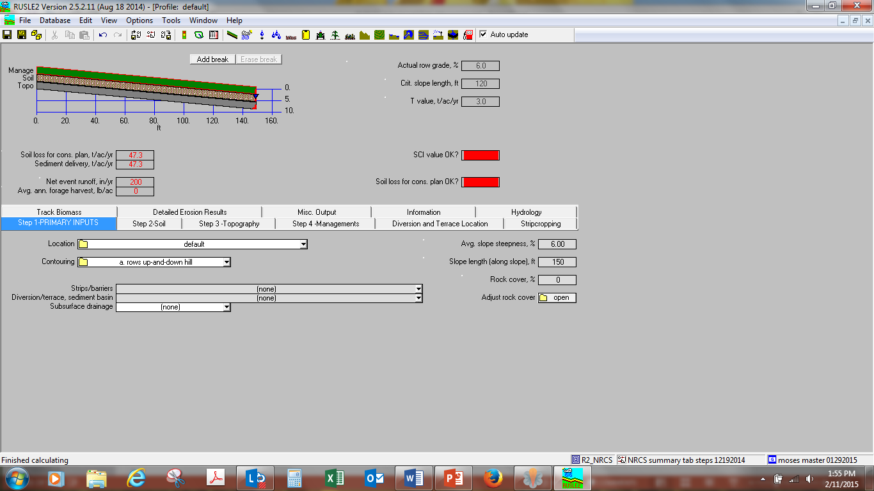
Rotation Builder

Slide 36
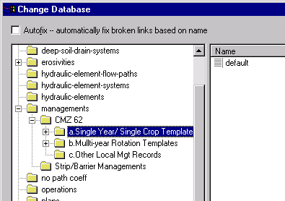

Slide 37
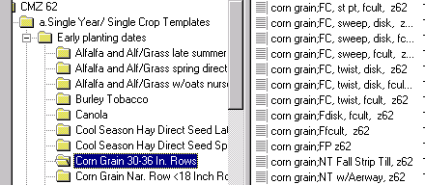
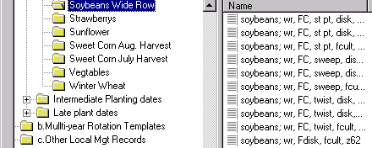
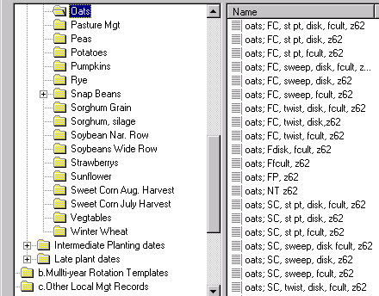
Oats spring chiseled
year1
Corn fall chiseled
Rotation Builder
year3
Soybeans Fall Chiseled
year2

Slide 38
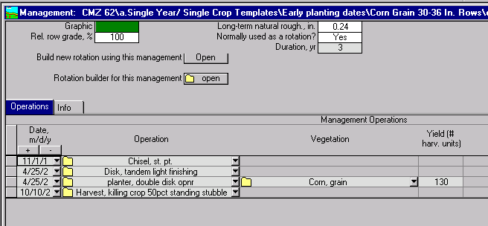

Slide 39
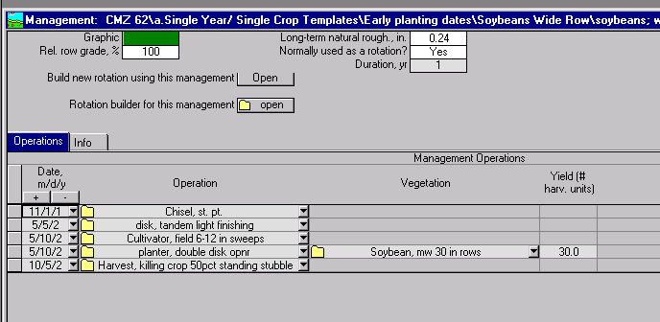

Slide 40
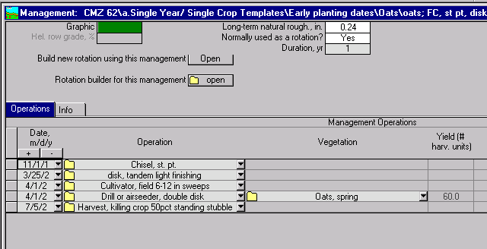

Slide 41
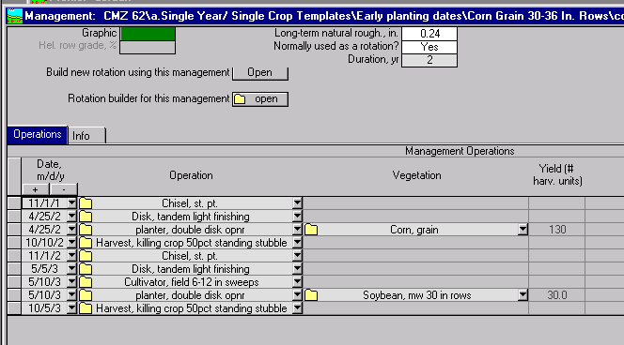

Slide 42
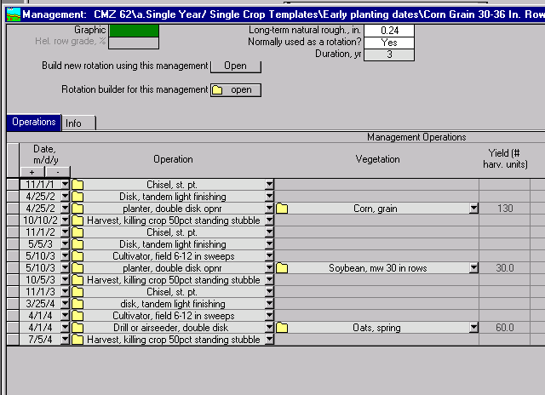

Slide 43
Current Agronomic Models
Each model currently contains it own databases
Most utilize similar data
  Soil map unit and component data
  Climate location data on temperature, precipitation and wind energy
  Crop and plant data
  Tillage, pesticide, nutrient and manure application, planting and harvest operations
  Crop Management Scenarios
NRCS is currently developing, trying to maintain and serve up separate databases for each model

Slide 44
Sheet and Rill Erosion Rate
Wind Erosion Rate
Particulate Emission Concentration
Sediment Delivery
Detached Particle Information
Nitrate Leaching
Phosphorus Runoff
Carbon Sequestration / Losses
Pesticide Leaching
Nutrient Loading
Organic Matter Trends
Soil Tillage Intensity Ratings
Advanced PRISM Climate Data
Climate generator sub module
Residue Decomposition Sub module
Residue Database
Water Erosion Model
Crop Rotation Builder sub module
NASIS/SSURGO Soils data
SCI and STIR
Phosphorus Index
Common User Interface
WinPST
NLEAP
Support Practices Database
Field operations database
Manure Management Program
AnnAGNPS
Residue Burial sub module
Wind Erosion Model
Crop Management Scenarios Database
Random Roughness Degradation sub module
Vegetation and Crop Database
On-site Field and Landscape Information

Slide 45
Future Plans to Reduce Time Spent on Database Development/Maintenance
Land Management Operations Database
Obtain Database from Area of Interest
Access Soils Directly from Soil Data Access Facility

