Slide 1
RUSLE2
New Crop Year Results
New functionality in the model to report selected results based on Crop Intervals (i.e. the period of time from the harvest of the previous cash crop to the harvest of the current cash crop).
Giulio Ferruzzi, WNTSC Agronomist (NRCS RUSLE2 science lead)
Linda Scheffe, NSSC Agronomist (NRCS RUSLE2 database manager)
Steve Boetger, ENTSC Agronomist
Steve Woodruff, ENTSC Agronomist/Forage Specialist
??, CNTSC Agronomist

Slide 2
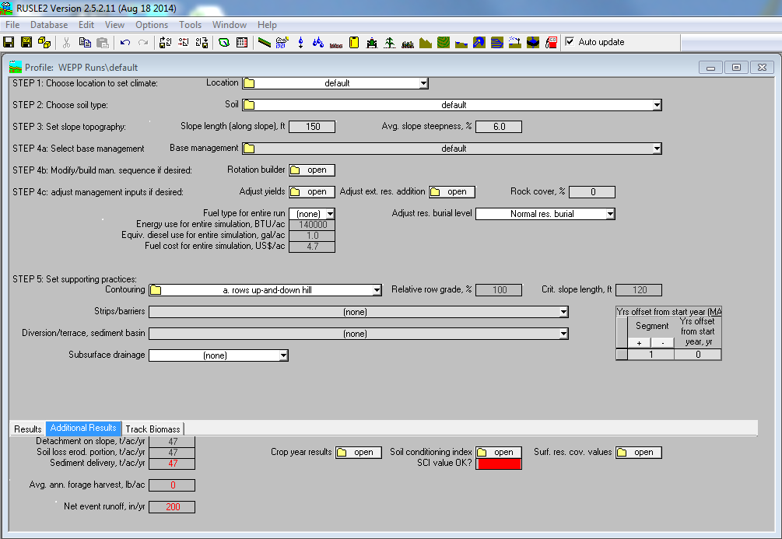
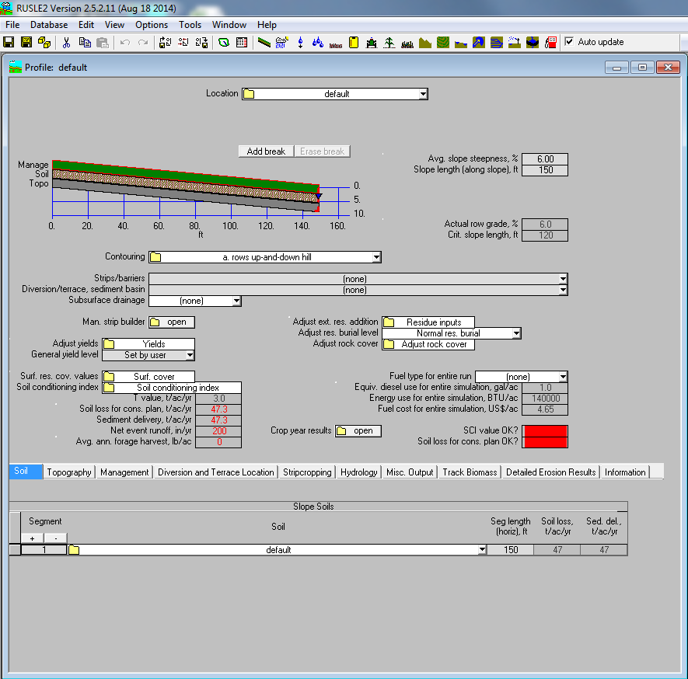
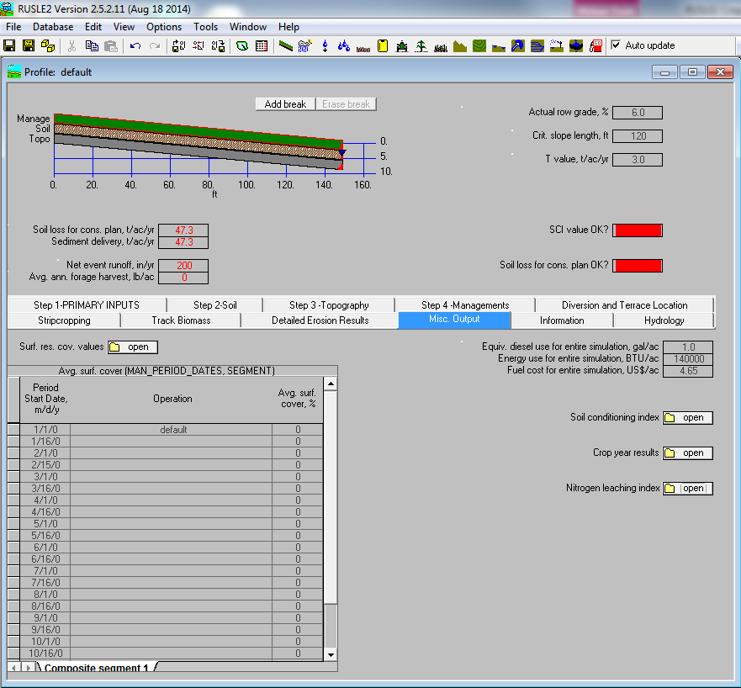
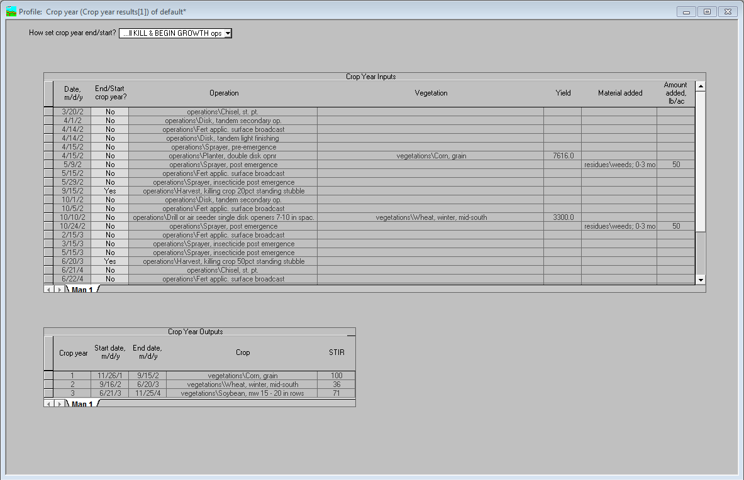
How do you get to the Crop year results information (Profile view)?

Slide 3
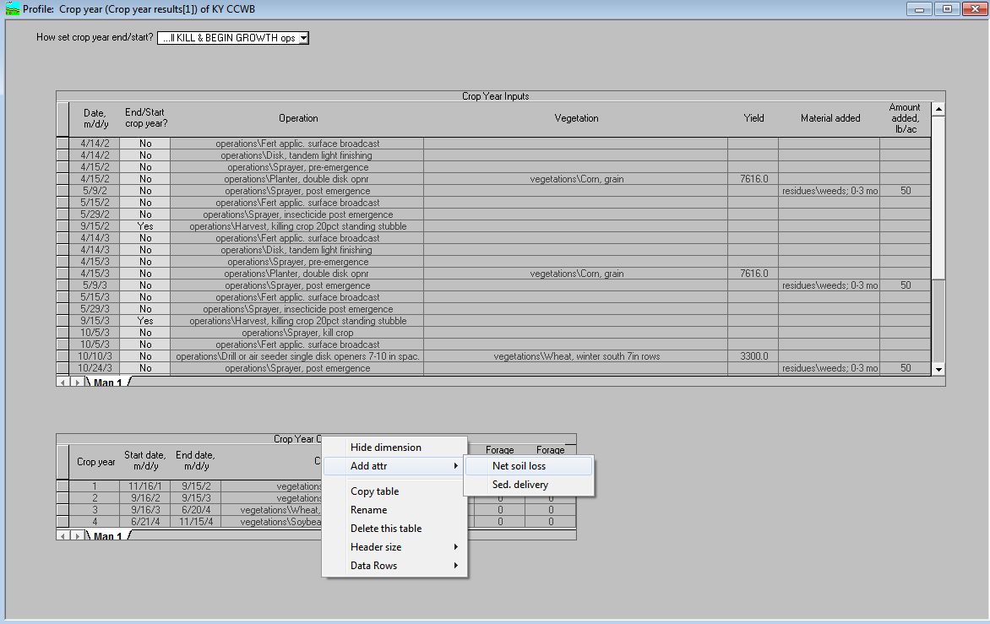
How do you get to the Crop year results information (Profile view)?
Dropdown menu gives you several choices of how to set the end/starting points for the crop year. These choices do not always set the correct dates and the user may need to manually adjust.
Ensure that there is a YES next to each Harvest operation for every annual crop. For crops with multiple harvests, ensure that there is a YES next to the last Harvest only.
Hover your pointer over the table title “Crop Year Outputs” and right-click.
Hover your pointer over the “Add attr” option then select “Net soil loss” or “Sed. delivery”

Slide 4
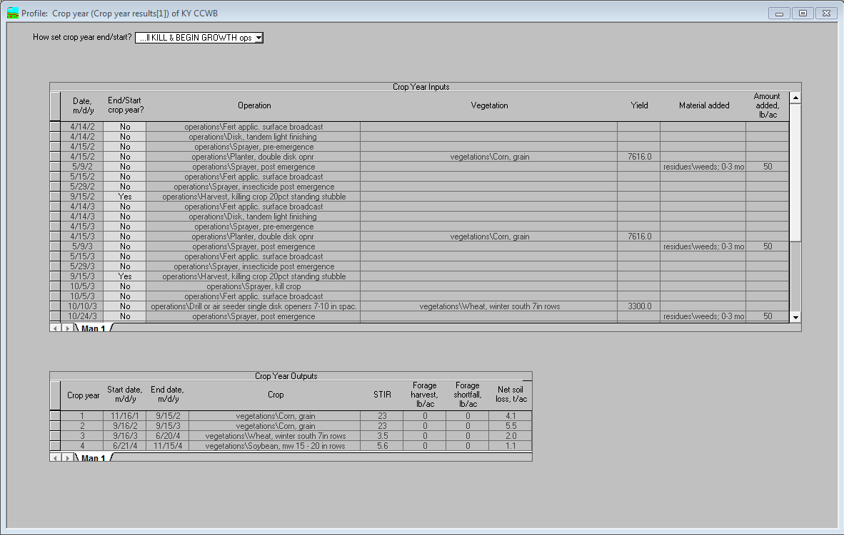
How do you get to the Crop year results information (Profile view)?
Notice that the units are T/Ac NOT T/Ac/yr! Must convert to compare to Average Annual Erosion. Next RUSLE2 release will do this for you.
Hover your pointer over the table title “Crop Year Outputs” and right-click then select “Copy table”. Copy into Excel®.

Slide 5
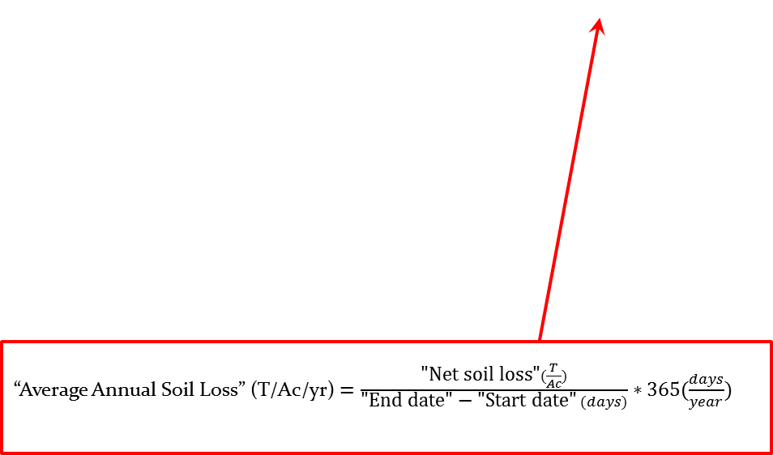
How do you get to the Crop year results information (Profile view)?
Start date, m/d/y | End date, m/d/y | Crop | STIR | Forage harvest, lb/ac | Forage shortfall, lb/ac | Net soil loss, t/ac | Calculated Soil Loss T/Ac/yr
11/16/2001 | 9/15/2002 | vegetations\Corn, grain | 23 | 0 | 0 | 4.1 | 4.9
9/16/2002 | 9/15/2003 | vegetations\Corn, grain | 23 | 0 | 0 | 5.5 | 5.5
9/16/2003 | 6/20/2004 | vegetations\Wheat, winter south 7in rows | 3.5 | 0 | 0 | 2 | 2.6
6/21/2004 | 11/15/2004 | vegetations\Soybean, mw 15 - 20 in rows | 5.6 | 0 | 0 | 1.1 | 2.7
 |  | Sum of Net Soil Loss divided by rotation length in years (3)= |  |  |  | 4.23
The sum of the “Net soil loss” values will equal the Average Annual Soil Loss for the rotation (may be ± 0.01 due to rounding effects).
“Average Annual Soil Loss” (T/Ac/yr) $=\frac{\text{"}\text{Net} \text{soil} \text{loss}\text{"}(\frac{T}{Ac})}{\text{"}\text{End} \text{date}\text{" − "}\text{Start} \text{date}\text{"} (days)}∗365(\frac{days}{year})$

Slide 6
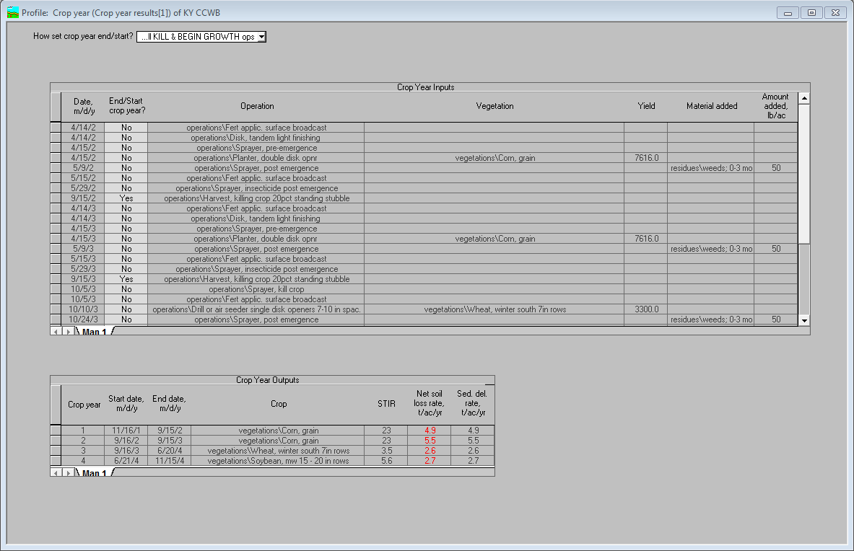

How do you get to the Crop year results information (Profile view)?
New RUSLE2 release will report T/Ac/yr.
Same as calculated with Excel®.

Slide 7
Why is this important?
Some programs like MMP require soil loss results on an annual basis for the crops receiving manure application.
You must ensure that you are reporting soil loss in the correct units and for the correct time period.
Helps with identifying which crop in the rotation is most susceptible to erosion/has the most potential for improvement.

Slide 8
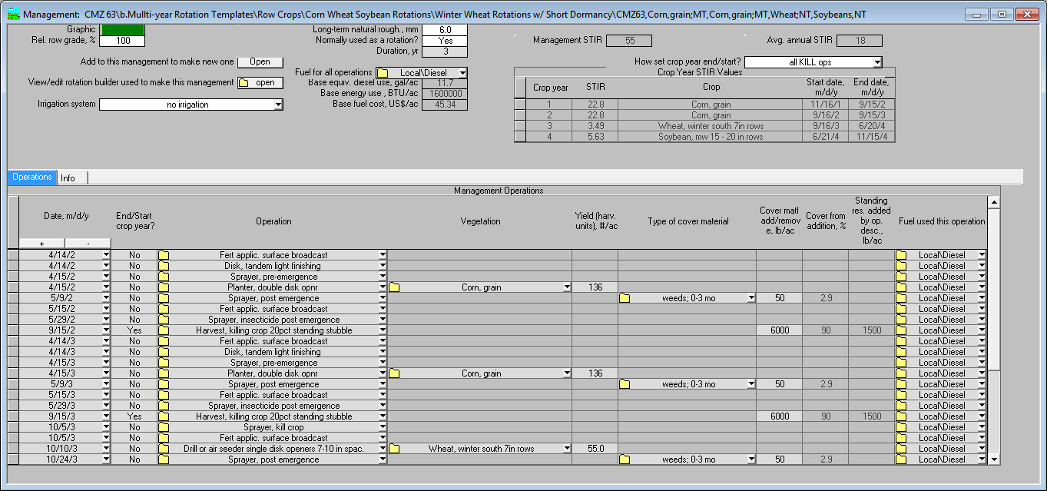
How do you get to the Crop year results information (Management view)?
Management STIR = The cumulative sum all operation STIR values in the management.
Dropdown menu gives you several choices of how to set the end/starting points for the crop year. These choices do not always set the correct dates and the user may need to manually adjust.
Crop year STIR results for each Crop in the rotation. Cover crops are considered part of the next cash crop’s crop year interval.
Avg. annual STIR = The management STIR value divided by the number of years in the rotation.
Ensure that there is a YES next to each Harvest operation for every annual crop. For crops with multiple harvests, ensure that there is a YES next to the last Harvest only.

Slide 9

Questions?
$*@#*&%# RUSLE! Wait, that’s not a question…

