Slide 1
RUSLE 2 Database Management
Linda Scheffe, NSSC Agronomist (NRCS RUSLE2 database manager)
Giulio Ferruzzi, WNTSC Agronomist (NRCS RUSLE2 science lead)
Steve Boetger, ENTSC Agronomist
Steve Woodruff, ENTSC Agronomist/Forage Specialist

Slide 2
RUSLE 2 Database Management
This PowerPoint Presentation* will walk you through the necessary steps to SET-UP or UPDATE your RUSLE2 database.

Slide 3
RUSLE2 Database Maintenance
Topic Slides
Frequency of Database Maintenance Schedule 4
Archiving Database Schedule and Locations 5
Archiving Database Instructions 6
Where Version Loaded and Reconnecting Working
Moses Database 7-12

Slide 4
Program/ Database | Install during first time use | Check for new update monthly | Check for new update every 6-12 months | Check for new update if a special request was made | Update when instructed to do so by the State Agronomist
RUSLE2 Program | * |  |  |  | *
Base Database Updates |  |  |  |  | 
Crop Management Zone |  |  |  |  | 
Climate |  |  |  | 
Soil |  |  |  |  | 
* IT will install program and new base database on the C:\ drive

Slide 5
Archiving the moses.gdb database
At least once a year.
Additionally as instructed by the State Office.
Follow State Office Guidance and Instructions.
If moses.gdb is located on the S:\Service_Center\NRCS\RUSLE2\, make sure that IT has provided full control to users
Archived moses.gdb should be located in S:\Service_Center\NRCS\RUSLE2\archives\ and renamed appropriately.

Slide 6
Database Archiving Instructions
Copy your current “moses.gdb” database that should be located in S:\Service_Center\NRCS\RUSLE2 into the S:\Service_Center\NRCS\RUSLE2\archives folder that you previously created or will create.
Rename the “moses.gdb” database in the archives folder to “moses XX-XX-20XX.gdb” where XX-XX-20XX is the date which you archived your database so that it will not get overwritten the next time you archive the database.

Slide 7
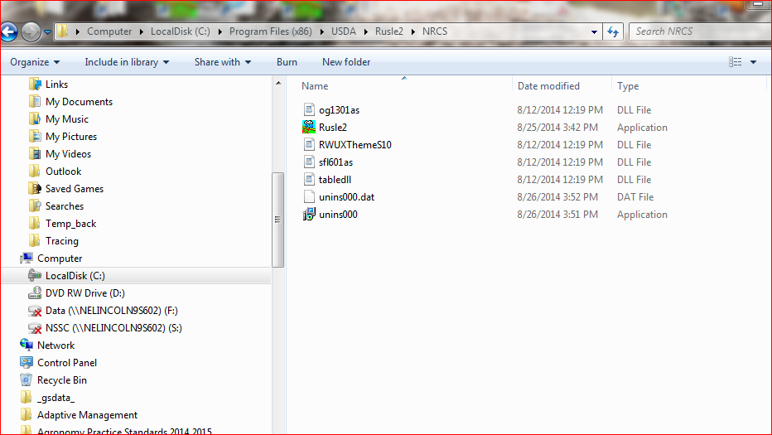
New version loaded at C: Program Files (x86)\USDA in a RUSLE2 folder.

Slide 8
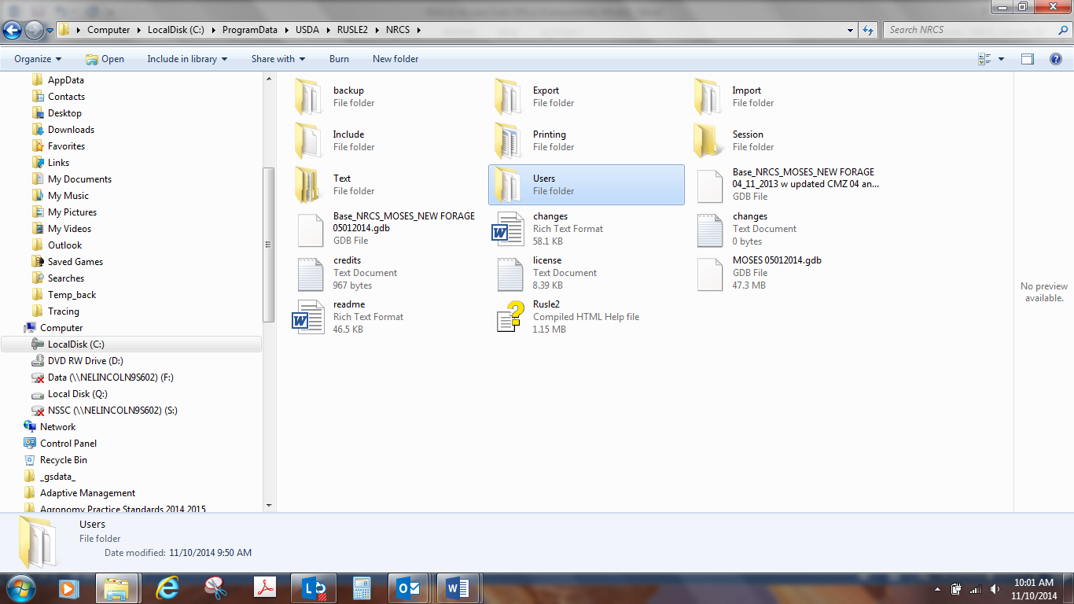
Program Data loaded at C: ProgramData\USDA\RUSLE2\NRCS. Open the folder to get list of files below

Slide 9
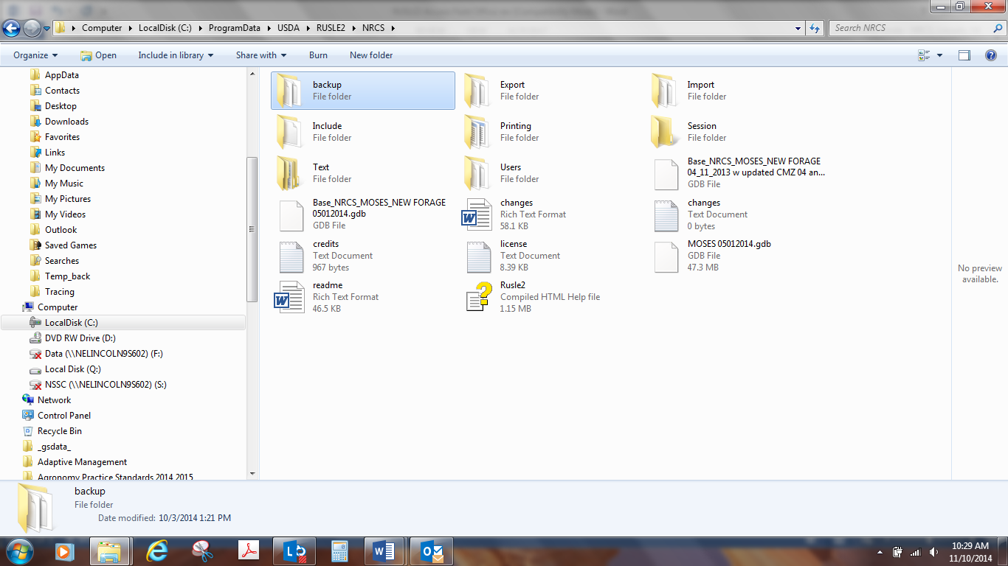
If you have your working moses database on your C: drive,
The moses database that you have been working on should have been automatically backed up to the backup folder in the new version:

Slide 10
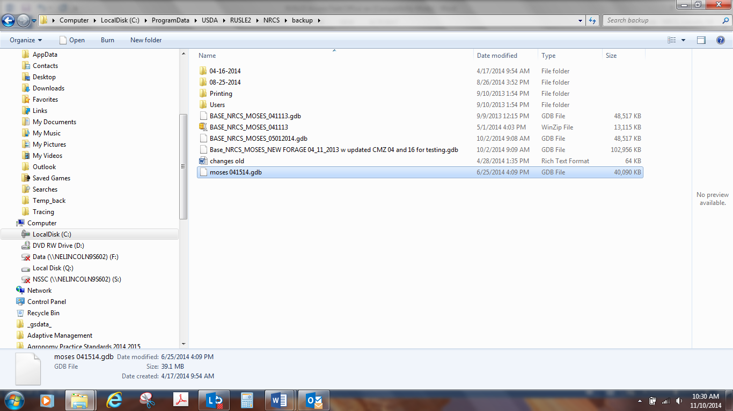
If you have your working moses database on your C: drive,
Go to backup folder, find your working moses database, right click and copy

Slide 11
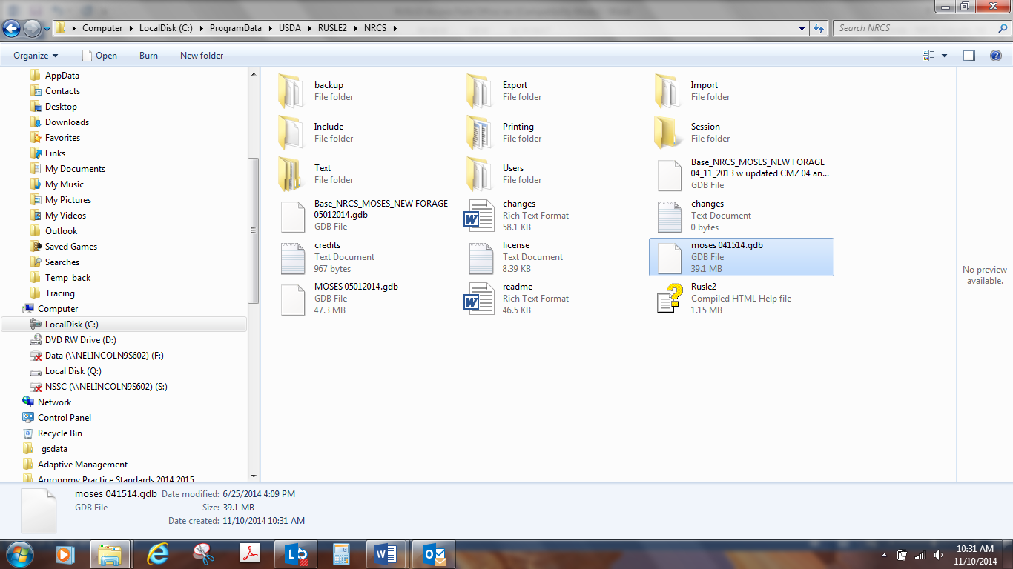
If you have your working moses database on your C: drive,
Go to your root folder where your databases are and right click, paste.You will need to go to RUSLE2, right click on lower right corner, open alternate database and browse to the moses database. Then, right click and select startup database.

Slide 12
If you have your working moses database on your S: drive, no automatic backup will have been made
You will have to ensure that your working moses database on the S: drive is accessible and that IT has granted full user control
You will need to go to RUSLE2, right click on lower right corner, open alternate database and browse to the moses database on the share drive. Then, right click and select startup database.

Slide 13
RUSLE2 File Downloading
Topic Slides
Official RUSLE2 Website 14
Downloadable Program (for IT) 16
Base Database “MOSES” 17
Downloading the latest Base Database Updates 18-19
Downloading the Climate Database 20
Downloading the Crop Management Zone Database 21-22
Downloading the Soil Database 23-24
RUSLE2 User’s Guide 25

Slide 14
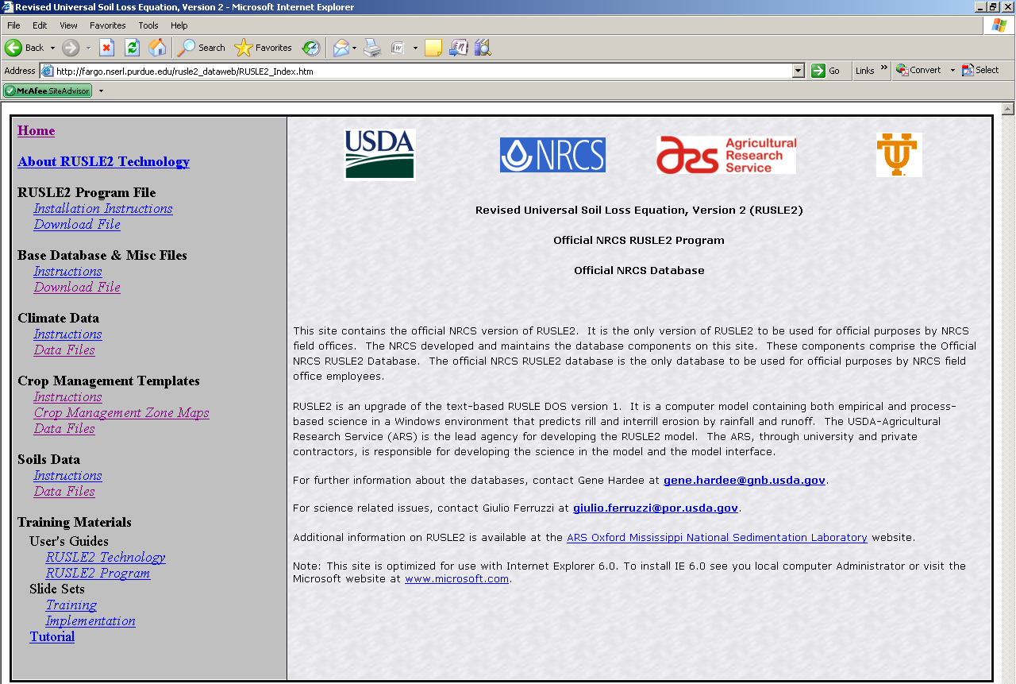
This is the Official RUSLE2 database site.
Contains:
Current software
Current databases
User Guides and Instructions

Slide 15
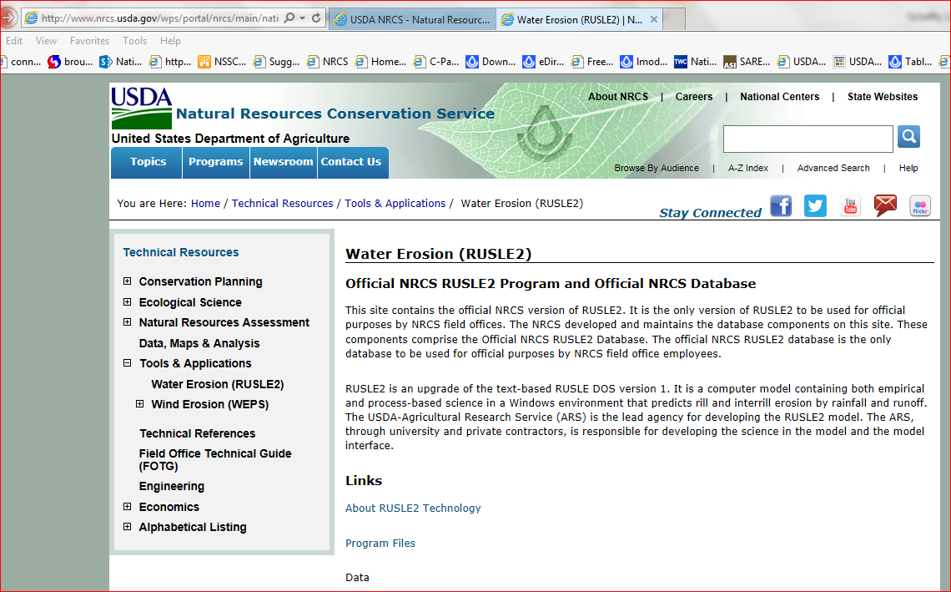
NRCS Website being transitioned to: http://www.nrcs.usda.gov/wps/portal/nrcs/main/national/technical/tools/rusle2/

Slide 16
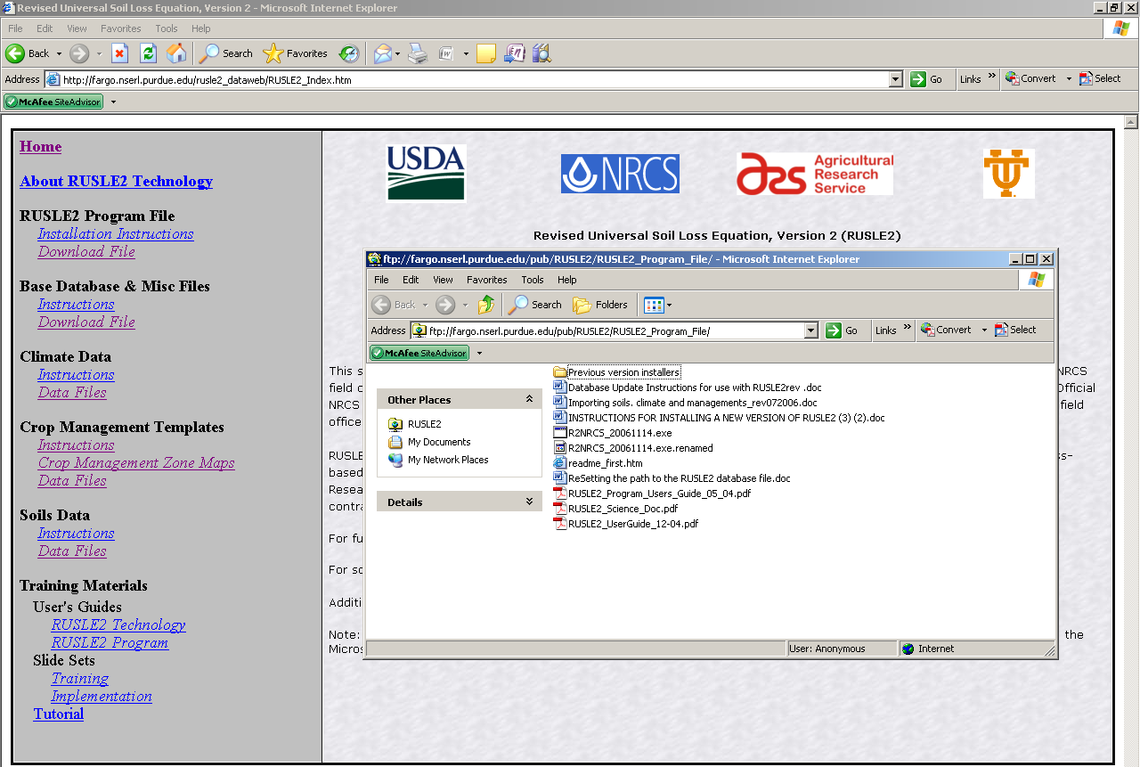
RUSLE2 Program + Base Database (IT will do this step)

Slide 17
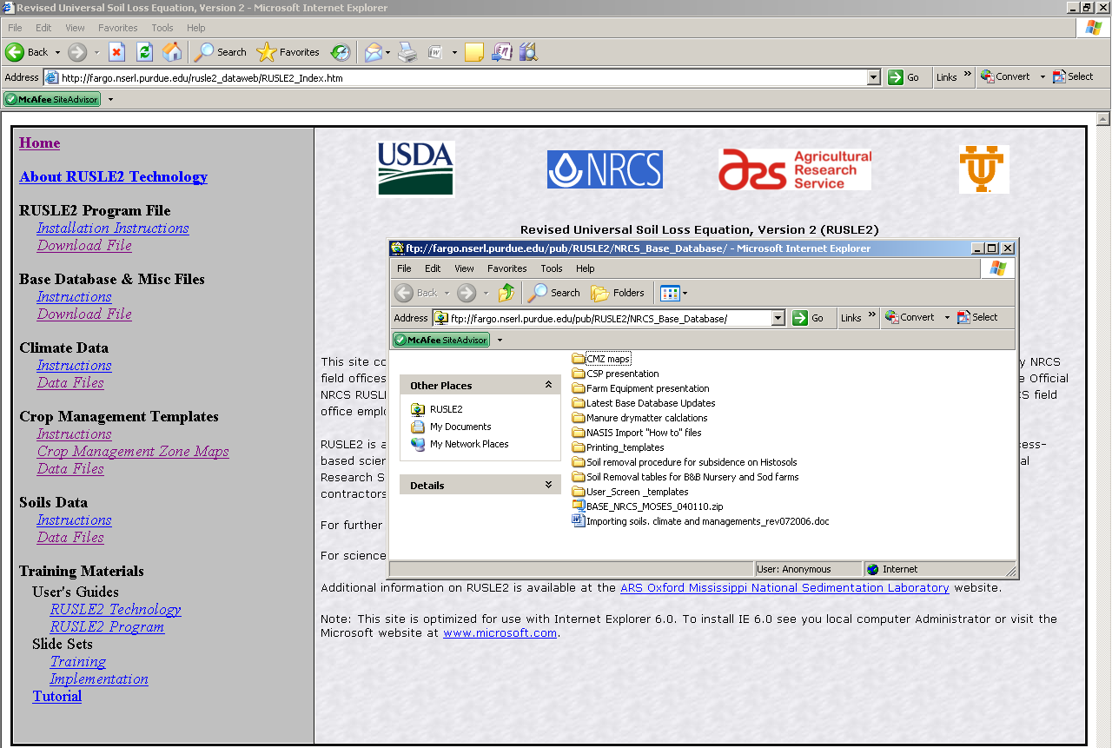
Base Database
And/Or Updates
Save ALL database files in the RUSLE2 “IMPORT” Folder so you can find them easily when it comes time to actually import them into RUSLE2

Slide 18
Open the “Latest Base Database Updates” folder

Slide 19
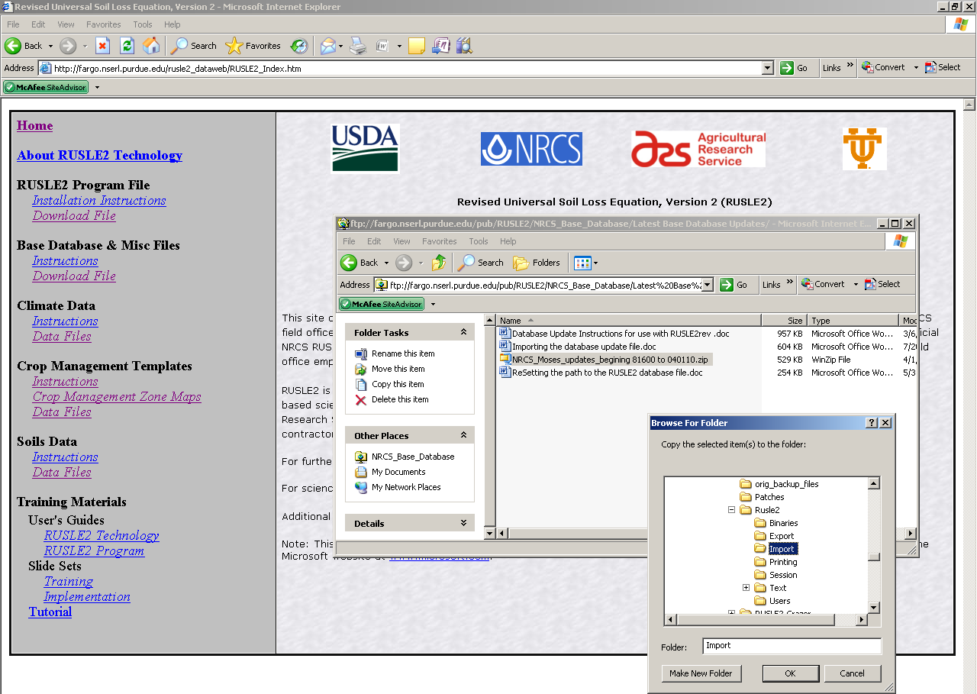
Download to the“Import” Folder

Slide 20
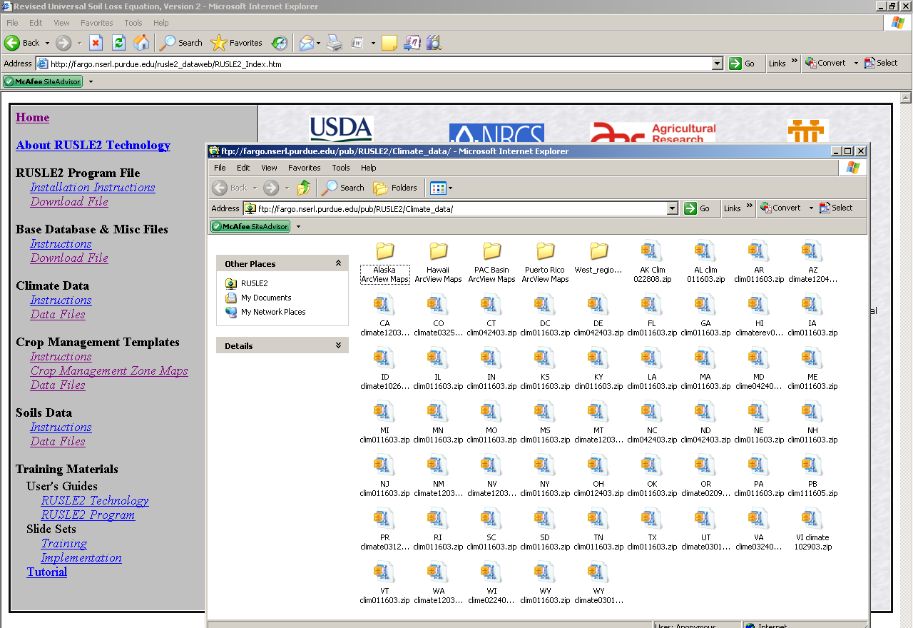
Climate
Download the NM
state file and unzip

Slide 21
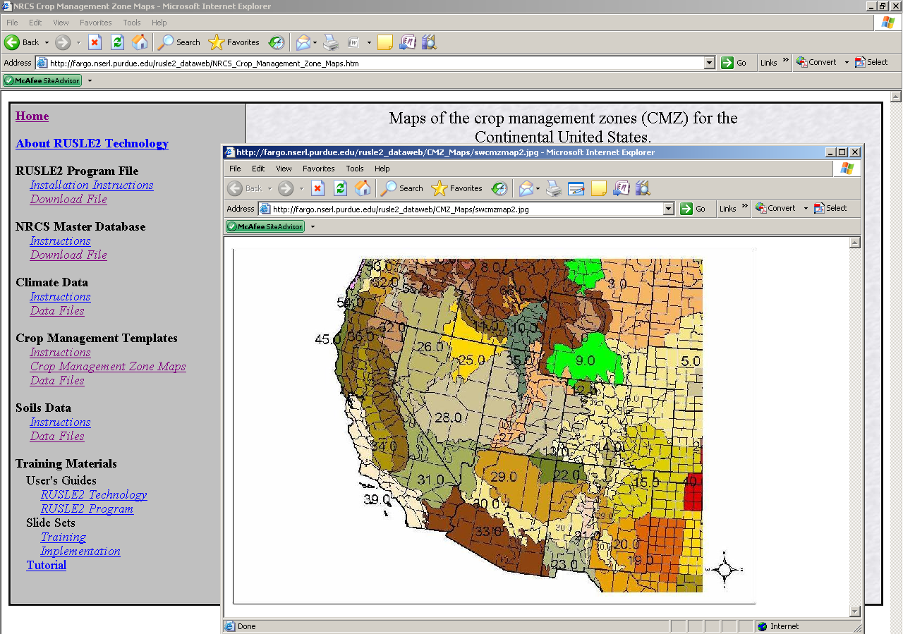

Slide 22
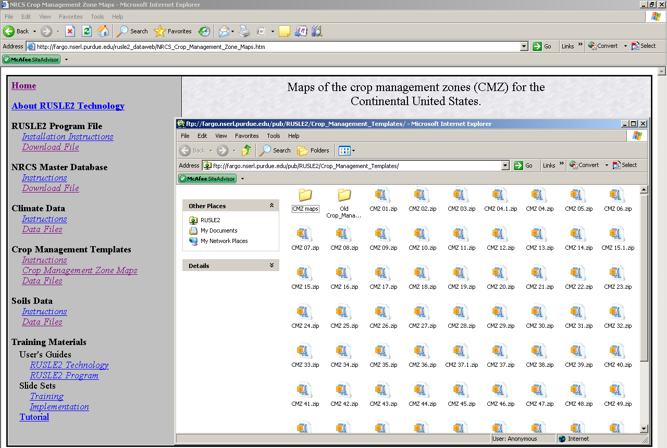
Crop Management Templates
Download appropriate CMZ(s) depending on your location (see map) to the “Import” folder.

Slide 23
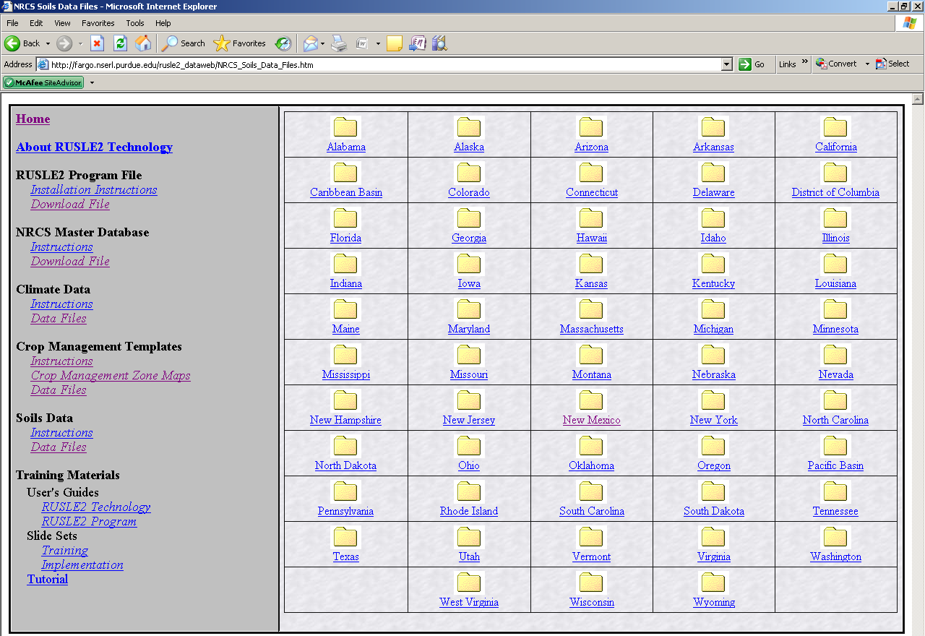
Soils
Double Click to Open “New Mexico” Folder

Slide 24
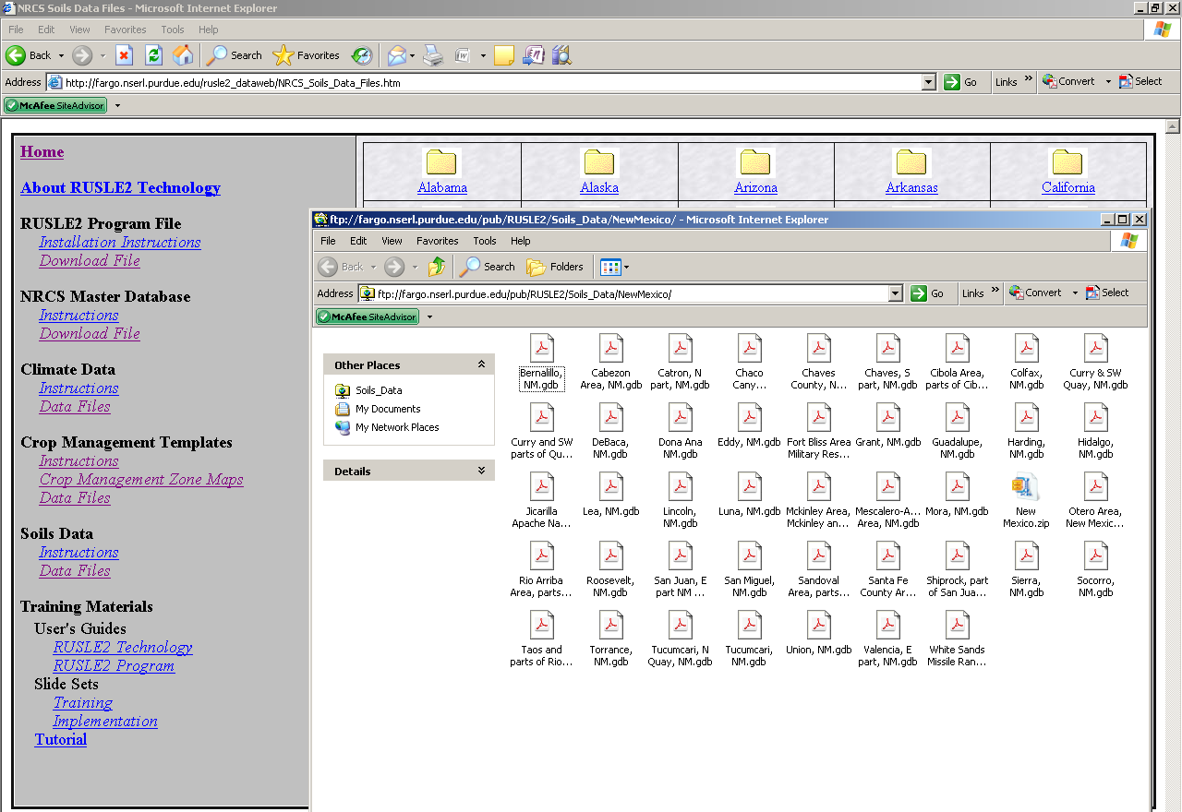
NM by Soil Survey Area
Download one or more Soils Databases to the “Import” folder.

Slide 25
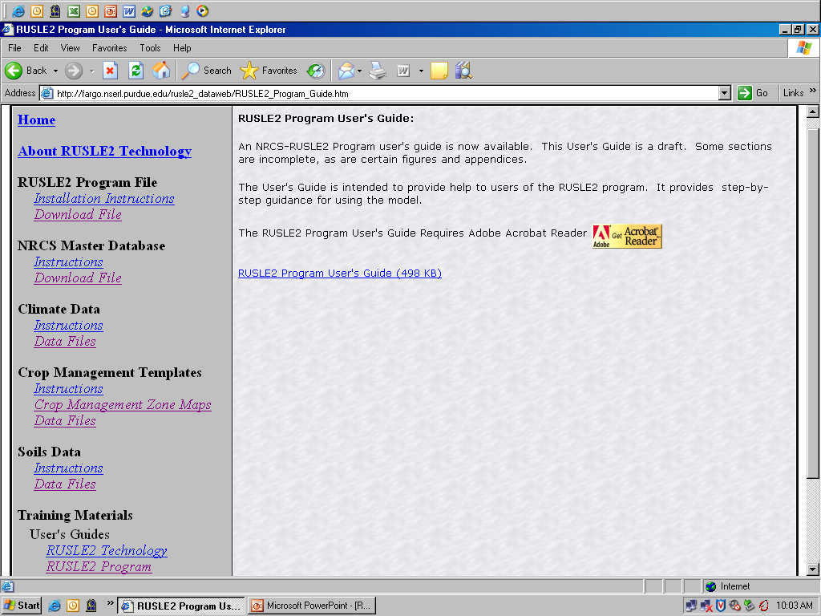
RUSLE2 User’s Guide

Slide 26
RUSLE2 File Importing
Topic Slides
Importing the latest Base Database Updates 27-29
Importing the Crop Management Zone Database 30-31
Importing the Climate Database 32-33
Importing the Soil Database (Not shown but done in the same way as other imports)

Slide 27
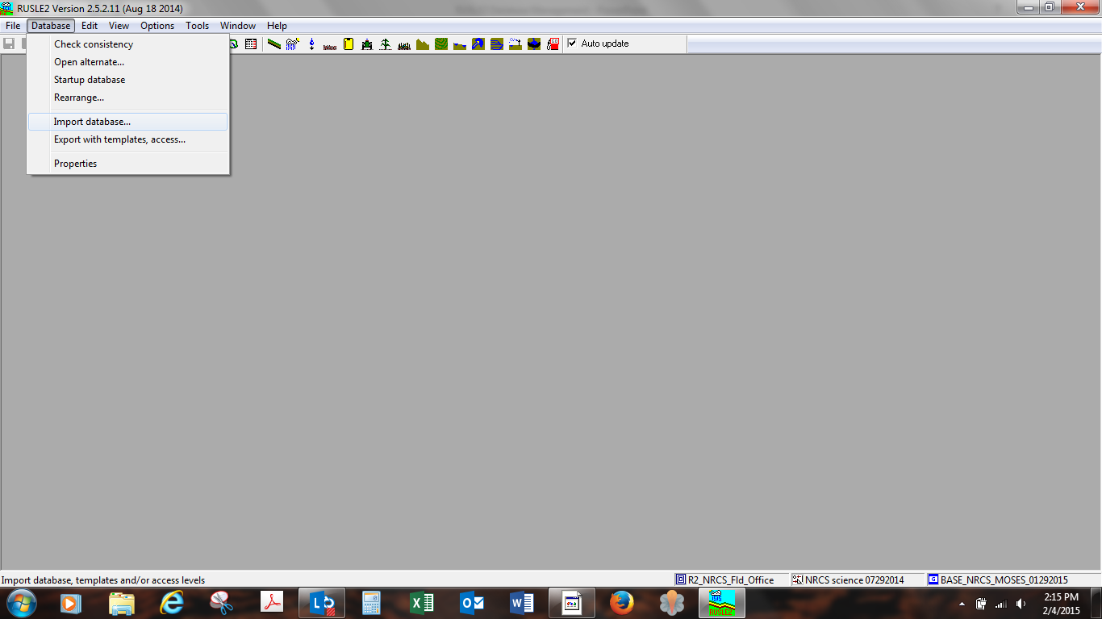
Select
“Import RUSLE2 database”

Slide 28
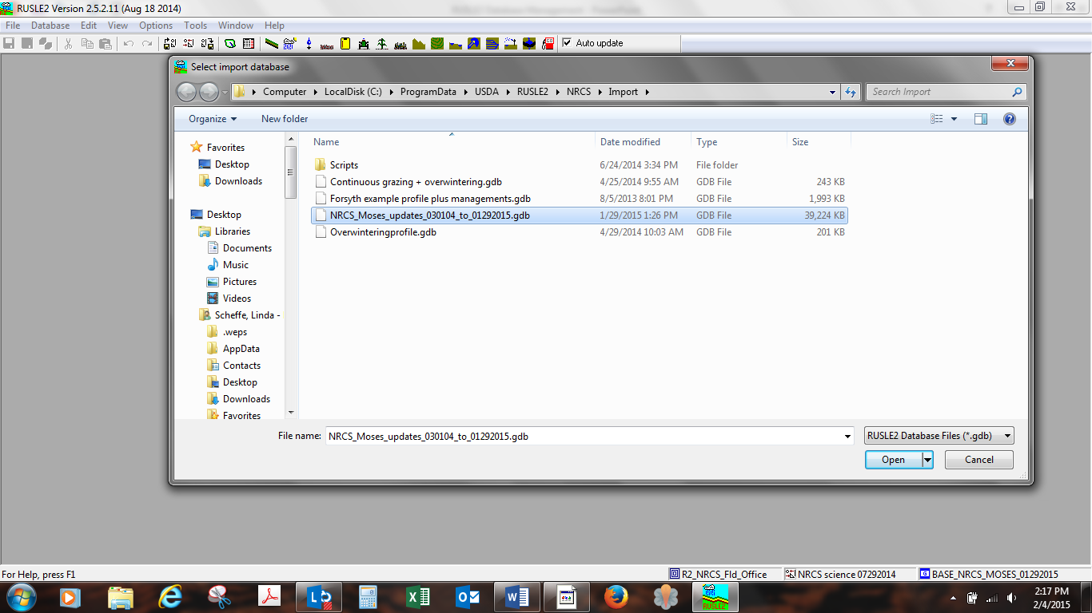
Select Database to Import
Ex. NRCS_Moses_updates_030104to01292015.gdb
Click OPEN

Slide 29
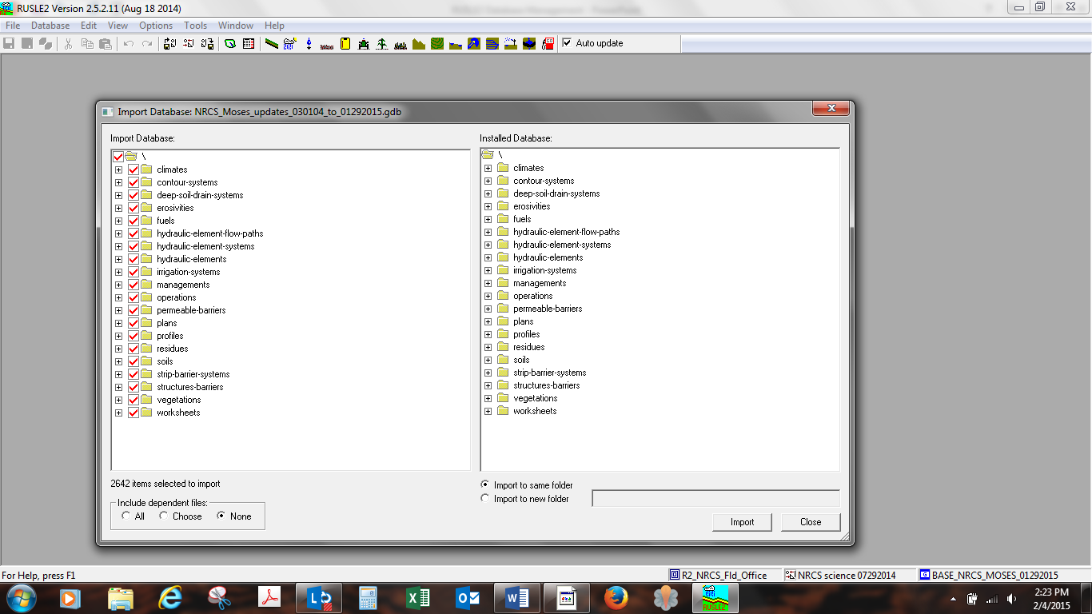
1st - When importing a “Base database Updates CHECK ALL BOXES in the “Import Database” side.
3rd - Select – “Import to same folder”
2nd - Check “NONE”
4th - Click on “Import”

Slide 30
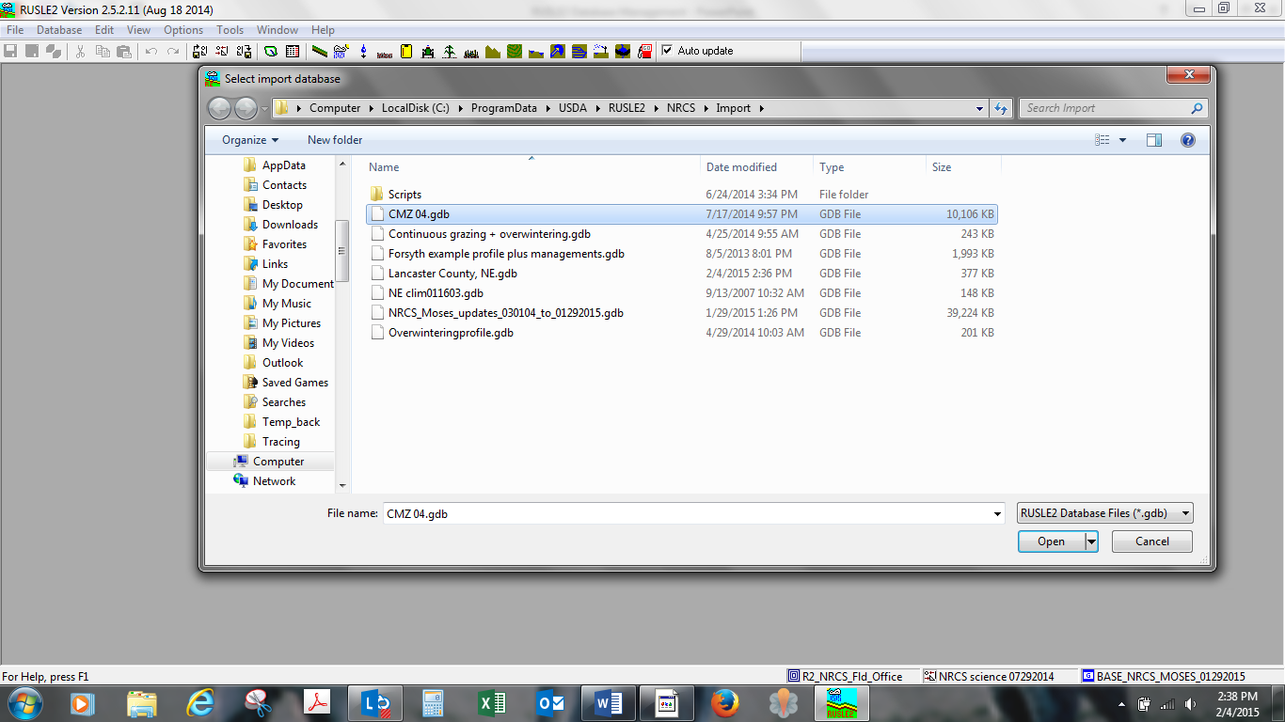
Importing a Crop Management Zone Database Ex. CMZ 04
Click OPEN

Slide 31
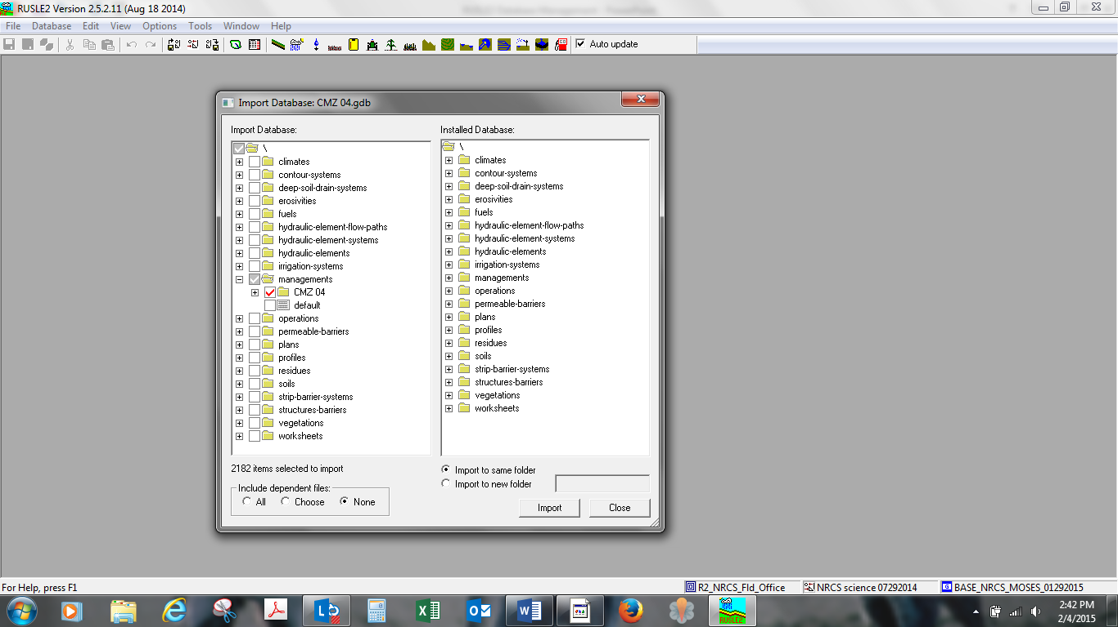
1st - For CMZ “Management” databases Select “Managements”
3rd - Import to same folder
4th - Click on IMPORT
2nd - Select “NONE”

Slide 32
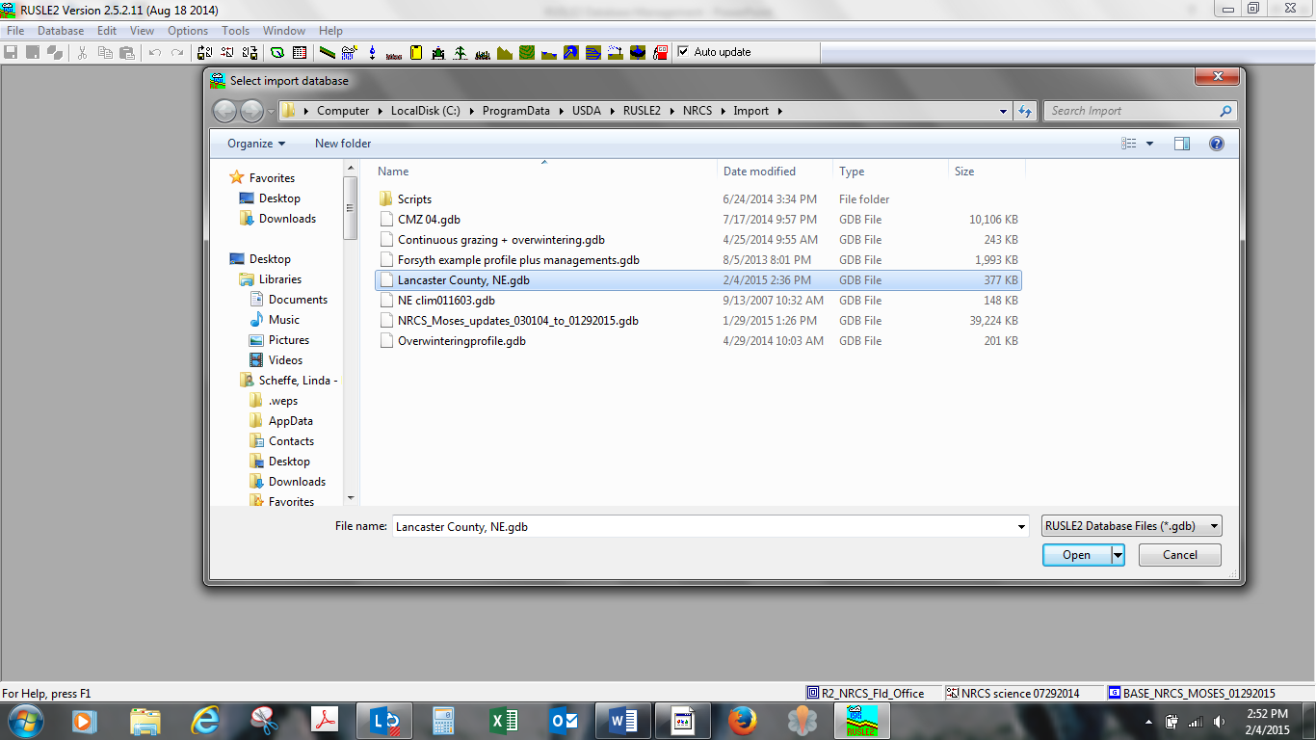
Importing NE Climate Database
Click OPEN

Slide 33
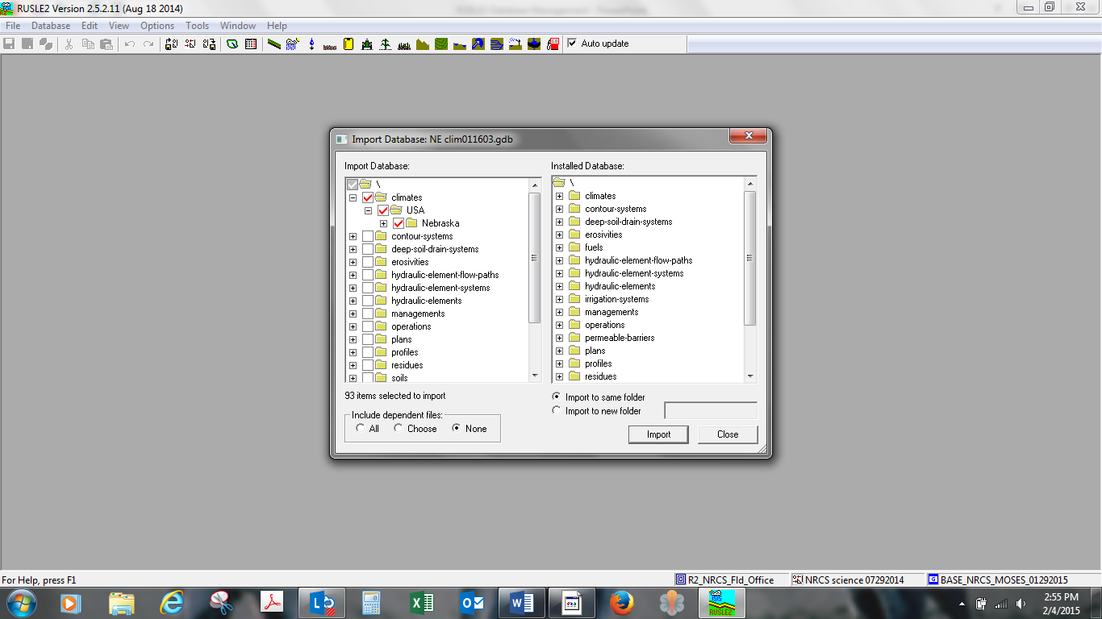
1st - When importing Climate databases Check “Climate and State” and you can even drill into the individual county or counties that you want, excluding unwanted counties.
2nd - Check NONE
3rd - Click on IMPORT

Slide 34
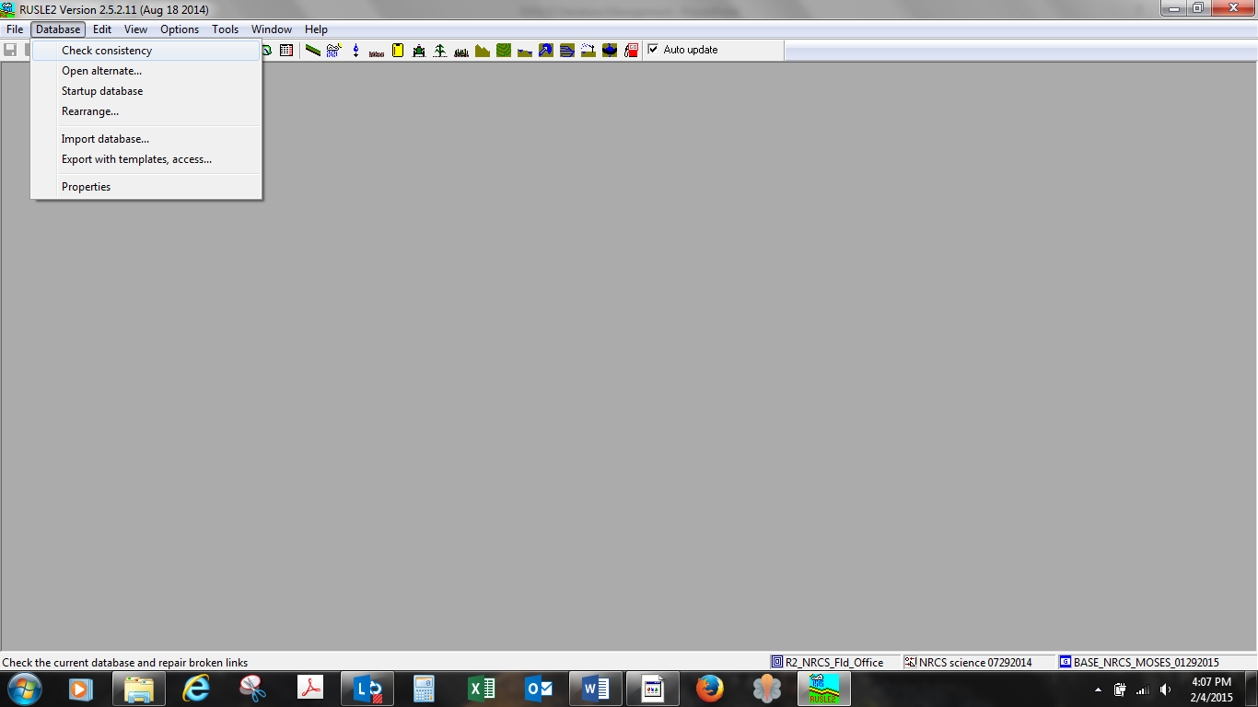
Do a check consistency to make sure there are no broken links especially after importing local c folder managements, profiles, worksheets, and plans.

Slide 35
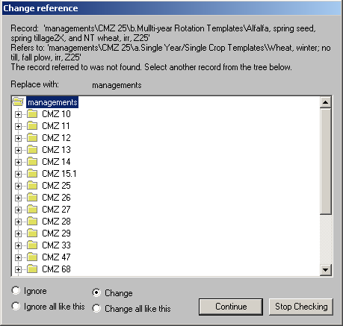
You should get a warning that another record that depended on the renamed record can no longer find that record and R2 cannot complete the database without a broken link.

Slide 36
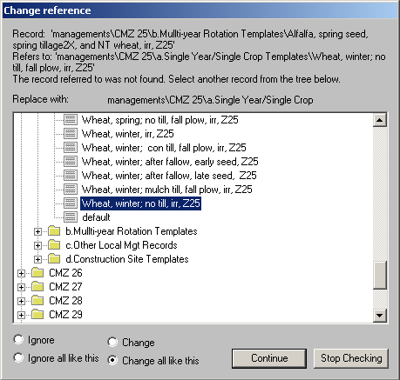
You must manually reconnect the renamed record to the dependent record by selecting the new record in the database, choosing the “Change all like this” option so that all records looking for the old, deleted record will be replaced with the new, renamed record and then click “Continue”.

Slide 37
Make sure that EVERY broken link is reconnected to an appropriate replacement record. If you are unsure how to correct a broken link, click “stop checking” at the bottom of the window and call a RUSLE2 support staff or the state agronomist to help you fix the broken links BEFORE ever using RUSLE2.

Slide 38
RUSLE2 File Exporting
Exporting records into databases that can be e-mailed.

Slide 39
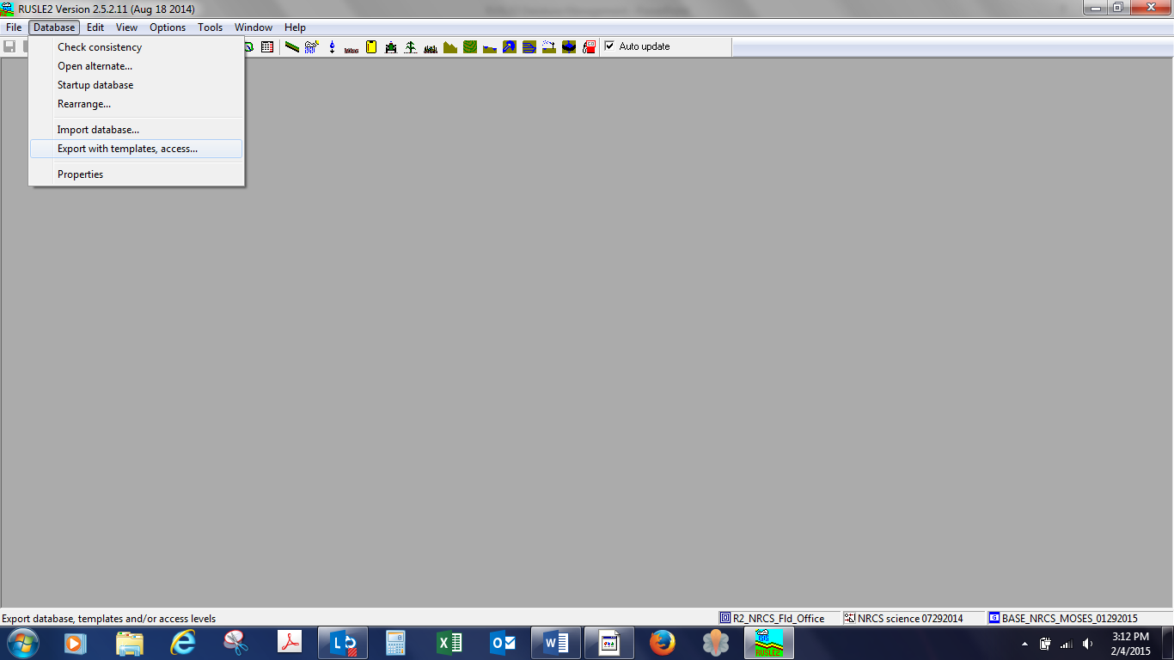
To Export Records – Select “Export with templates, access…”

Slide 40
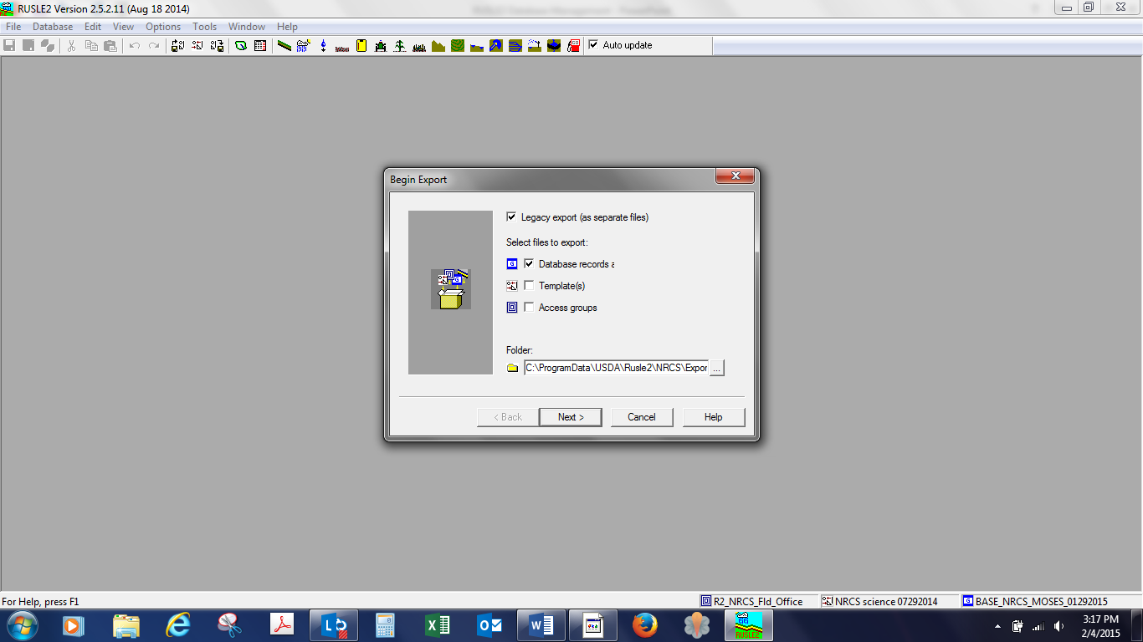
This will Export your desired database to the RUSLE2/Export Folder
To Export Databases:
1st – Check Database.
2nd - Click NEXT to proceed.

Slide 41
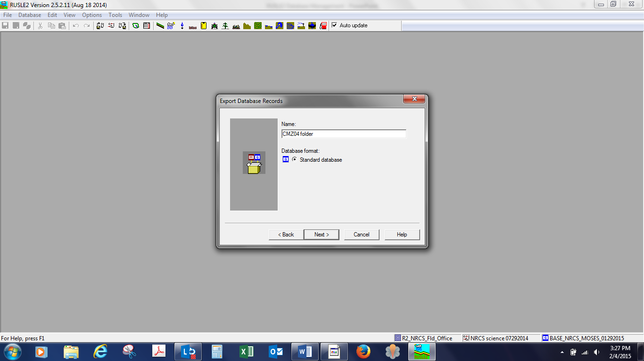
This is where you name the database you wish to Export.
Ex. CMZ04 folder
After entering the file name – Click NEXT

Slide 42
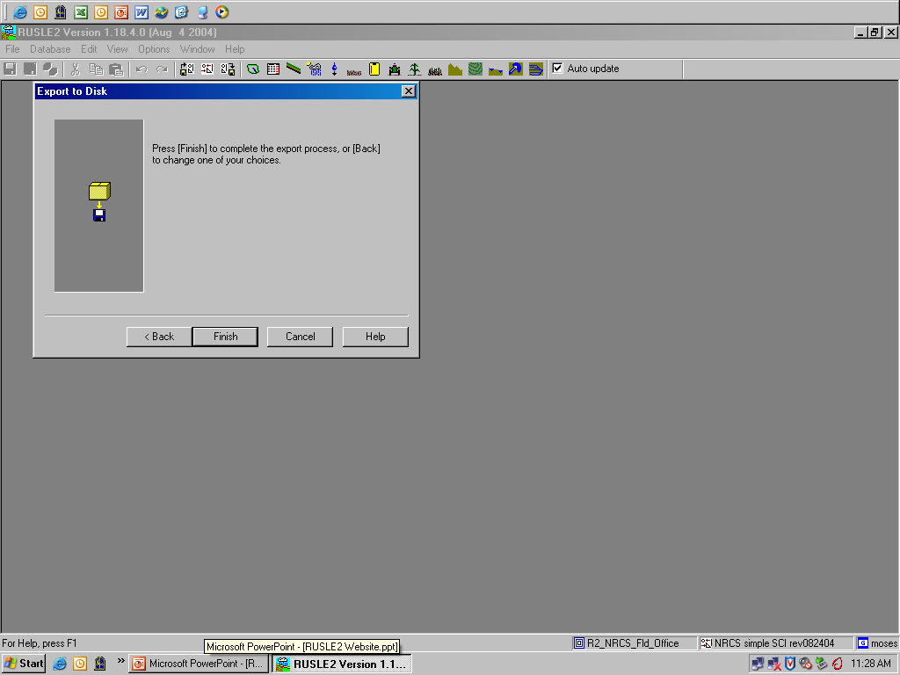
Click on FINISH to proceed.

Slide 43
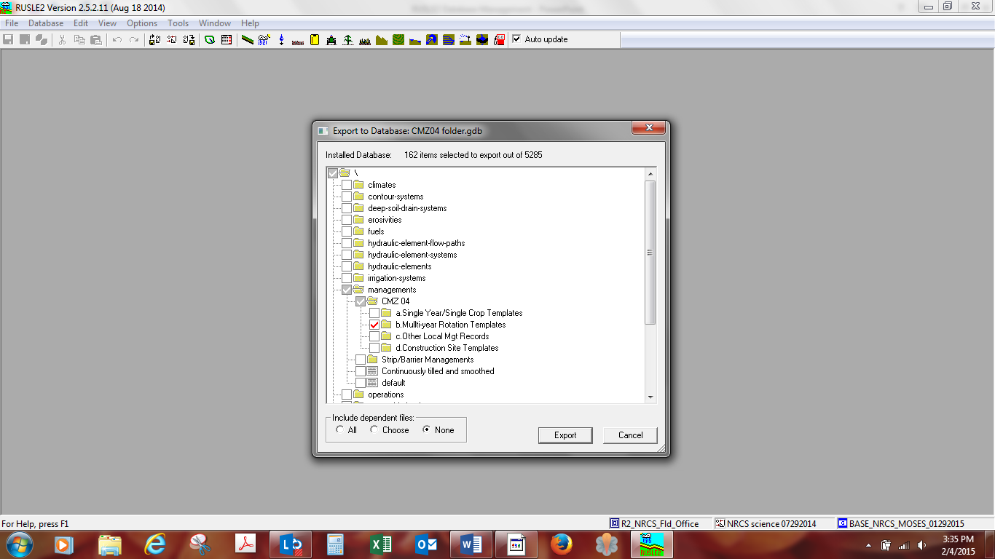
1st - Since we want to export management files we open the management folder and select the files we wish to export.
Ex. CMZ 04 and the entire b. Folder Multi-year Rotation Templates.
2nd - Check NONE if you are sending a record you have created. Check ALL ONLY if you are creating an export of a problem record or records
3rd – click EXPORT

Slide 44
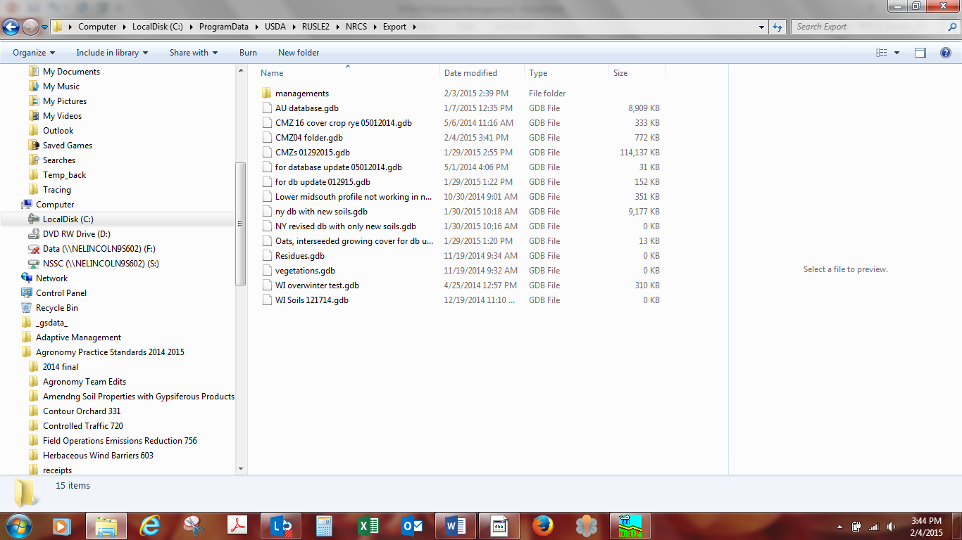
Open “Windows Explorer” and navigate to the RUSLE2/Export Folder
You should see the file database that you just exported.
At this point you can email this database to the state agronomist. The state agronomist will then go through the process of saving it to their RUSLE2 “import” folder then importing it into their RUSLE2 database. Never swap files between field offices without informing the state agronomist!!

