Slide 1
RUSLE2
Other New Results
New functionality in the model to report other selected results.
Giulio Ferruzzi, WNTSC Agronomist (NRCS RUSLE2 science lead)
Linda Scheffe, NSSC Agronomist (NRCS RUSLE2 database manager)
Steve Boetger, ENTSC Agronomist
Steve Woodruff, ENTSC Agronomist/Forage Specialist

Slide 2
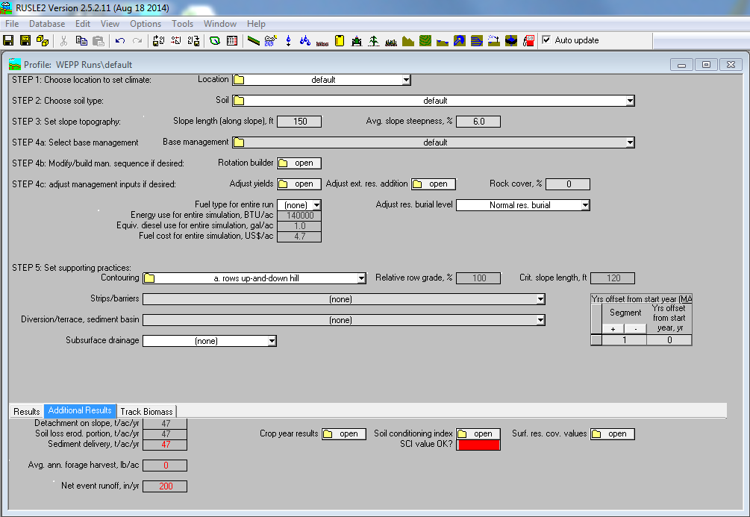
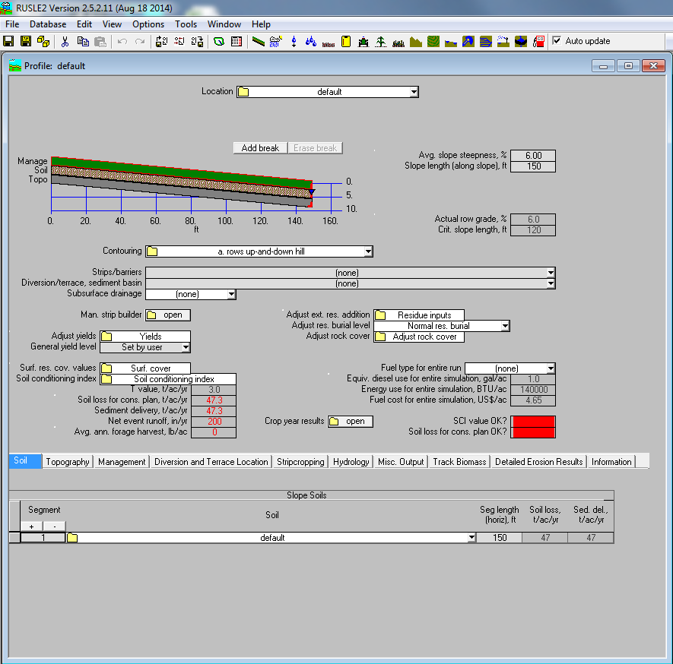
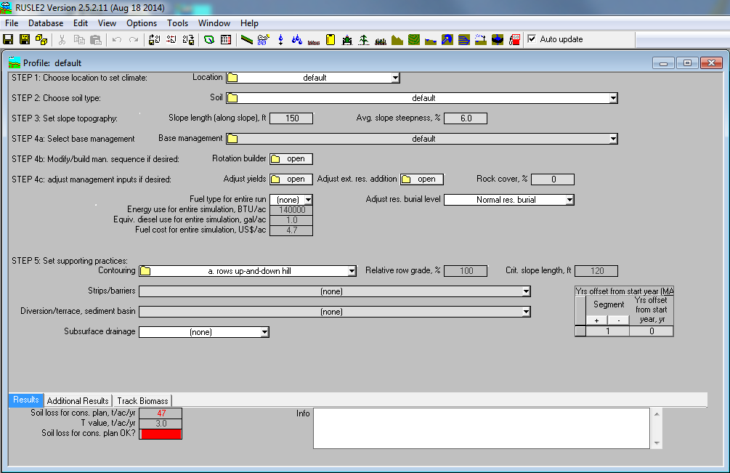
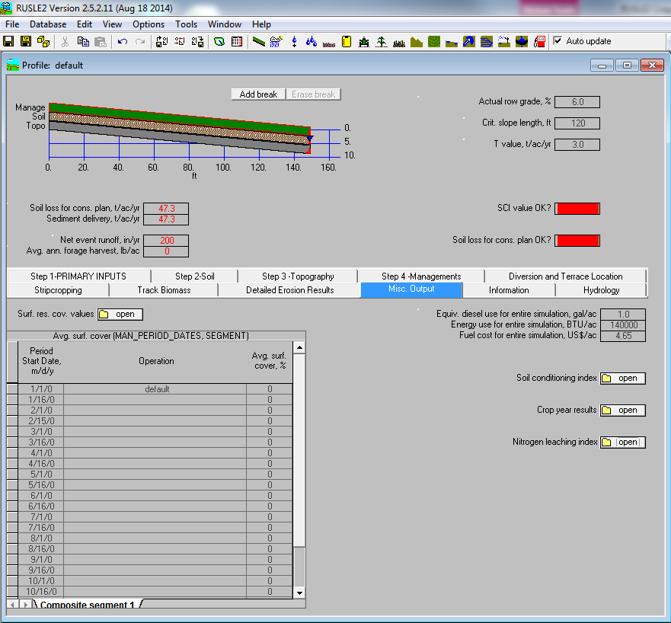
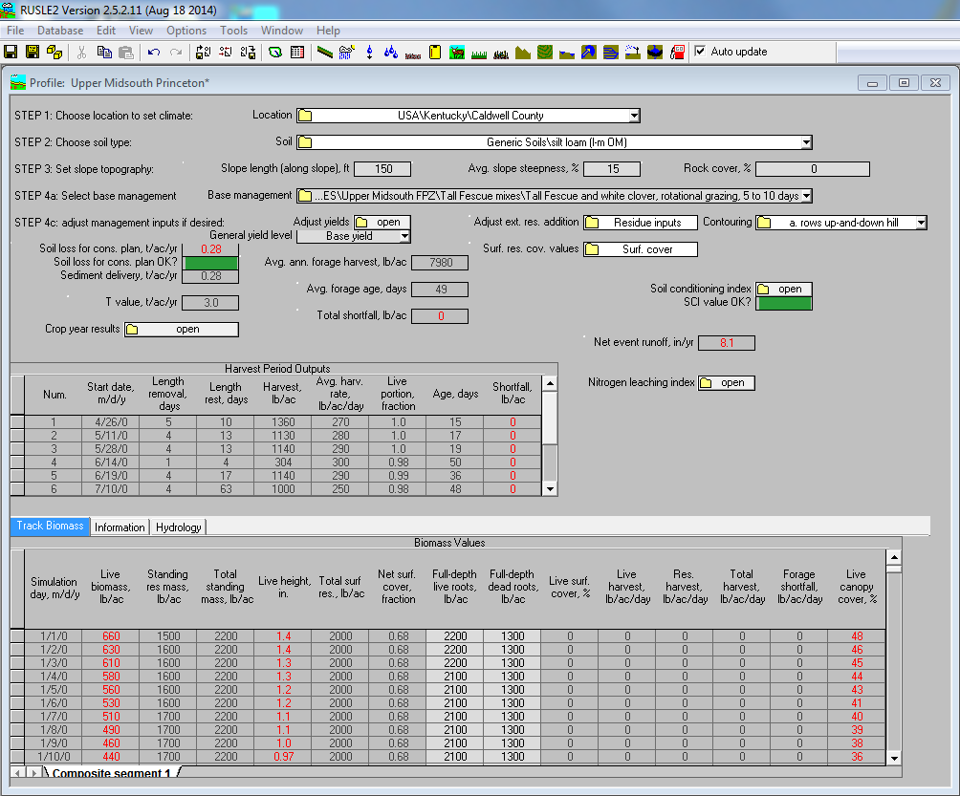
How do you view the new results?

Slide 3
How do you view the new results?
This is an output graphic. When the calculated SCI value for the profile run is 0.2 or greater, the cell will display green. If the calculated SCI value for the profile run is between 0.2 and -0.2 the cell will display yellow. Lastly, if the calculated SCI value for the profile run is -0.2 or less, the cell will display red.
This is an output graphic. When the calculated soil loss for cons. plan value for the profile run is 2T or greater, the cell will display red. If the calculated soil loss for cons. plan value for the profile run is between T and 2T the cell will display yellow. Lastly, if the calculated soil loss for cons. plan value for the profile run is T or less, the cell will display green.
The average annual runoff leaving the last segment of a hillslope. The value is calculated as the summation of runoff amounts for all simulated events divided by the number of years in the rotation or non-rotation simulation period. This is the runoff equivalent of sediment delivery at the downslope end of the last segment.
The average annual difference between forage demand and forage consumption. Forage shortfall is only calculated for operations that use a forage removal method specifying rate and time on, and is the sum of the shortfalls for each day. Shortfall is calculated only for these removal methods because when forage harvest is based on height or utilization portion, forage removal stops when the criterion to end a grazing period is met, so there is no shortfall.

Slide 4
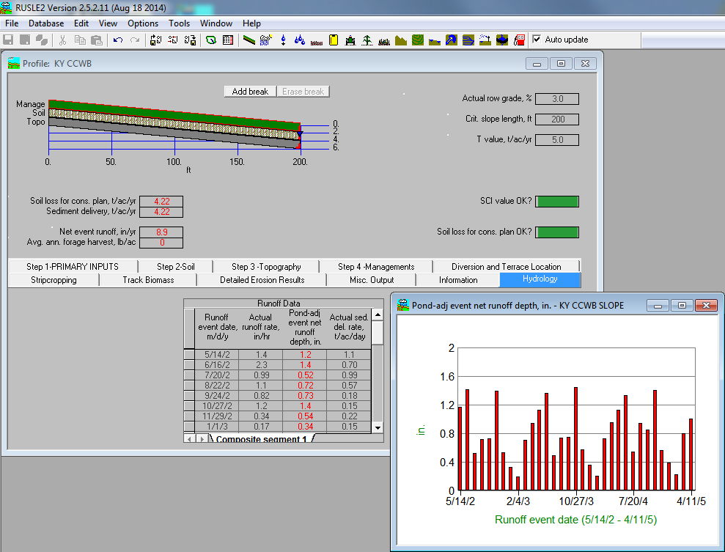
How do you view the new results?
This is the tab where the detailed runoff data resides and can be graphed.

Slide 5
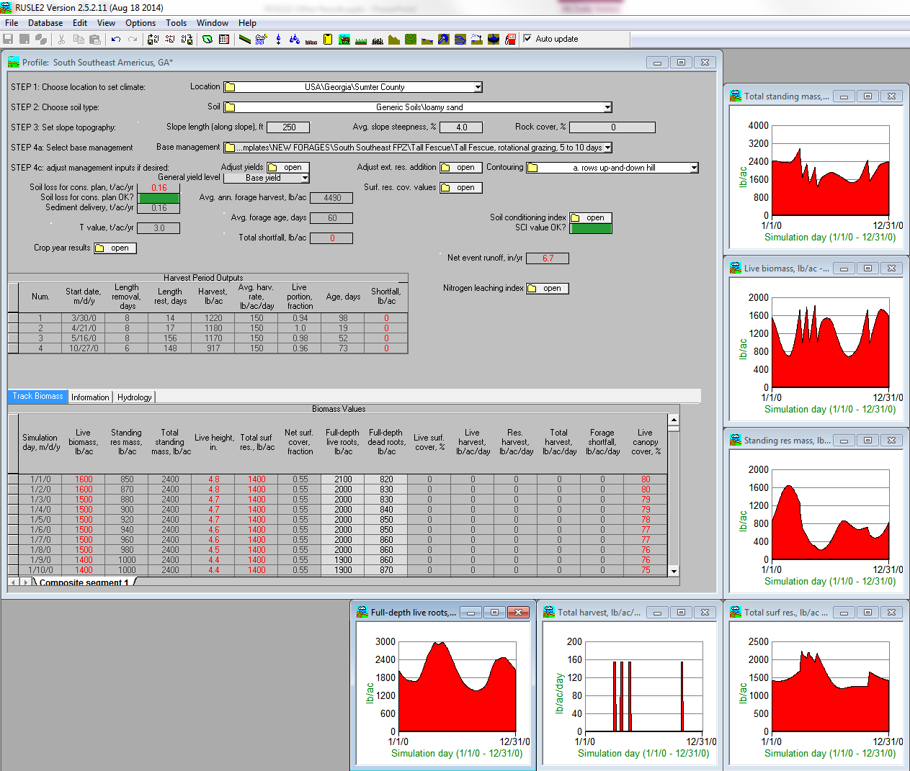
How do you view the new results?
Average annual sum of all live above ground biomass and standing residue harvested as forage.
The mass weighted average age of live and dead herbage removed as forage, where the age of harvested standing dead residue is set equal to the lifespan of the forage that produced the standing dead residue.
The average annual difference between forage demand and forage consumption. Forage shortfall is only calculated for operations that use a forage removal method specifying rate and time on, and is the sum of the shortfalls for each day. Shortfall is calculated only for these removal methods because when forage harvest is based on height or utilization portion, forage removal stops when the criterion to end a grazing period is met, so there is no shortfall.

Slide 6
Why is this important?
SCI & Soil Loss Graphics make soil condition and erosion status quick to identify by color.
New perennial vegetation parameters help to better model rotations with grazing and haying.
Runoff values help compare differences in the amount of rain infiltration. In times of drought, having the rotation with higher infiltration will mean more available water for the crop.

Slide 7

Questions?
If I have a RUSLE2 question, who do I call?

