Slide 1
RUSLE 2 Database Management*
* This presentation was originally produced by Dave Lightle (NSSC Agronomist, retired) and subsequently edited and presented by Steve Boetger (ENTSC Agronomist), Giulio Ferruzzi (WNTSC Agronomist and NRCS RUSLE2 science lead & database manager), Linda Scheffe (NSSC Agronomist, retired), and Steve Woodruff (ENTSC Agronomist/Forage Specialist).

Slide 2
RUSLE 2 Database Management
This PowerPoint Presentation* will walk you through the necessary steps to SET-UP or UPDATE your RUSLE2 database.

Slide 3
RUSLE2 Database Maintenance
Topic Slides
Frequency of Database Maintenance Schedule 4
Archiving Database Schedule and Locations 5
Archiving Database Instructions 6
Where Version Loaded and Reconnecting Working
Moses Database 7-12

Slide 4
Program/ Database | Install during first time use | Check for new update monthly | Check for new update every 6-12 months | Check for new update if a special request was made | Update when instructed to do so by the State Agronomist
RUSLE2 Program | * |  |  |  | *
Base Database Updates |  |  |  |  | 
Crop Management Zone |  |  |  |  | 
Climate |  |  |  | 
Soil |  |  |  |  | 
* Can be installed from the Software Center. When new versions are released, the new version will replace the current version on your machine.

Slide 5
Archiving the moses.gdb database
At least once a year.
Additionally as instructed by the State Office.
Follow State Office Guidance and Instructions.
By default, located and installed in C:\ProgramData\USDA\RUSLE2\NRCS\
The database can be located on the S:\Service_Center\NRCS\RUSLE2\ however,make sure that IT has provided full control to users.
The database can also be located similarly in OneDrive.

Slide 6
Database Archiving Instructions
Copy your current “moses.gdb” database that could be located in:
C:\ProgramData\USDA\RUSLE2\NRCS\
S:\Service_Center\NRCS\RUSLE2\, or
OneDrive\...
into
C:\ProgramData\USDA\RUSLE2\NRCS\backup\
S:\Service_Center\NRCS\RUSLE2\archives\, or
OneDrive\...\archives\
Respectively.
Rename the “moses.gdb” database in your archives folder to “moses XX-XX-20XX.gdb” where XX-XX-20XX is the date which you archived your database so that it will not get overwritten the next time you archive the database.

Slide 7
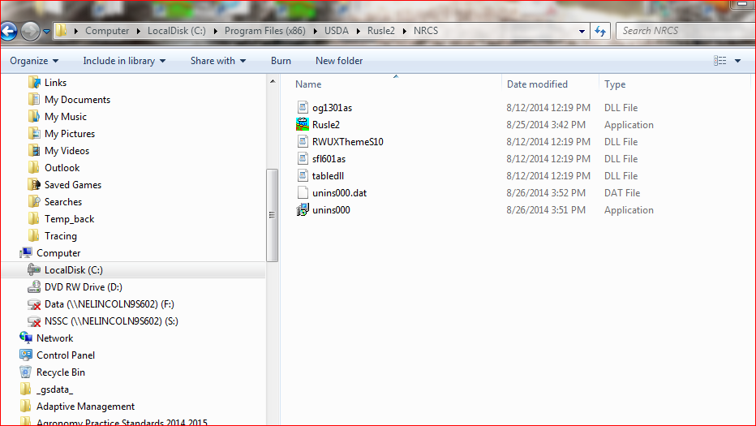
New version loaded at C: Program Files (x86)\USDA in a RUSLE2 folder.

Slide 8
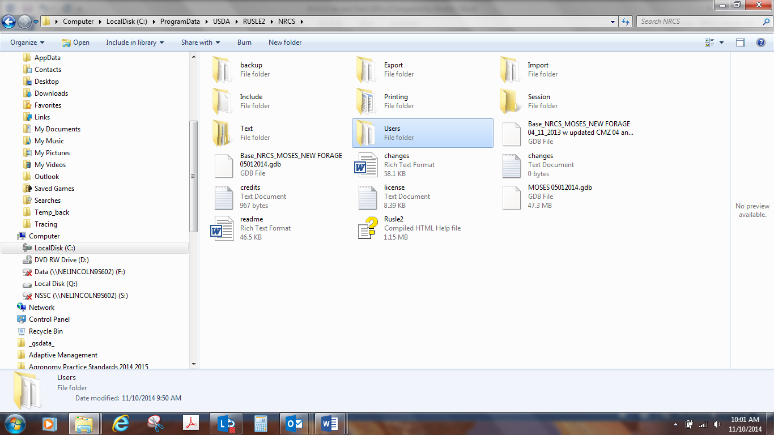
Program Data loaded at C: ProgramData\USDA\RUSLE2\NRCS by default. Open the folder to get list of files below

Slide 9
If you have your working moses database on your C: drive, The moses database that you have been working on should have been automatically backed up to the backup folder when RUSLE2 is updated to a new version:

Slide 10
If you have your working moses database on your C: drive, Go to backup folder, find your working moses database, right click and copy

Slide 11
If you have your working moses database on your C: drive, Go to your root folder where your databases are and right click, paste.You will need to go to RUSLE2, right click on lower right corner, open alternate database and browse to the moses database. Then, right click and select startup database.

Slide 12
If you have your working moses database elsewhere, no automatic backup will have been made
You will have to ensure that your working moses database at your alternate location is accessible and that IT has granted full user control
You will need to go to RUSLE2, right click on lower right corner database icon, select open alternate database and browse to the moses database in the alternate location. Once switched, right click on lower right corner database icon and select startup database.

Slide 13
RUSLE2 File Downloading
Topic Slides
Official RUSLE2 Website 14
Downloadable Program (for IT) 16
Base Database “MOSES” 17
Downloading the latest Base Database Updates 18-19
Downloading the Climate Database 20
Downloading the Crop Management Zone Database 21-22
Downloading the Soil Database 23-24
RUSLE2 User’s Guide 25

Slide 14
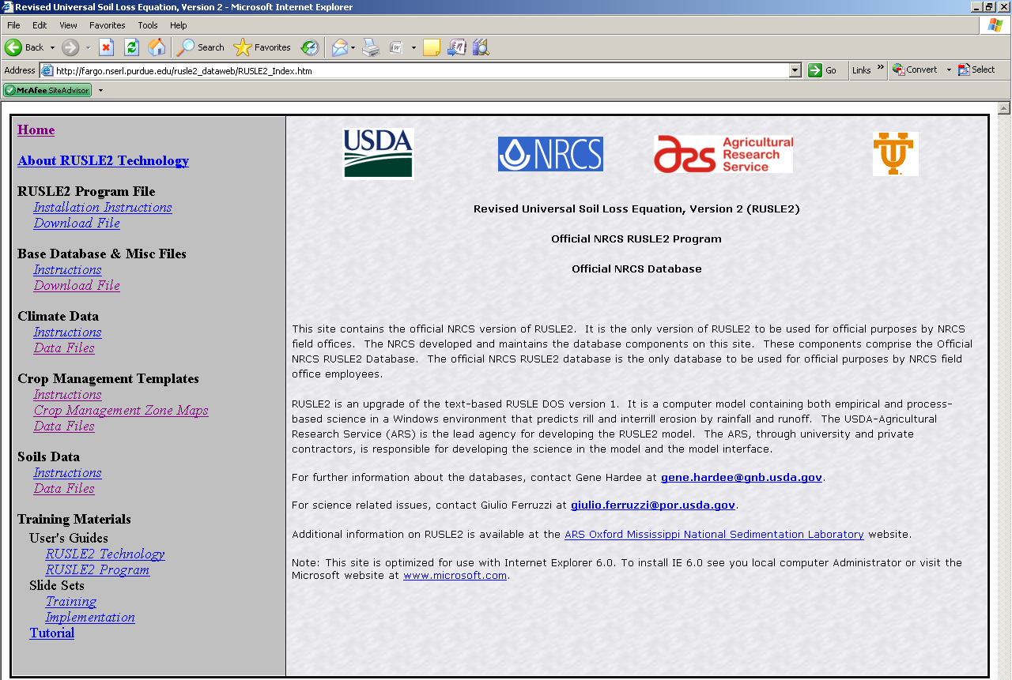
This is the “Purdue” RUSLE2 database site.
Contains:
Current software
Current databases
User Guides and Instructions

Slide 15
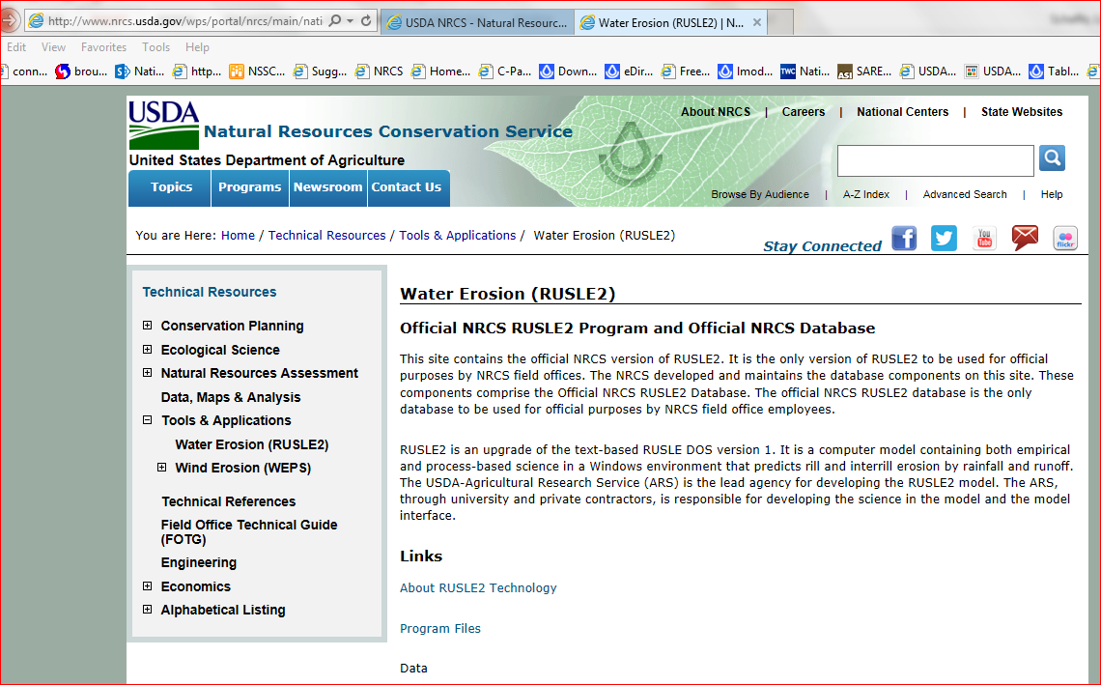
NRCS Website being transitioned to: http://www.nrcs.usda.gov/wps/portal/nrcs/main/national/technical/tools/rusle2/

Slide 16
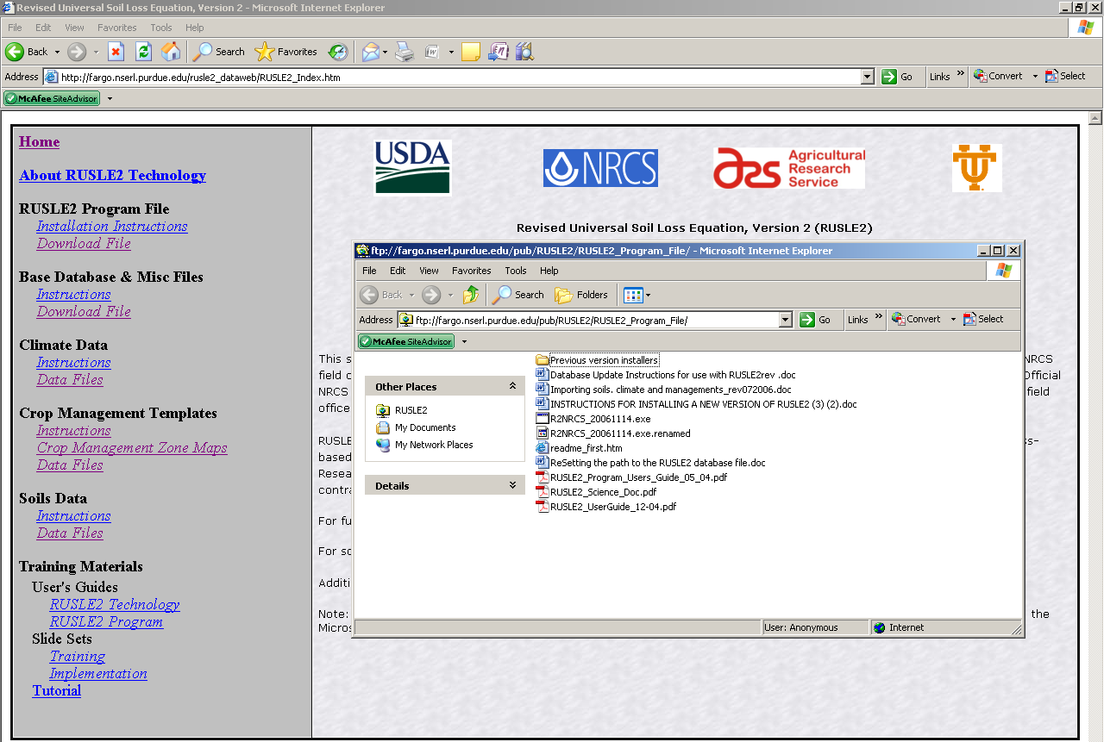
RUSLE2 Program + Base Database for TSPs (NRCS employees will get this from the software center).

Slide 17
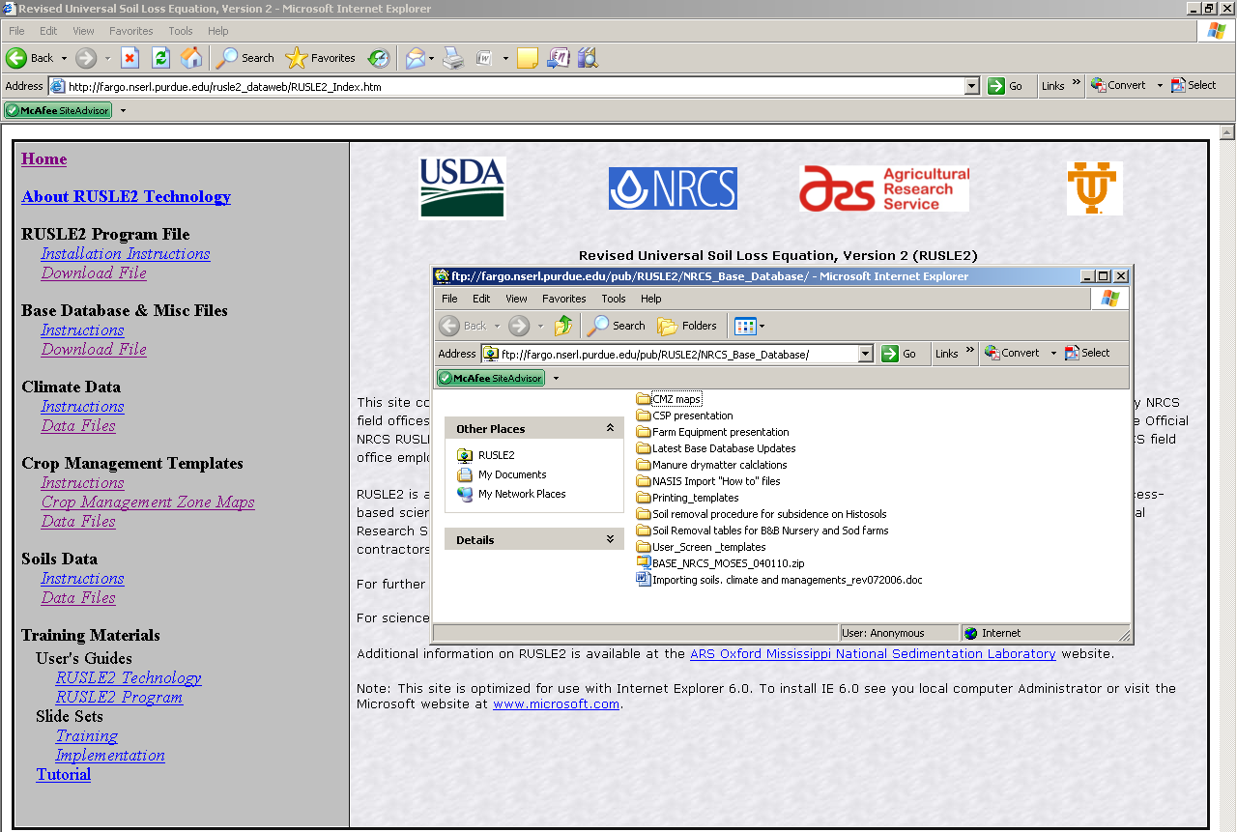
Base Database
And/Or Updates
Save ALL database files in the RUSLE2 “IMPORT” Folder so you can find them easily when it comes time to actually import them into RUSLE2

Slide 18
Open the “Latest Base Database Updates” folder

Slide 19
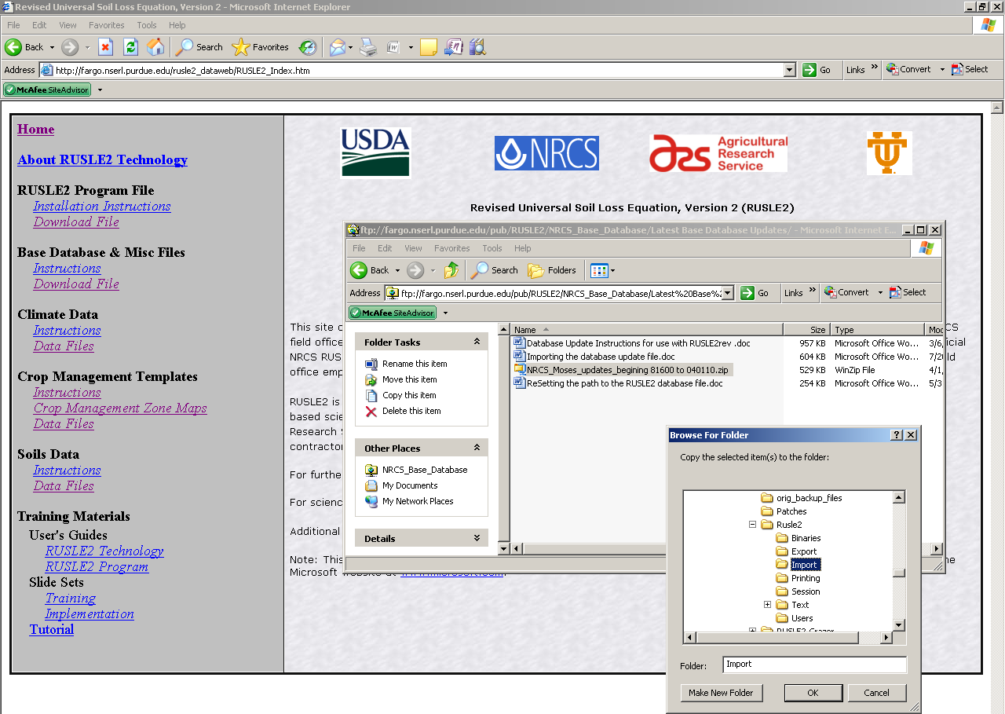
Download to the“Import” Folder

Slide 20
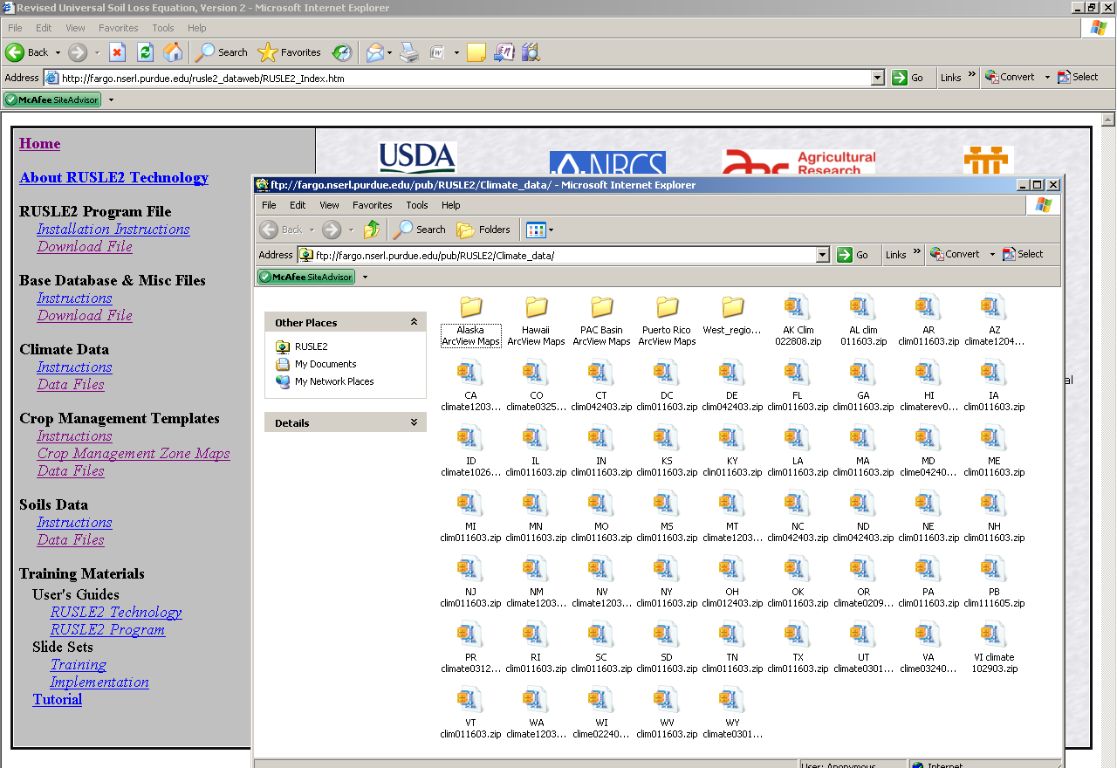
Climate
Download your
state file and unzip

Slide 21
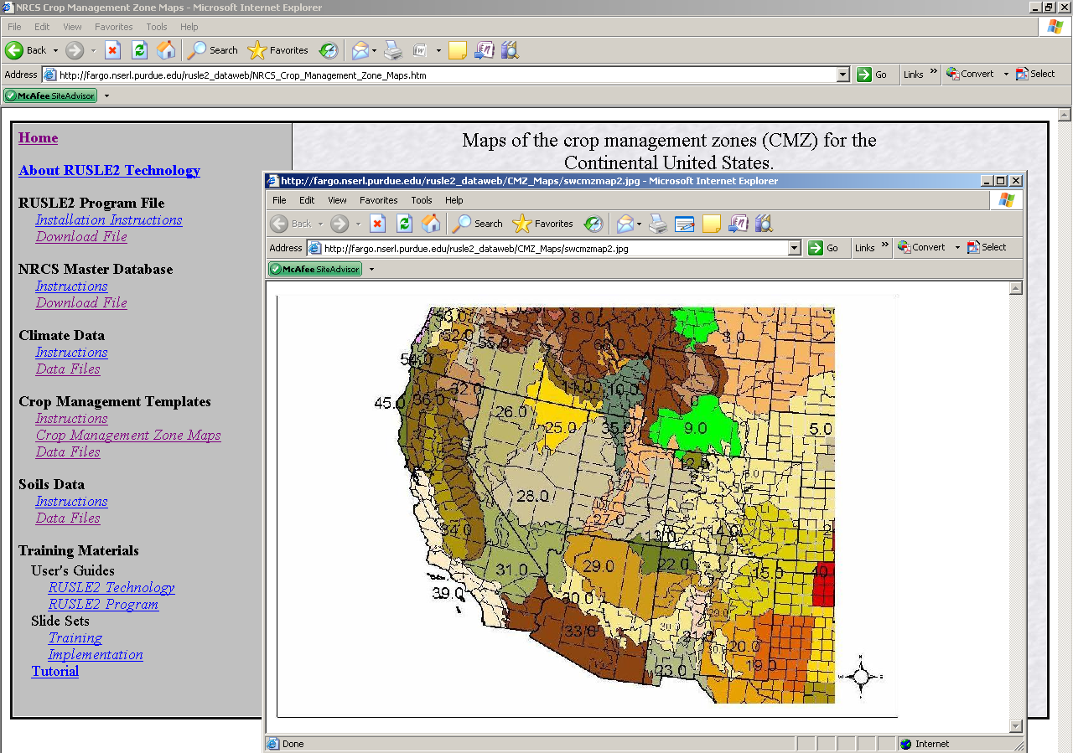

Slide 22
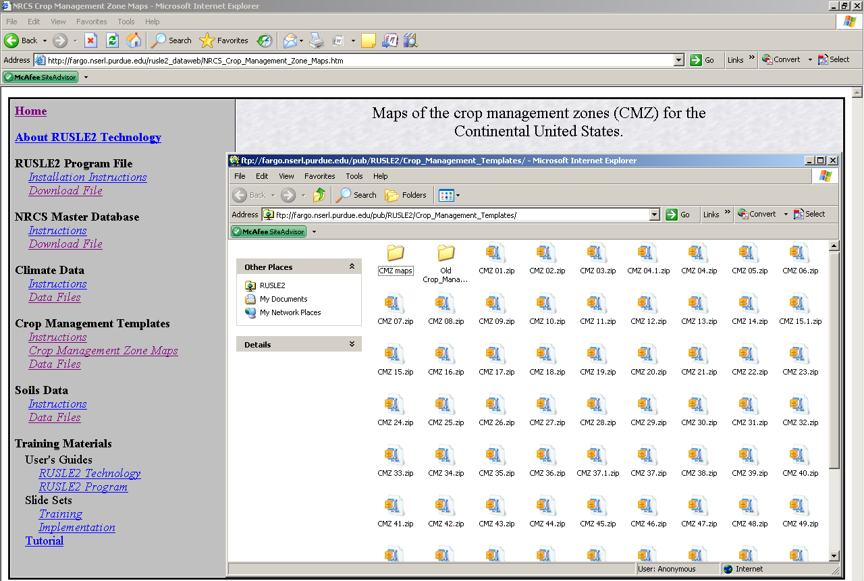
Crop Management Templates
Download appropriate CMZ(s) depending on your location (see map) to the “Import” folder.

Slide 23
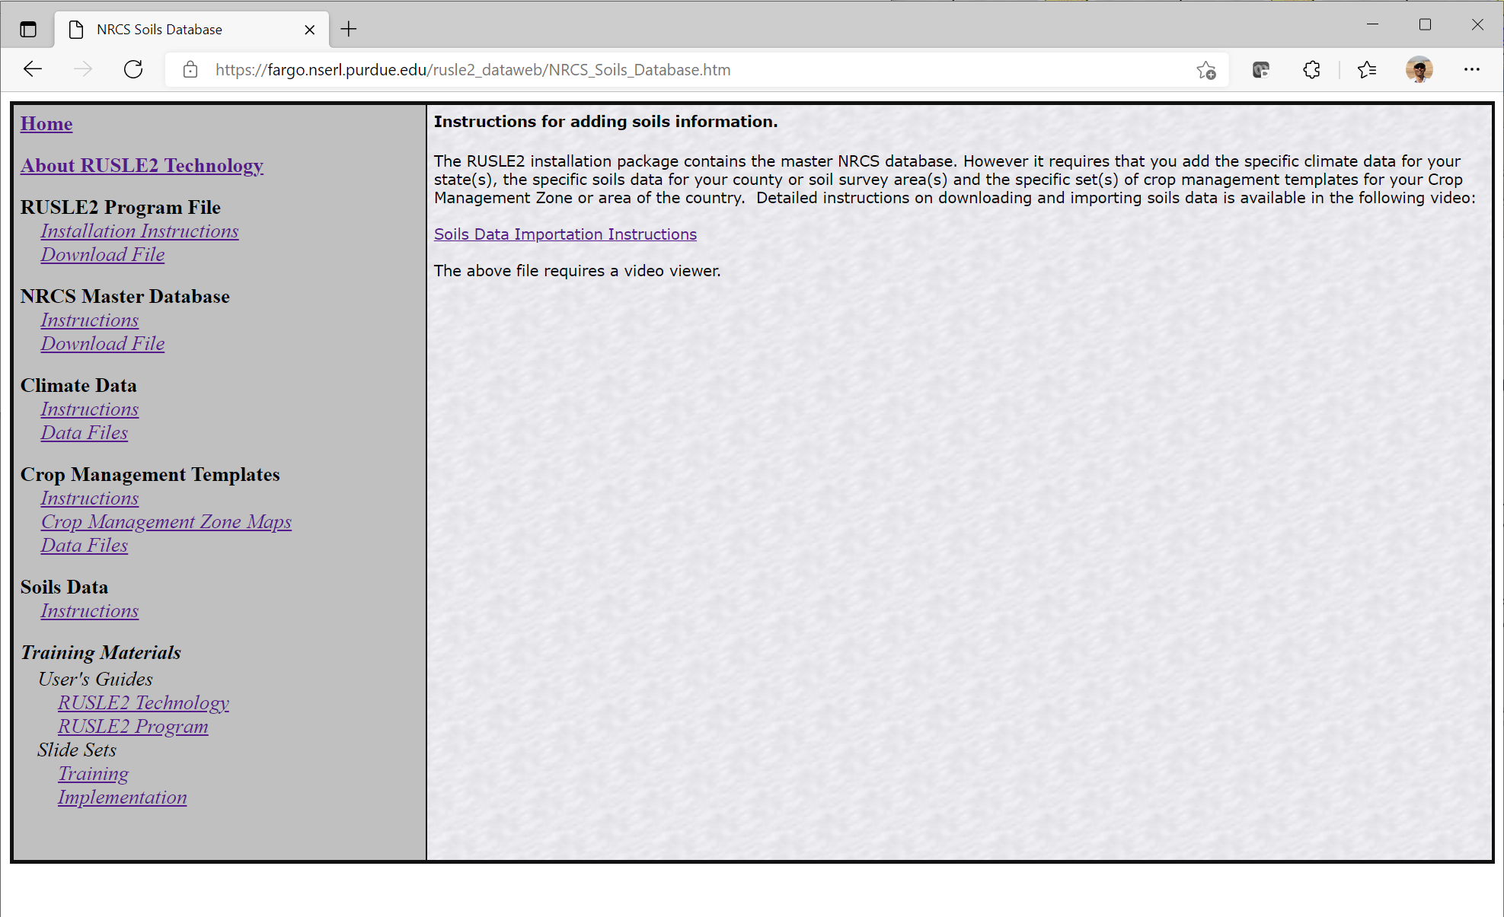
Click on the link to view the video.
Soils
Soils are no longer posted to the website

Slide 24
Watch the video to learn how to download soils information directly into the RUSLE2 program at https://fargo.nserl.purdue.edu/RUSLE2_ftp/NRCS_Base_Database/RUSLE2 Instructional Material/Training Presentations/Importing Soils into RUSLE2 v 2.5.9.0.mp4.

Slide 25
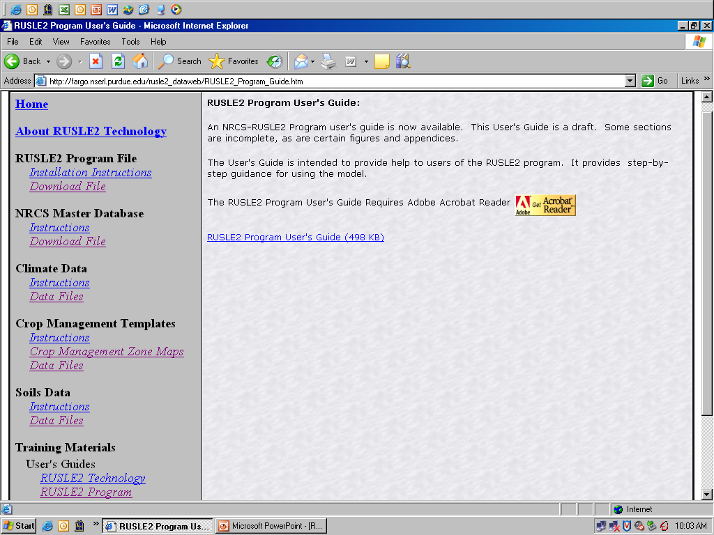
RUSLE2 User’s Guide

Slide 26
RUSLE2 File Importing
Topic Slides
Importing the latest Base Database Updates 27-29
Importing the Crop Management Zone Database 30-31
Importing the Climate Database 32-33
Importing the Soil Database 34-35
Database integrity check (i.e. Check consistency) 36-39

Slide 27
Select
“Import RUSLE2 database”

Slide 28
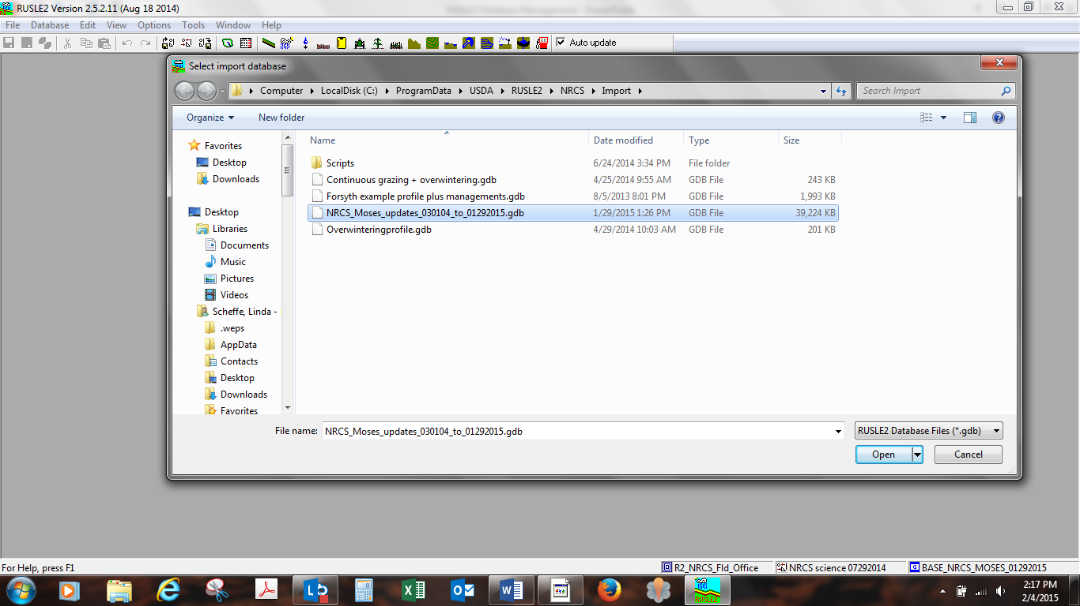
Select Database to Import
Ex. NRCS_Moses_updates_030104to01292015.gdb
Click OPEN

Slide 29
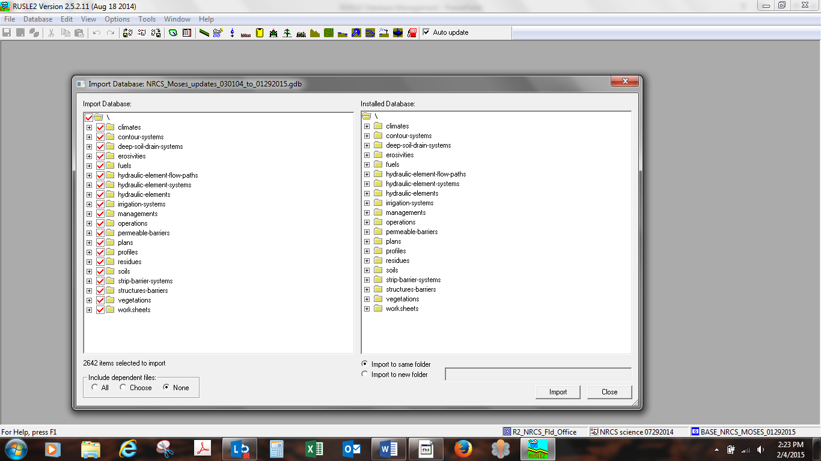
1st - When importing a “Base database Updates CHECK ALL BOXES in the “Import Database” side.
3rd - Select – “Import to same folder”
2nd - Check “NONE”
4th - Click on “Import”

Slide 30
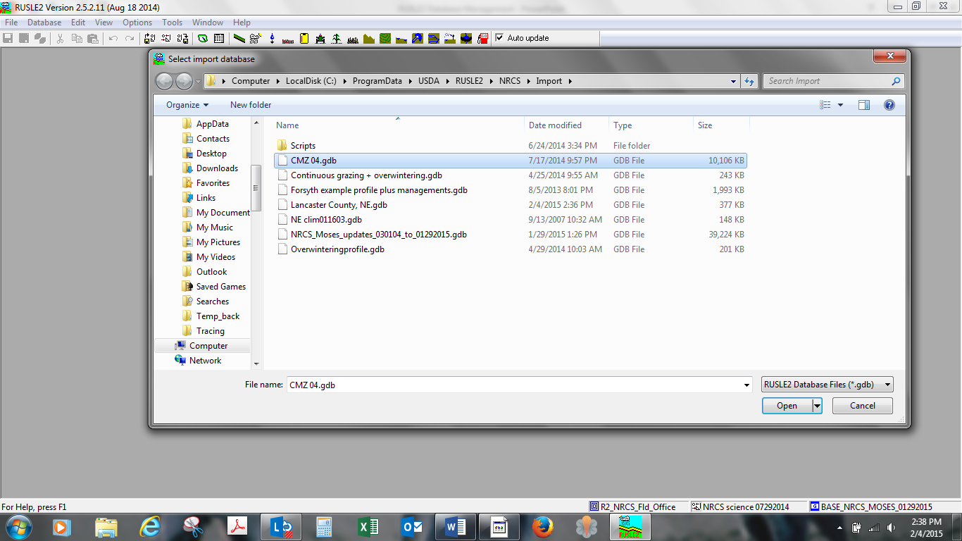
Importing a Crop Management Zone Database Ex. CMZ 04
Click OPEN

Slide 31
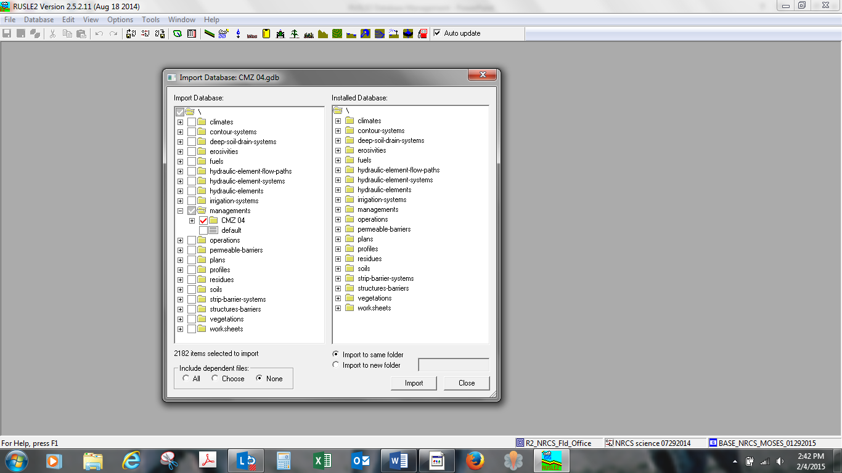
1st - For CMZ “Management” databases Select “Managements”
3rd - Import to same folder
4th - Click on IMPORT
2nd - Select “NONE”

Slide 32
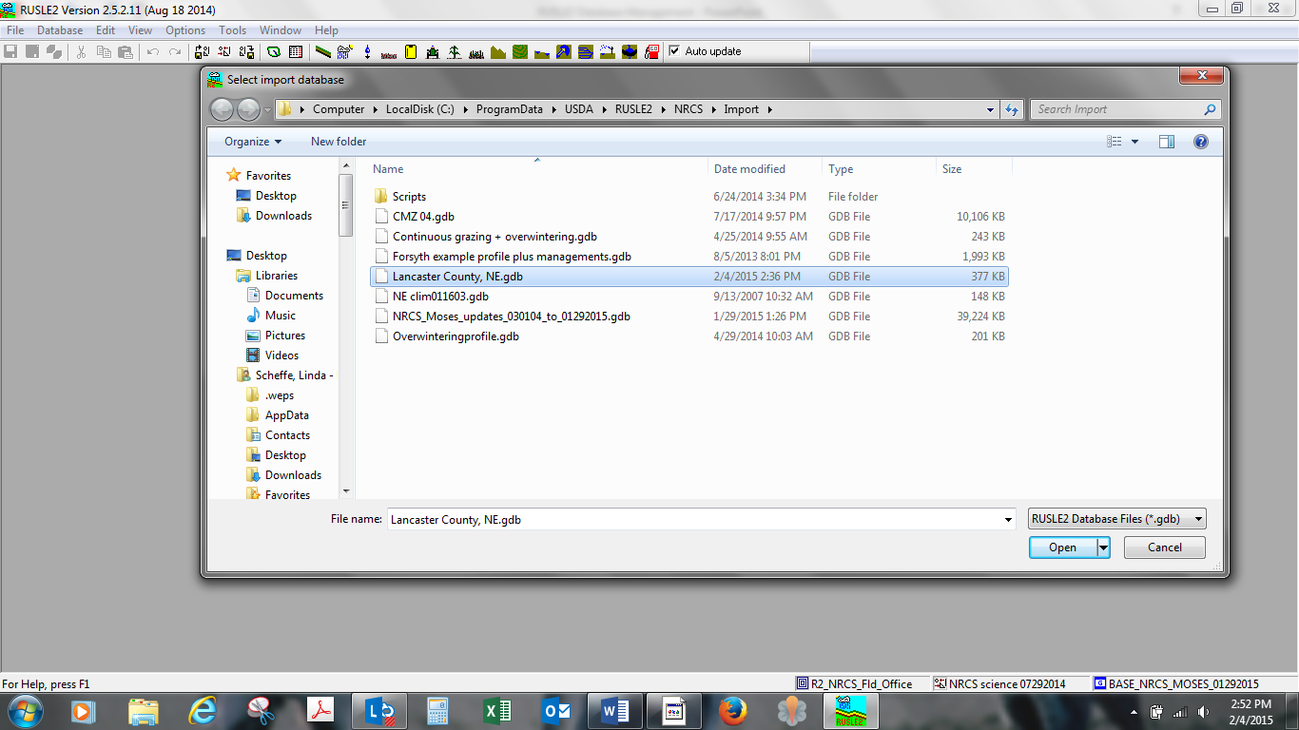
Importing NE Climate Database
Click OPEN

Slide 33
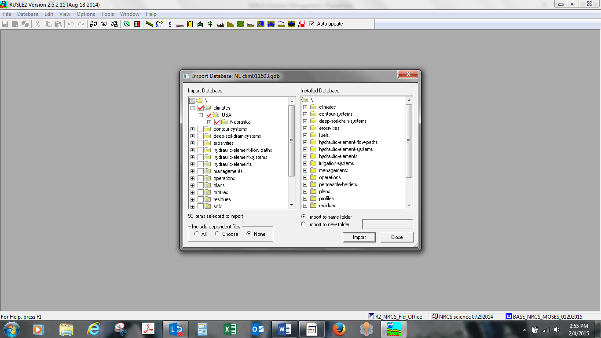
1st - When importing Climate databases Check “Climate and State” and you can even drill into the individual county or counties that you want, excluding unwanted counties.
2nd - Check NONE
3rd - Click on IMPORT

Slide 34
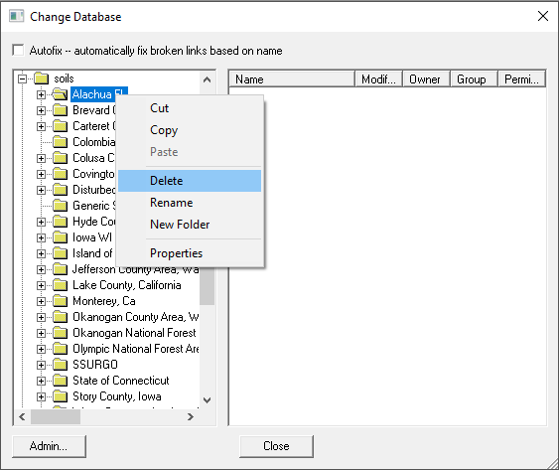
Soil Import Process
Begin by deleting the old soil folder from the current database from the “Rearrange...” option in the Database menu. Select the old soil folder, right-click to display action menu and select Delete.
Note: Your soils could be located under the soils “folder”, or they could be in the SSURGO subfolder depending on how long ago you downloaded your current soils data.

Slide 35
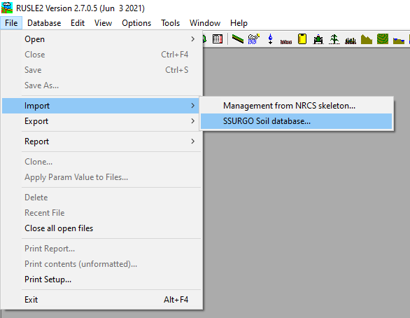
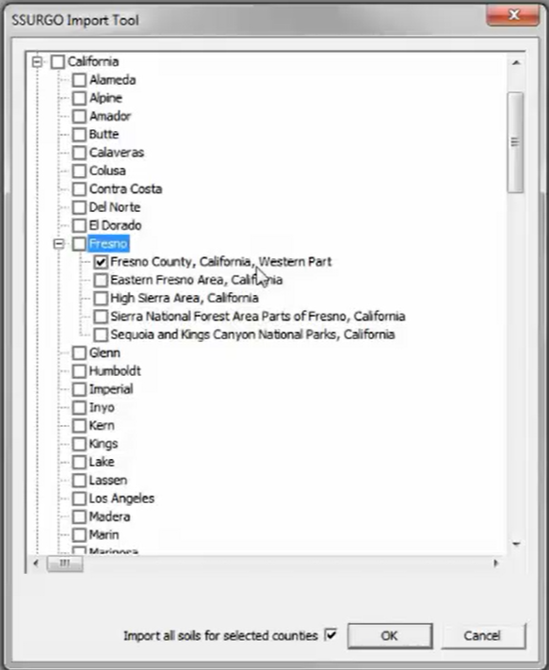
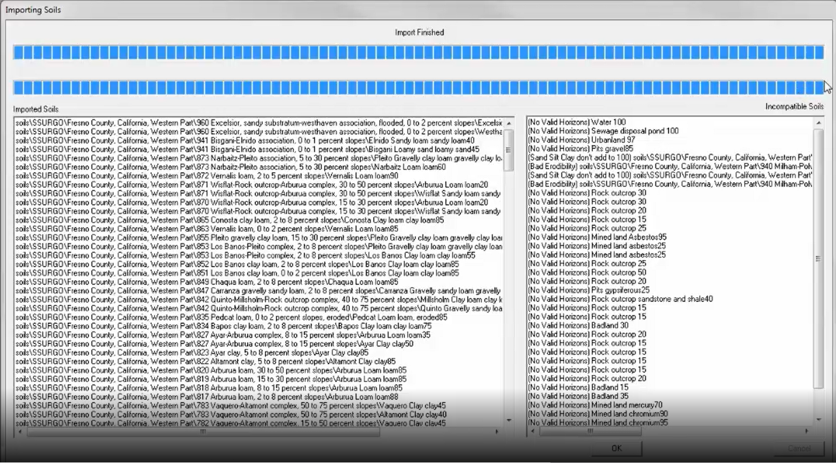
Soil Import Process
From the File menu, select Import and then, “SSURGO Soil database…”.
A new window will open and give you a choice of states and territories to select from. Click the plus sign next to the state, then county, and then soil survey area(s) you want to download and then click “OK” at the bottom right-hand corner.
Once the soil import is finished, the progress bars at the top of the window will be all blue. Click “OK” at the bottom right-hand corner.
Click OK
Note: If you do not see a plus sign next to the county name, left-click on the county name for a display of the soil surveys in that county.
Click OK

Slide 36
Do a check consistency to make sure there are no broken links especially after importing local c folder managements, profiles, worksheets, and plans.

Slide 37
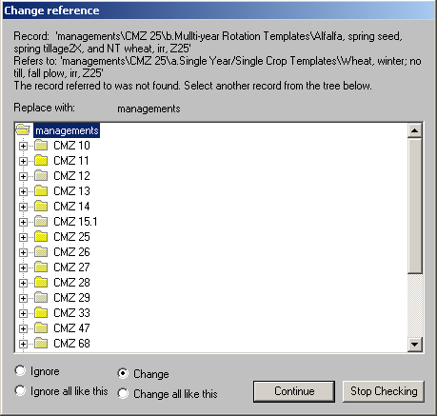
You could get a warning that a record that depended on another record can no longer find that record. RUSLE2 will ask you to fix the “broken” links.

Slide 38
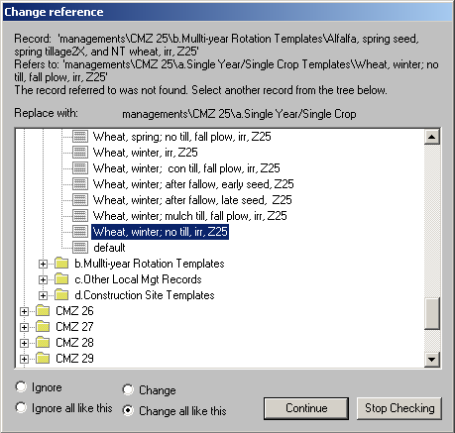
You must manually reconnect the renamed record to the dependent record by selecting the new record in the database, choosing the “Change all like this” option so that all records looking for the old, deleted record will be replaced with the new, renamed record and then click “Continue”.

Slide 39
Make sure that EVERY broken link is reconnected to an appropriate replacement record. If you are unsure how to correct a broken link, click “stop checking” at the bottom of the window and call a RUSLE2 support staff or the state agronomist to help you fix the broken links BEFORE ever using RUSLE2.

Slide 40
RUSLE2 File Exporting
Exporting records into databases that can be e-mailed.

Slide 41
To Export Records – Select “Export with templates, access…”

Slide 42
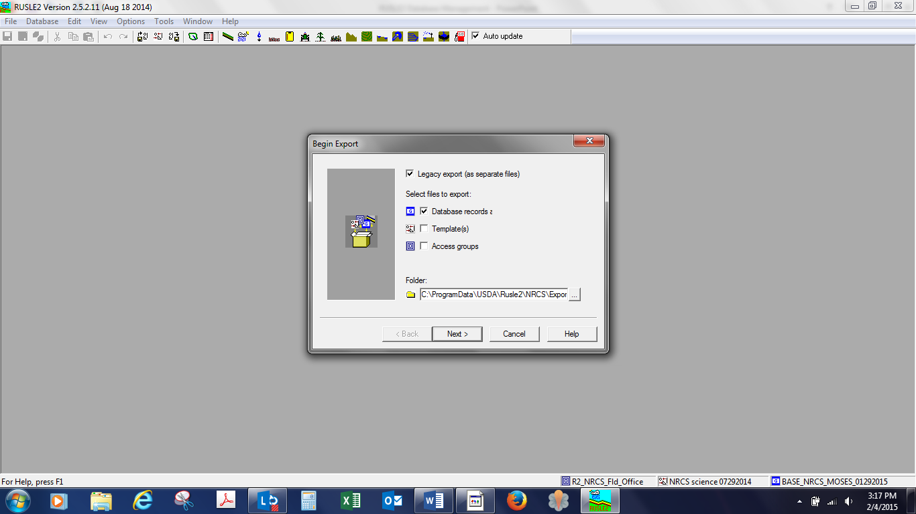
This will Export your desired database to the RUSLE2/Export Folder
To Export Databases:
1st – Check Database.
2nd - Click NEXT to proceed.

Slide 43
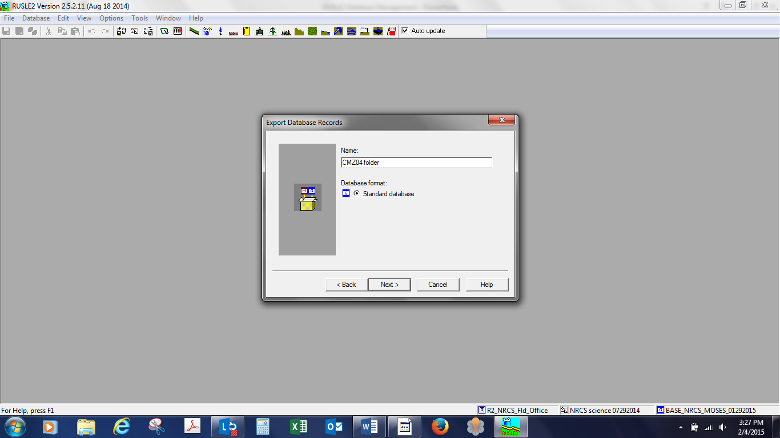
This is where you name the database you wish to Export.
Ex. CMZ04 folder
After entering the file name – Click NEXT

Slide 44
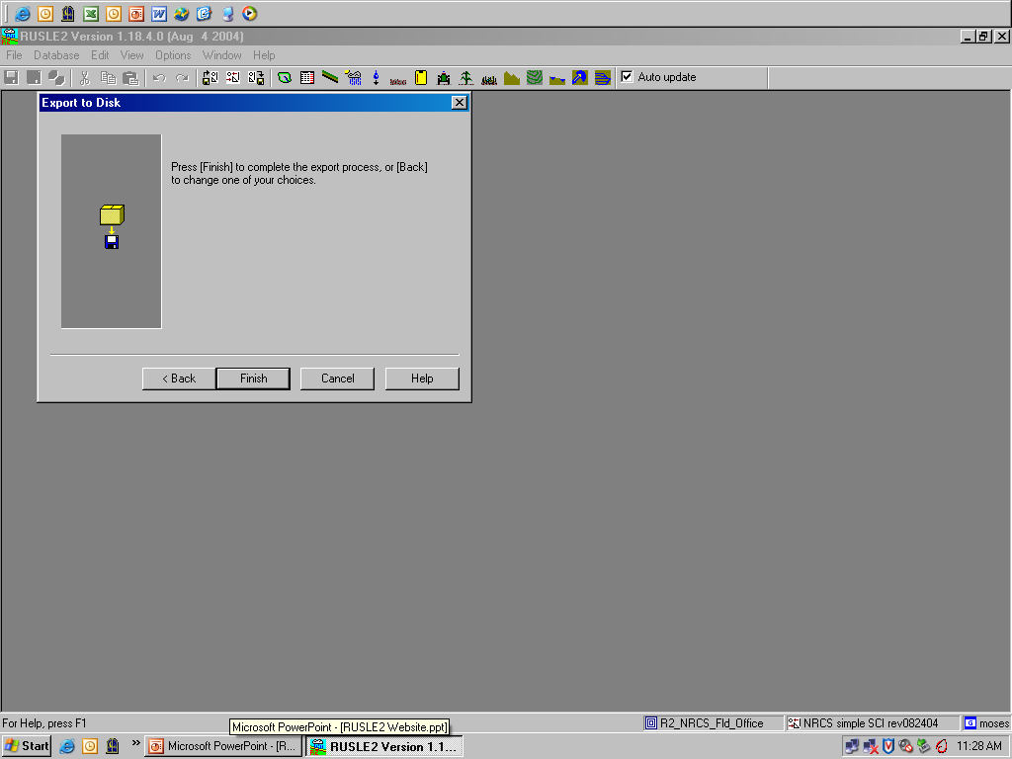
Click on FINISH to proceed.

Slide 45
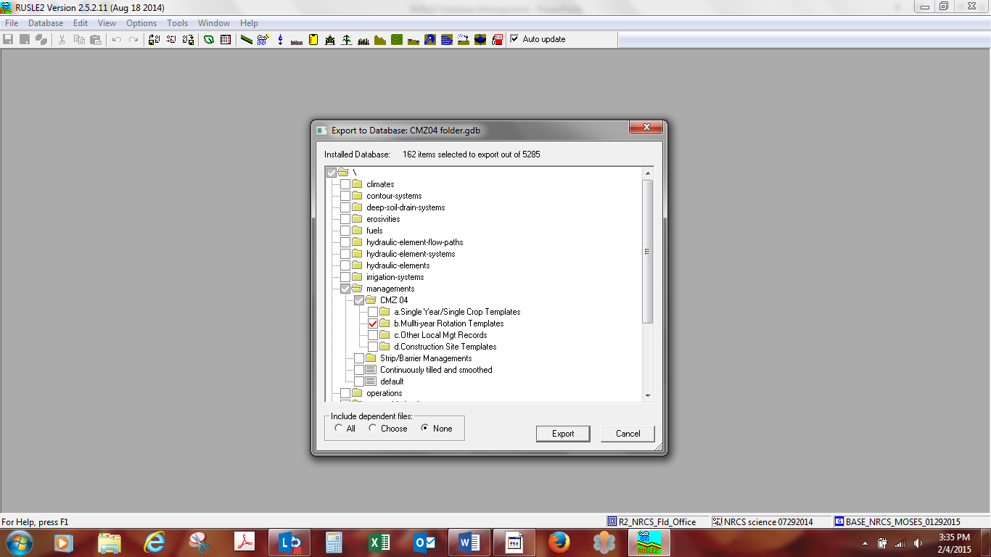
1st - Since we want to export management files we open the management folder and select the files we wish to export.
Ex. CMZ 04 and the entire b. Folder Multi-year Rotation Templates.
2nd - Check NONE if you are sending a record you have created. Check ALL ONLY if you are creating an export of a problem record or records
3rd – click EXPORT

Slide 46
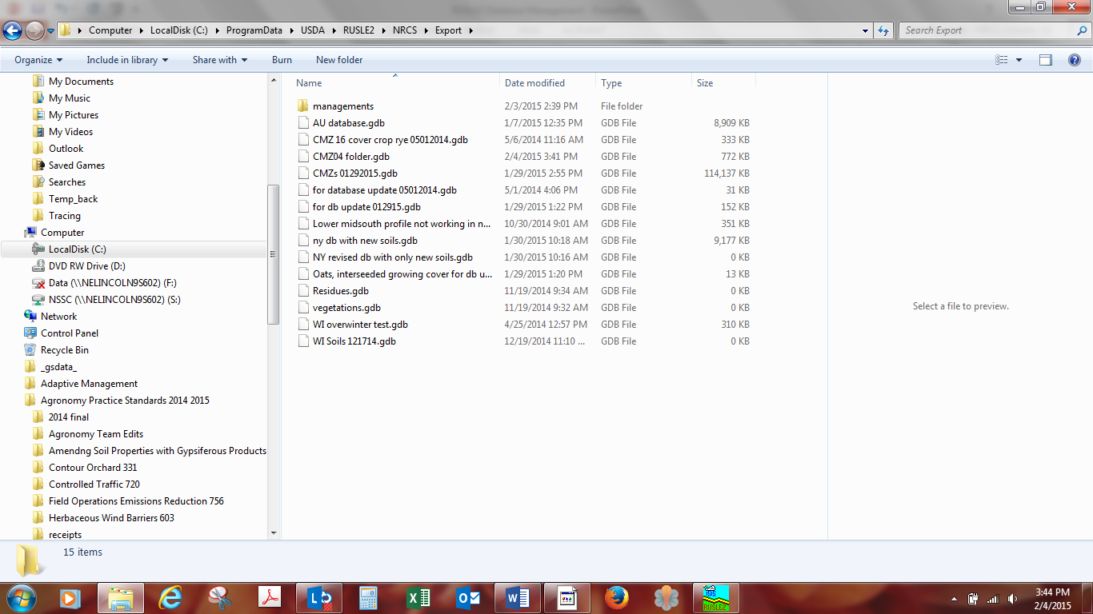
Open “Windows Explorer” and navigate to the RUSLE2/Export Folder
You should see the file database that you just exported.
At this point you can email this database to the state agronomist. The state agronomist will then go through the process of saving it to their RUSLE2 “import” folder then importing it into their RUSLE2 database. Never swap files between field offices without informing the state agronomist!!

