Slide 1
RUSLE2 New-style Perennial Vegetation & Management Records
New science to model perennial vegetation more accurately in response to haying and grazing
Giulio Ferruzzi, WNTSC Agronomist (NRCS RUSLE2 science lead)
Linda Scheffe, NSSC Agronomist (NRCS RUSLE2 database manager)
Steve Boetger, ENTSC Agronomist
Steve Woodruff, ENTSC Agronomist/Forage Specialist

Slide 2
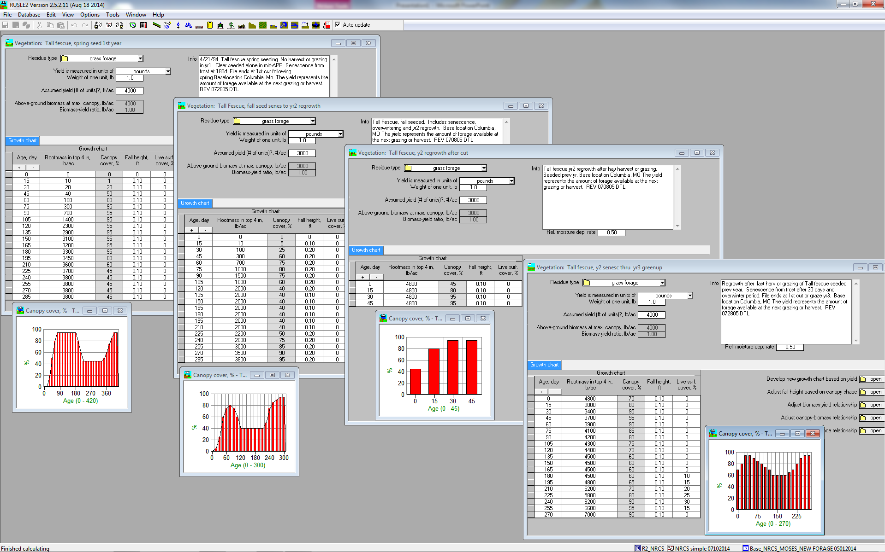
Perennial vegetation records as you knew them…

Slide 3
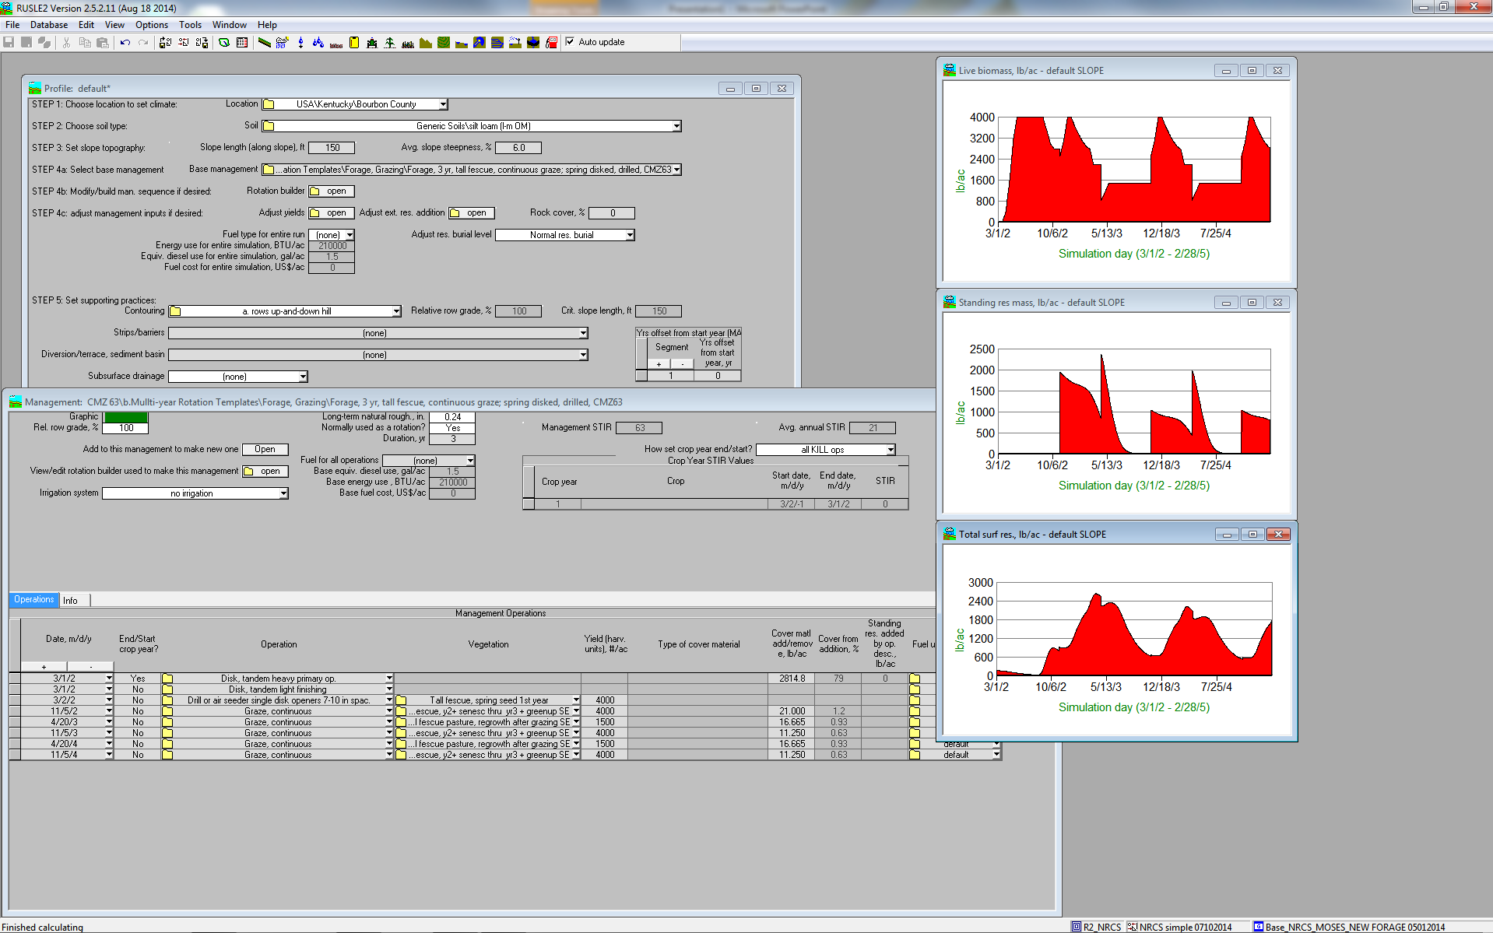
Perennial vegetation records as you knew them…

Slide 4
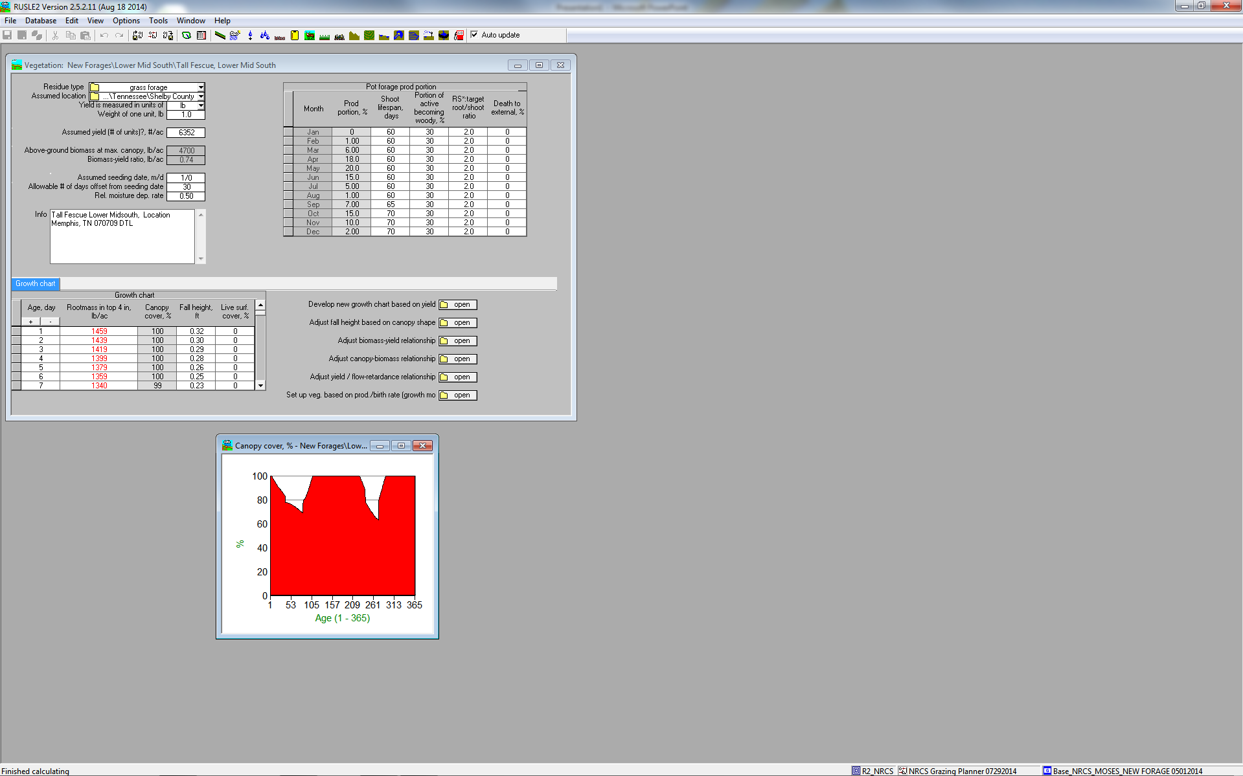
New perennial vegetation records look like this, on the surface
This new button is where the new information is found!

Slide 5
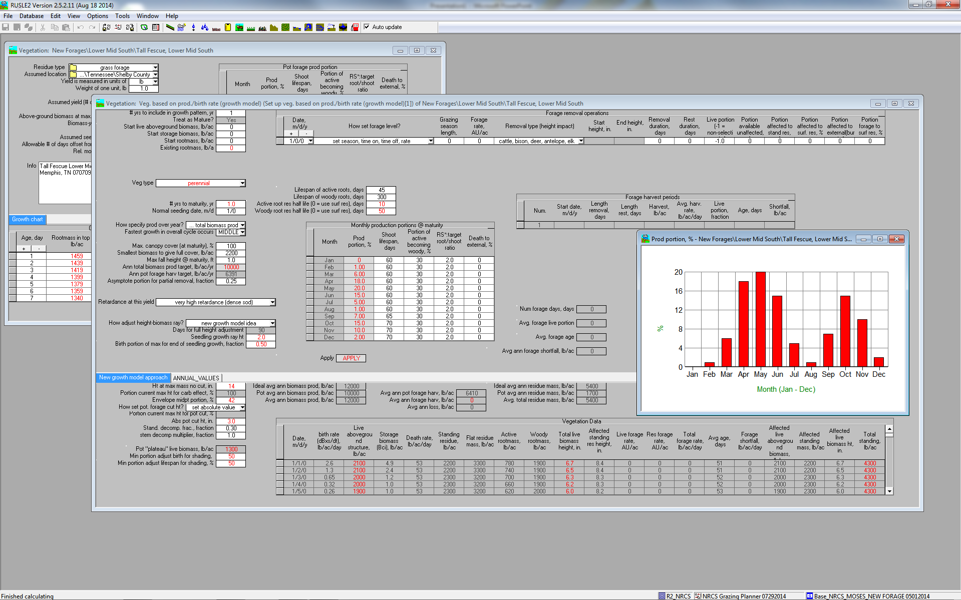
New perennial vegetation records…

Slide 6
New perennial vegetation records…

Slide 7
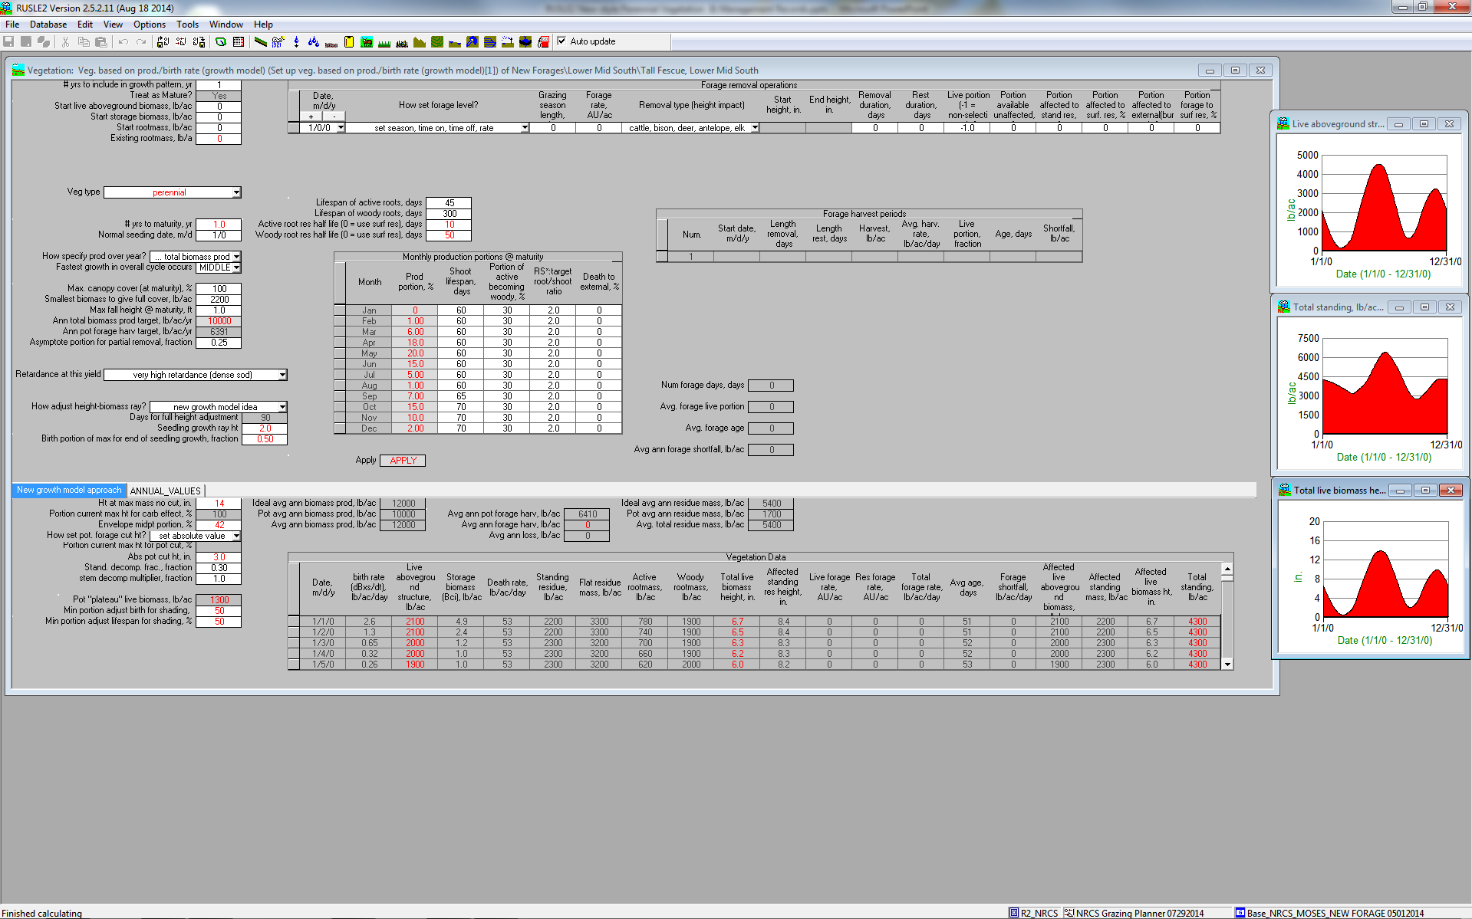
New perennial vegetation records…

Slide 8
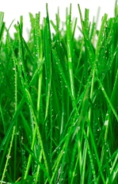

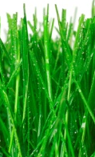
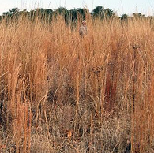




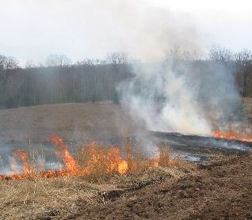
New perennial vegetation nomenclature
Live Above Ground Biomass
Available Live Above Ground Biomass
Affected Live Above Ground Biomass
Forage
AVAILABLE
(Above Graze Height)
AFFECTED
(Portion that will be converted to something other than live biomass)
FORAGE
(What the livestock actually ingest)
PRODUCTION
(Meat or hay removed from field)
OFF TO MARKET
STANDING RESIDUE
Portion forage to surf. res.
Portion affected to stand res.
UNAVAILABLE
(Stubble)
SURFACE RESIDUE
UNAFFECTED
(Not ingested nor killed due to soiling or vicinity to manure)
Portion affected to surf. res.
Portion available unaffected
SURFACE RESIDUE
Portion affected to external
EXTERNAL
(Burning)
NOTE: Similar paths exists for standing residue

Slide 9
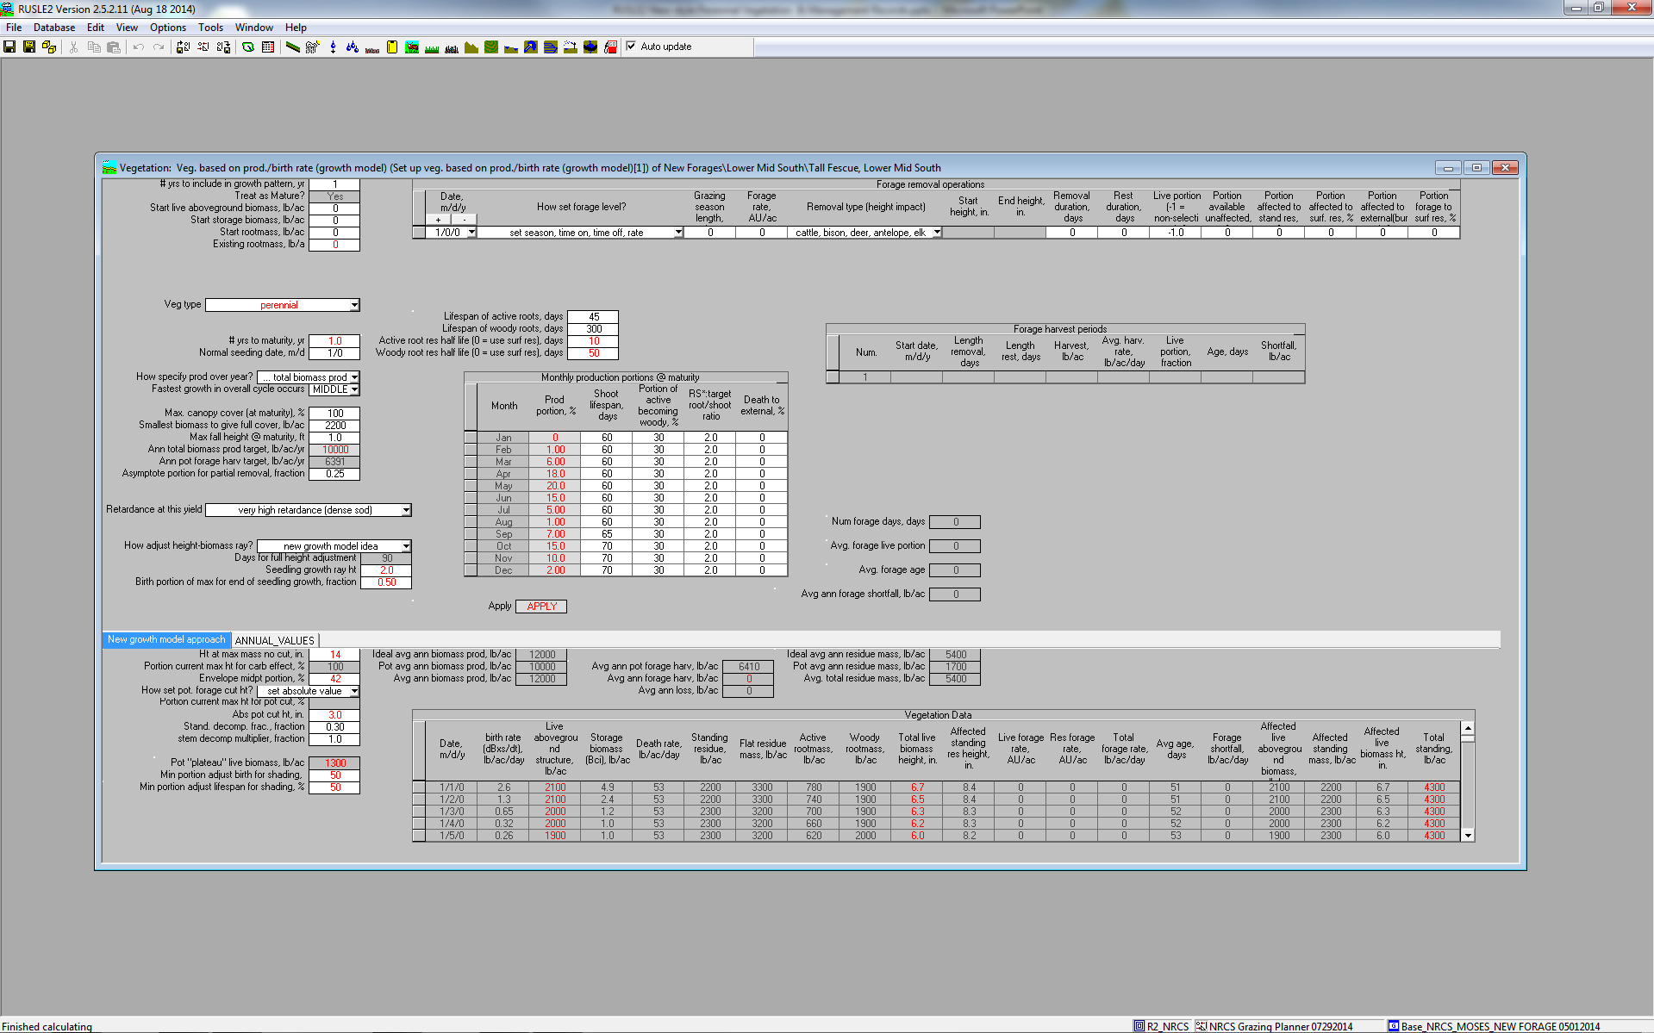
New perennial vegetation parameters to adjust

Slide 10
New perennial vegetation nomenclature defined
Parameter | Definition
# yrs to maturity | years from establishment to maturity
Abs pot cut ht | cutting height for optimal management (used to determine "potential" forage yield)
Ann total biomass prod target | user specified target of total annual NPP
Envelope midpt portion | fraction of maximum biomass resulting from repeatedly cutting at half of Hmax (=0.5 if not sod forming)
Existing rootmass | biomass of live woody roots when beginning growth in the presence of existing perennial vegetation
Fastest growth in overall cycle occurs | Part of season with fastest growth during establishment (EARLY, MIDDLE, LATE)
How specified prod over year | specify either total biomass or total forage production to moded the vegetation
Ht at max mass no cut | user specified vegetation full canopy height if uncut (not maximum inflorescence height)
Max fall height @ maturity | Max fall height is a single, representative maximum distance that a raindrop falls to the soil surface after being intercepted by canopy.
Normal seeding date | normal seeding date (default = not specified, full-year calculations begin on 1/1)
Prod portion | Monthly Production Fraction: Fraction of the total production occurring in a month.
RS*:target root/shoot ratio | 12 monthly estimates of RS*:target root/shoot ratio (default=2.0 for perennial vegetations and default=0.5 for annuals)
Shoot lifespan | 12 monthly average lifespan values for above ground live biomass
Smallest biomass to give full cover | The smallest amount of biomass that can achieve 100% canopy cover
Start live above ground biomass | initial value of above ground live biomass when seeded (0 = treat as mature)
Start rootmass | initial value of active root when seeded (0 = treat as mature)
Start storage biomass | initial value of storage biomass when seeded (0 = treat as mature)
Vegetation type | either annual or perennial (no woody roots created for annuals)

Slide 11
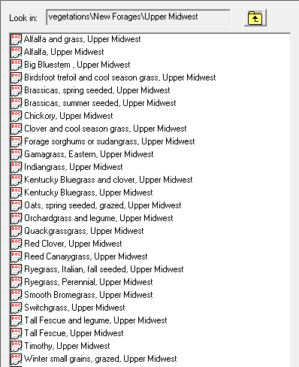
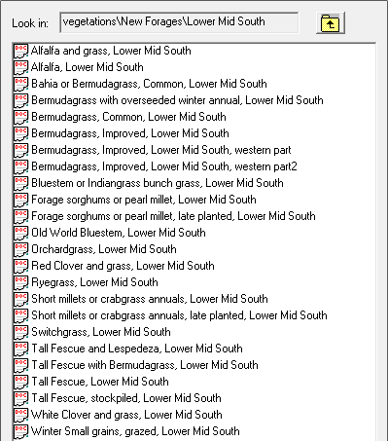
What information you need to develop your own Perennial vegetation records
First, you will need to determine which types of systems you would like to have available for the field offices. Some examples are:

Slide 12
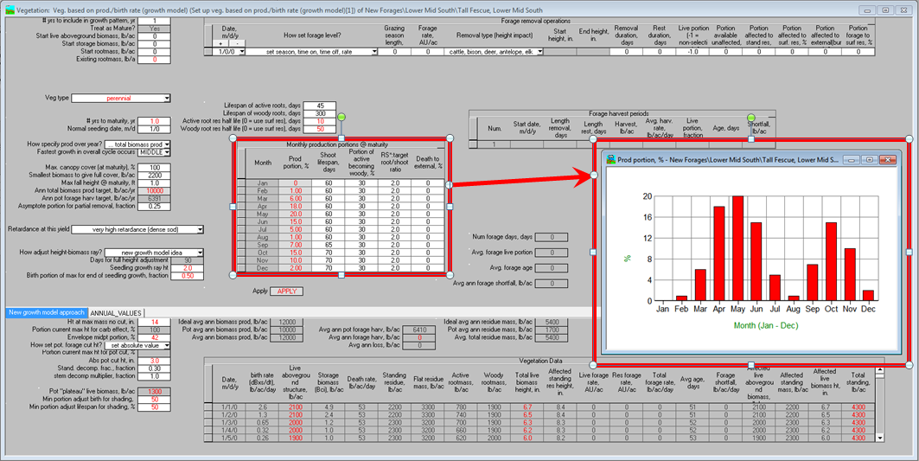
What information you need to develop your own Perennial vegetation records
Secondly, you will need to obtain the forage production information for those vegetations from reputable sources (e.g. NRCS grazing lands specialists, Land Grant Universities, etc.).

Slide 13
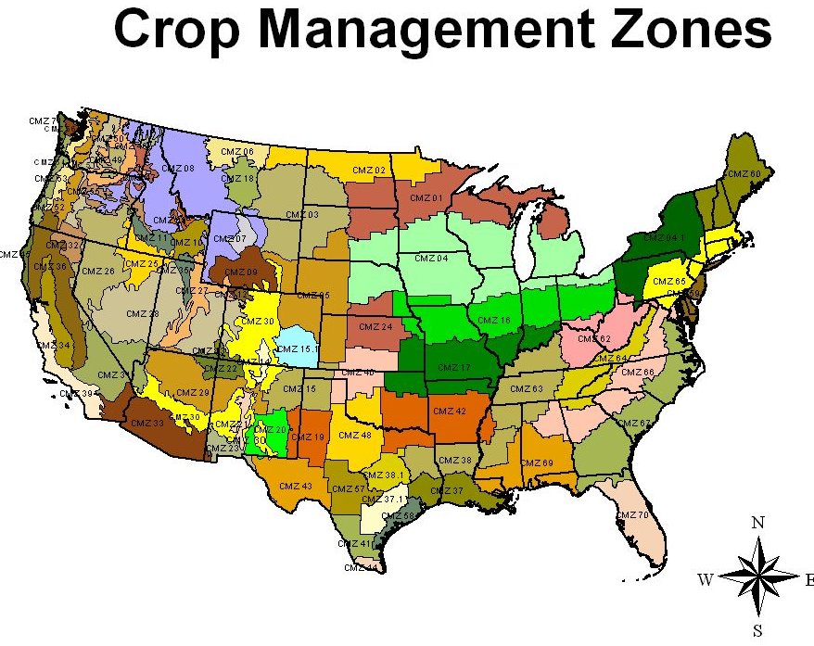
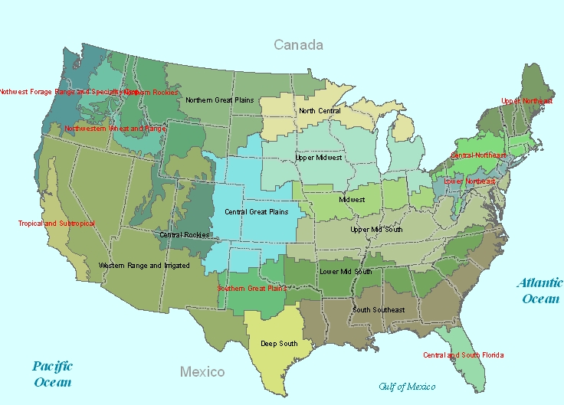
What information you need to develop your own Perennial vegetation records
Next, along with your Regional Agronomist, you will create vegetation and associated management records for the appropriate Forage Production Zone(s).
Finally, you will coordinate with your neighboring State Agronomists and Grazing Lands Specialists to determine the extent of the area for which the new records apply. That is, you will draw/edit/verify the boundaries of the Forage Production Zone(s) and create new ones if necessary.
New Forage Production Zones

