Slide 1
How to use the Rotation Builder
West National Technology Support Center
RUSLE2
Revised
Universal
Soil
Loss
Equation, version 2

Slide 2
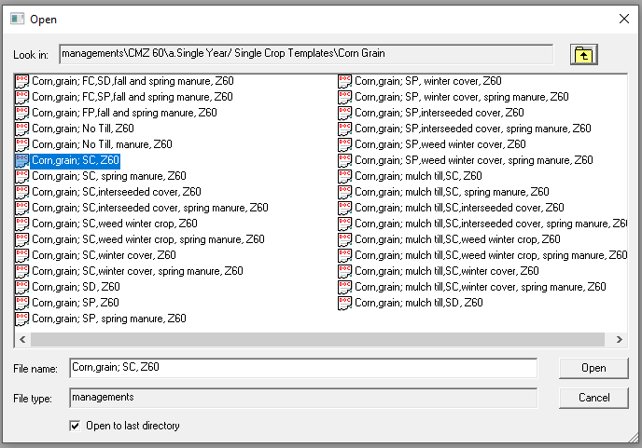
Understanding Managements
RUSLE2 managements…
…are like…
…Bricks!
Notes:
Single year folder (actually, each subfolder) is like the pallet that the bricks rest on. There are pallets for multi-year managements, local managements and construction managements.
The list of managements is like the stack of bricks waiting to be used.

Slide 3
Understanding Managements
1
2
1
2
3
3
Each of these have:
A starting point,
A structured and ordered middle, and
An end.
Notes:
Each of these have:
A starting point,
A structured and ordered middle, and
An end.

Slide 4
Building Rotations
Building a rotation is much like laying a row of bricks along a wall.

Slide 5
Building Rotations
Time
Corn,grain; SC, Z60
Soybeans; drilled, SD, Z60
Wheat,spring 7 inch rows; SD, Z60
Notes:
If we wanted to build a Corn-Soybean-Wheat rotation from single year managements, like this…

Slide 6
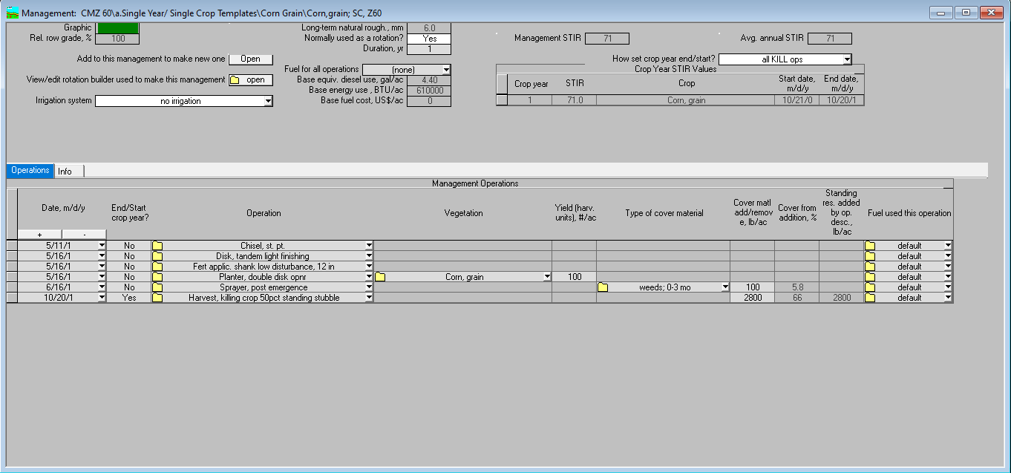
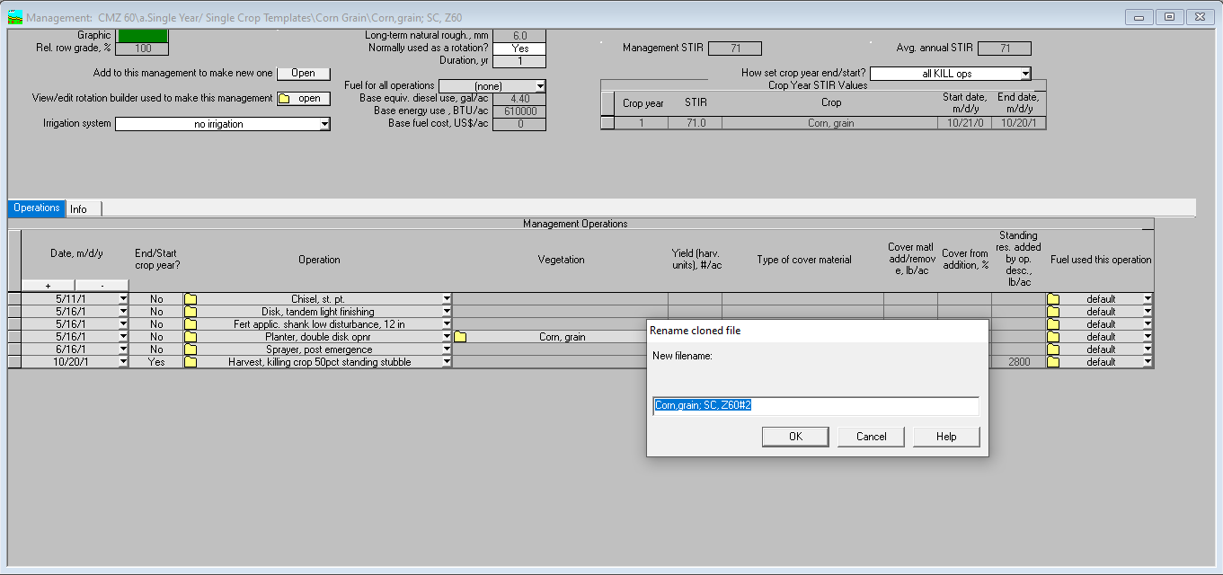
Building Rotations
Notes:
We would use the rotation builder in RUSLE2.
We would start by opening the corn management record.
Then, click on the “Add to this management to make a new one” Open button at the top, left-corner of the management.
A window will appear asking you to name the new rotation you will be creating. Enter a name and click “OK”.
A new Rotation-Builder window will appear with the new management name and location at the top of the window. In this case the location is the temp\ folder and the name of the management is Corn-Soybeans-Wheat.

Slide 7
Building Rotations
Notes:
Continued from last slide.
Click on the “+” button to add a line in the rotation builder. Note that each line is a brick and that you are “picking and stacking bricks” in this window.
A new line will appear as a duplicate of the one above it for the next available year (notice the date change from year 1 to year 2).
Click on the drop-down menu button to select the Soybean management record.
Repeat the above steps to add wheat.
Notice that the “stack of bricks” is listed in the table on the left.
The sequential list of all operations in the new management is listed in the table on the right.
Use the “correct dates by:” column to slide the start/end dates of the managements as needed.
Click “Apply/Close” button in the lower left corner when done.

Slide 8
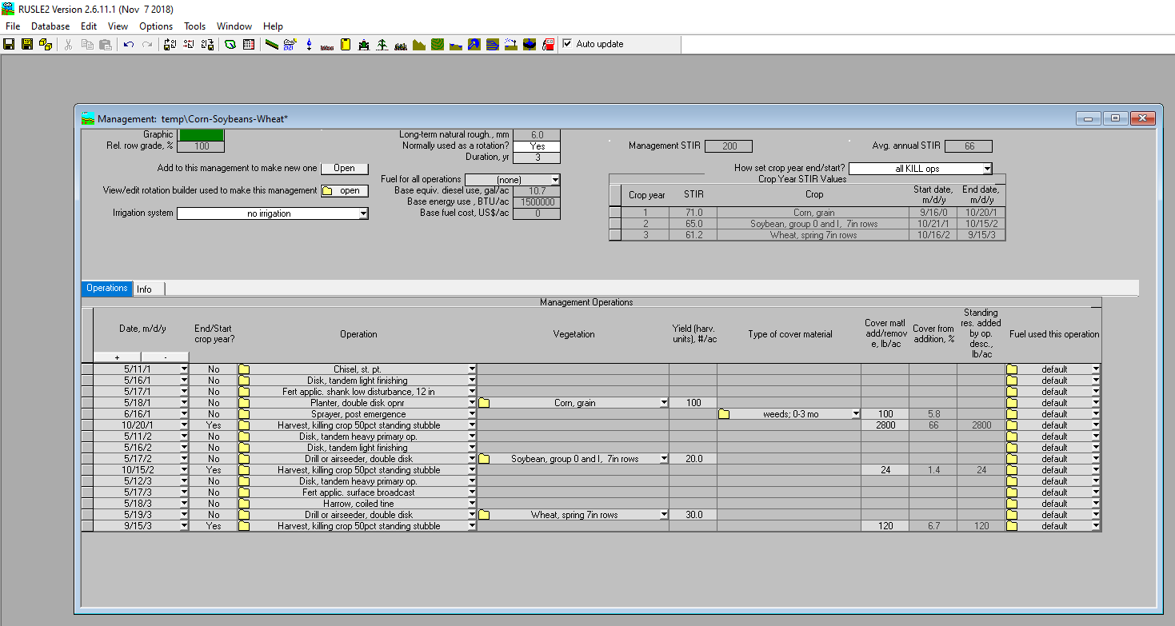
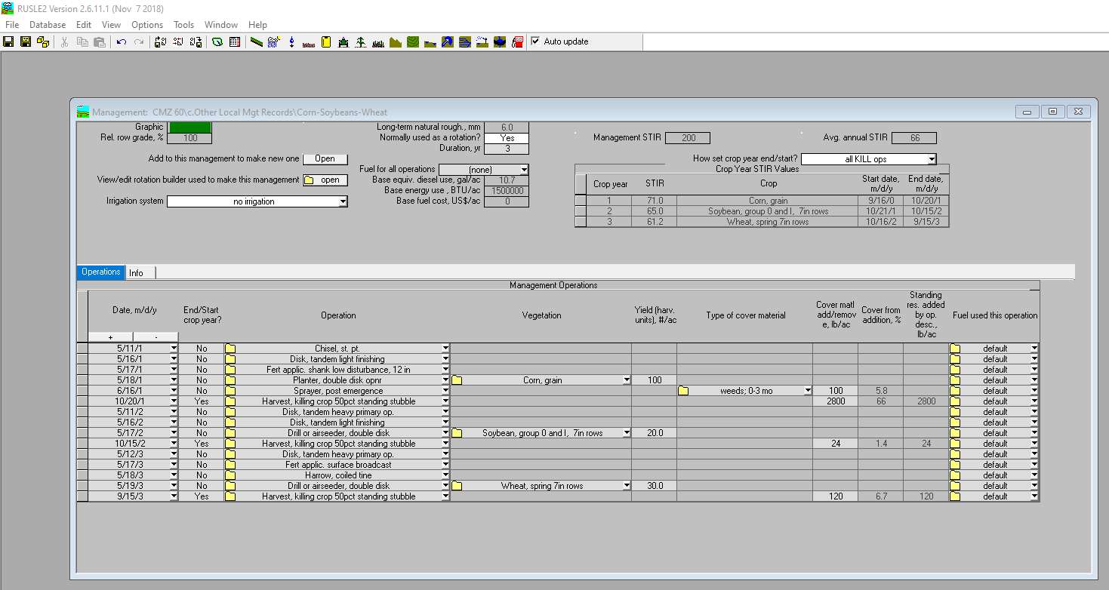
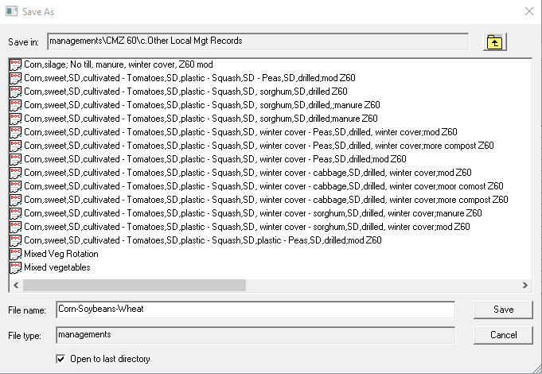
Building Rotations
Notes:
Continued from last slide.
Click on the “Save as” icon to save the management in the “c. folder”
You may need to navigate to the “c. folder” in the “Save as” window.
Click “Save” in the lower right corner of the window to save the newly created management record.
The management window will display the name and location of the new management at the top.

Slide 9
Building Rotations
Managements are like bricks in that they can be broken!
Or stretched too far!
Notes:
Care needs to be taken when building rotations because the bricks (i.e., the managements) can be broken!
If you try to start a management before the last one ends by sliding the dates back too far, that may result in dates of one or more operations changing so that the integrity of the single year management is not longer the same as the original record. You should always check the dates of the operations in the new rotation to make sure they make sense, that nothing is “broken”, and that there are no unintentional fallow or gap years were there ought not to be.

Slide 10
Checking for Accuracy
New Rotation:
Original managements (aka, bricks):
Notes:
The user should always verify that the created management is consistent with the intended results.

Slide 11
Caveats
Use the “View/edit rotation builder used to make this management” button to change out any of the single year management to another one.
Changing a single operation, vegetation or date in the “Management Operations” table will break the link to the single year managements used to create the management and it will no longer allow you change out the single year managements.
Notes:
Use the “View/edit rotation builder used to make this management” button to change out any of the single year management to another one.
Changing a single operation, vegetation or date in the “Management Operations” table will break the link to the single year managements used to create the management and it will no longer allow you change out the single year managements.

